Slide 1


Assembly
6th June 2025

Slide 2

One Peebles
What does that mean?
Everyone belongs here
Everyone can learn and achieve
Everyone is nurtured and cared for
We show everyone respect – in our school and our community
We celebrate each other
We look after each other

Slide 3
New School
Uniform!

Slide 4
Why Uniform?
Sense of belonging
School identity
Safety
High expectations and standards
Preparing for learning and life after school
Cost

Slide 5
What is our uniform?
White shirt and red PHS tie or plain/PHS white polo shirt (S1-S5)
Plain black jumper/cardigan/hoodie/sweatshirt or PHS sweatshirt/PHS hoodie/PHS blazer (S1-S5)
‘Special’ school hoodies – black or red
Black trousers/skirt/dress/long tailored shorts/leggings (made of thick material with no patterns) (S1-S6)
Plain black footwear (S1-S6)
S6 tie* and S6 jumper* or PHS blazer (all S6)
House Captains and Senior Prefects – relevant tie and PHS blazer with red piping
PE uniform - plain white/PHS PE t-shirt, black shorts/leggings/joggers

Slide 6


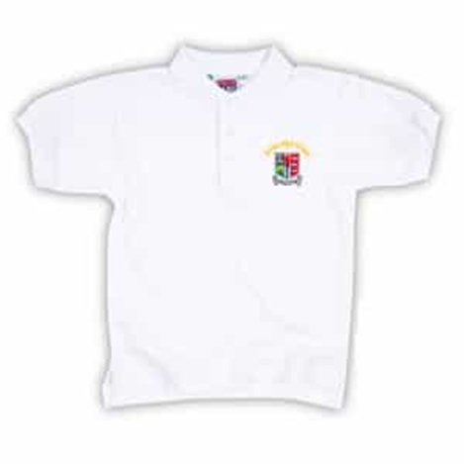
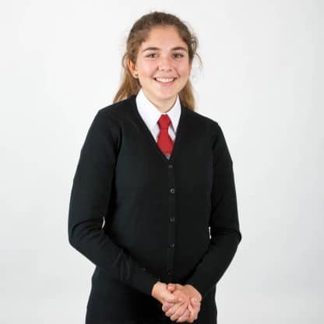
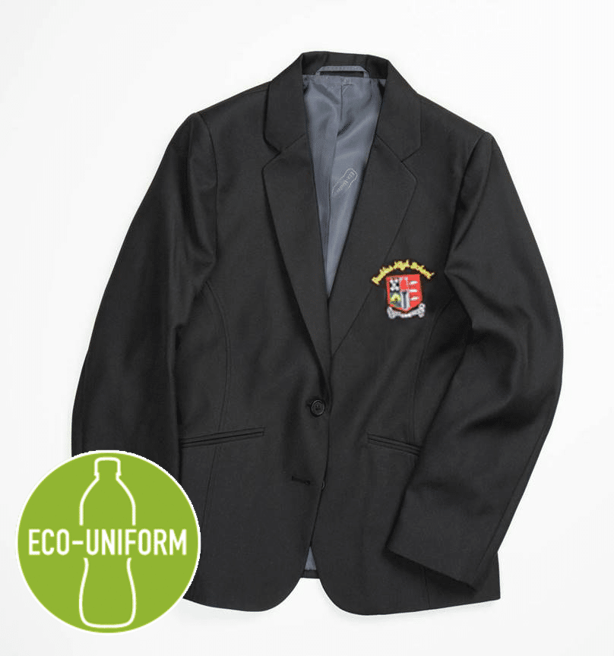
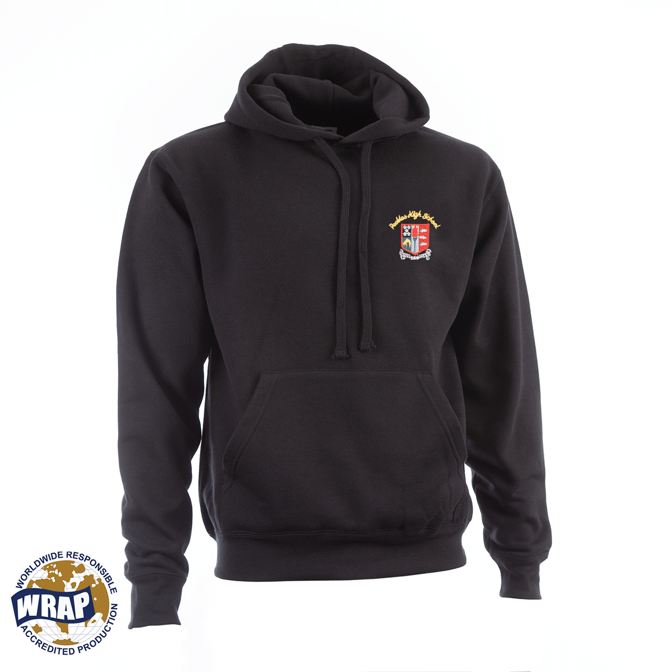
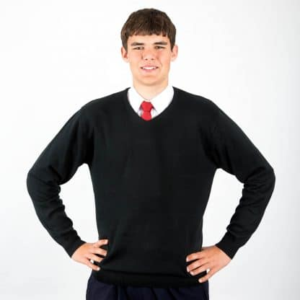
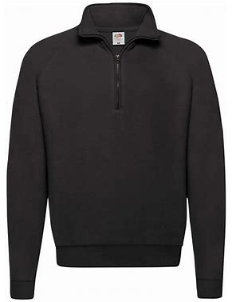
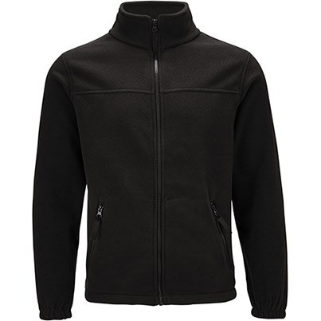
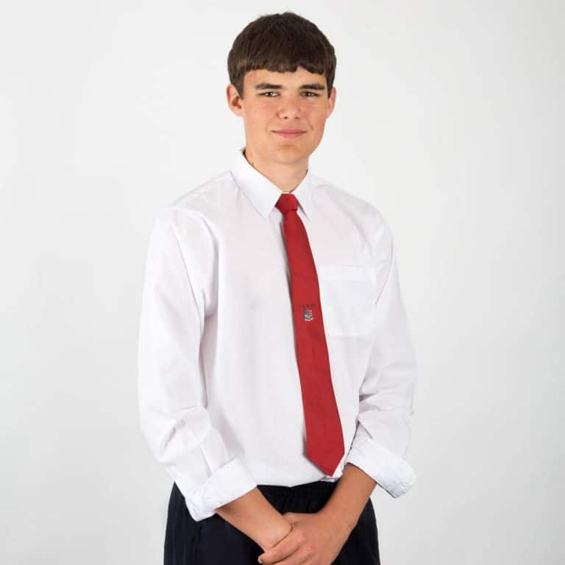
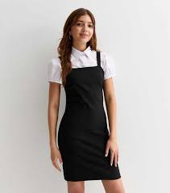
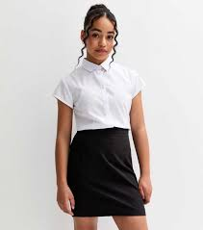

Slide 7
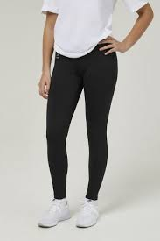
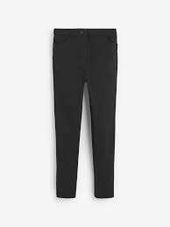
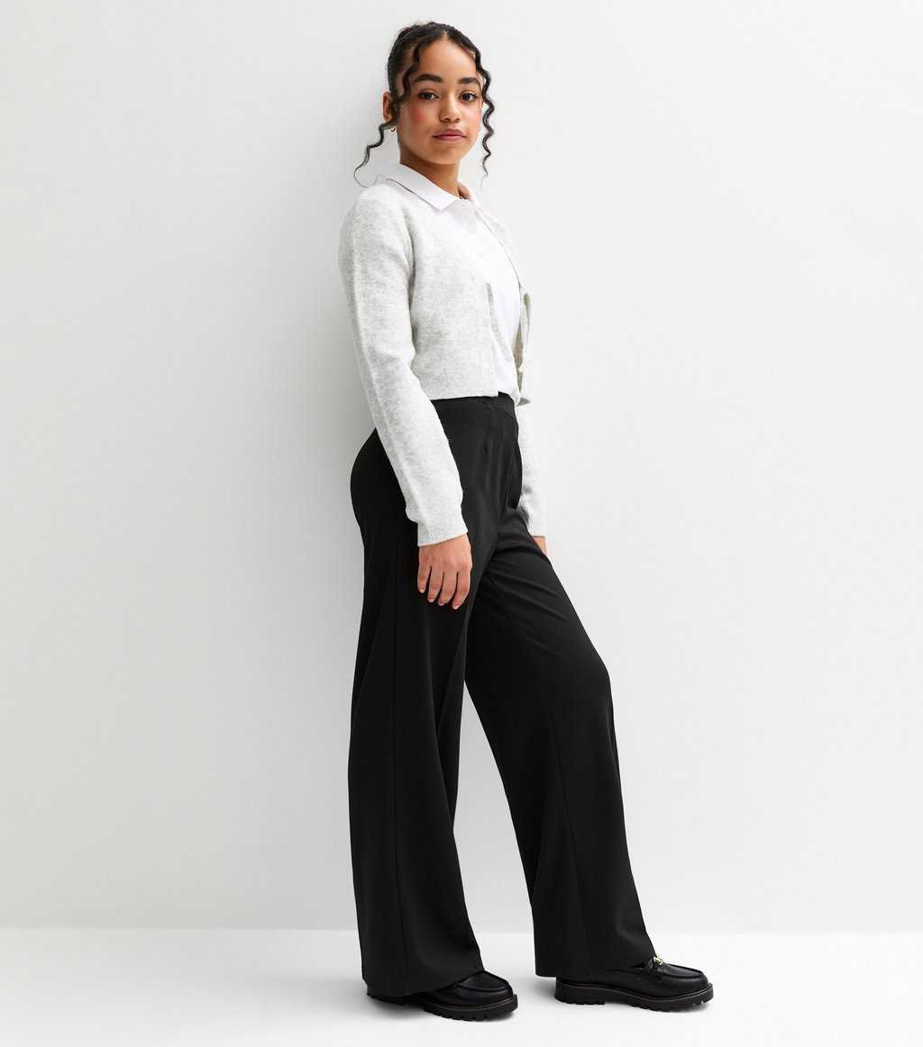
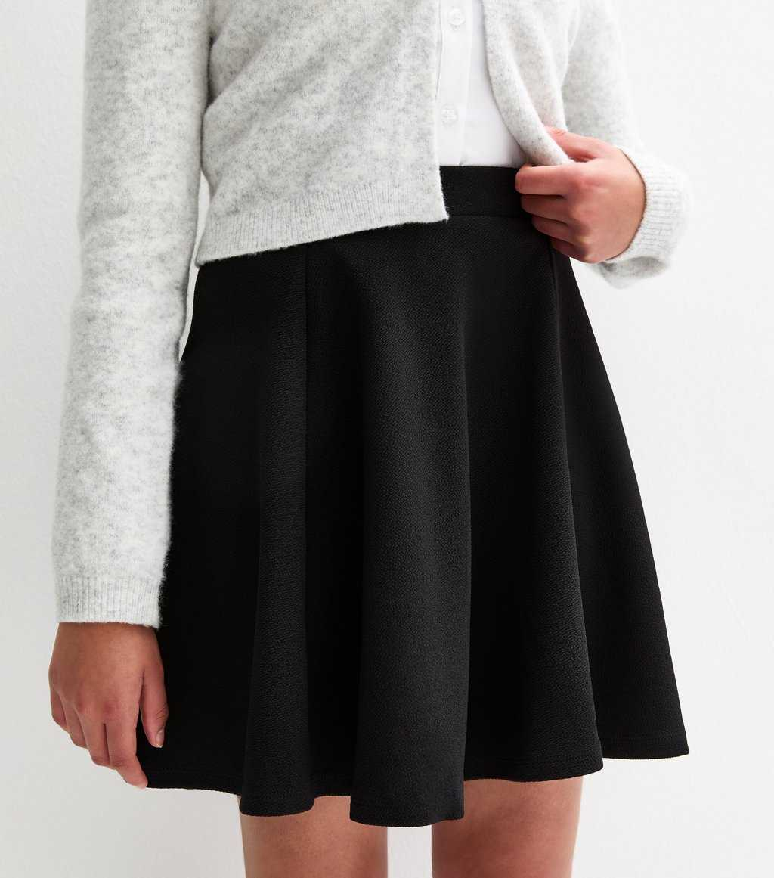
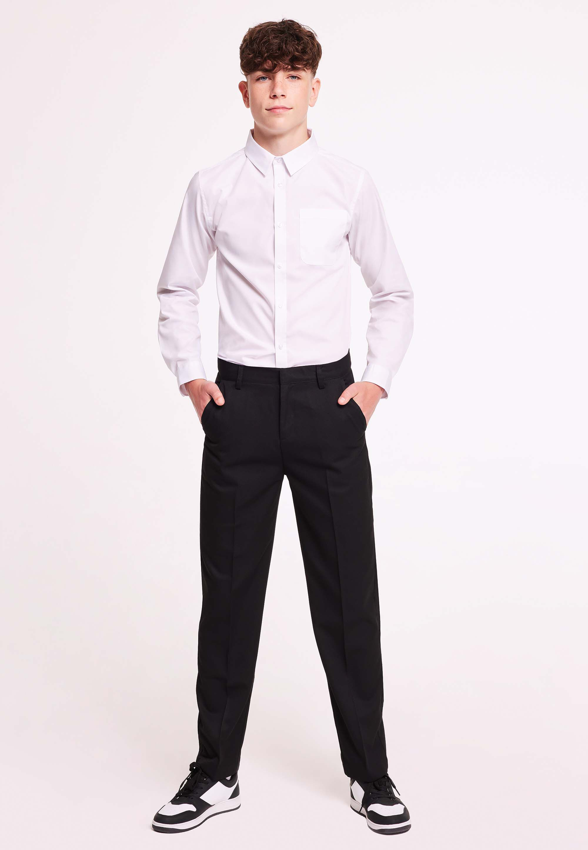
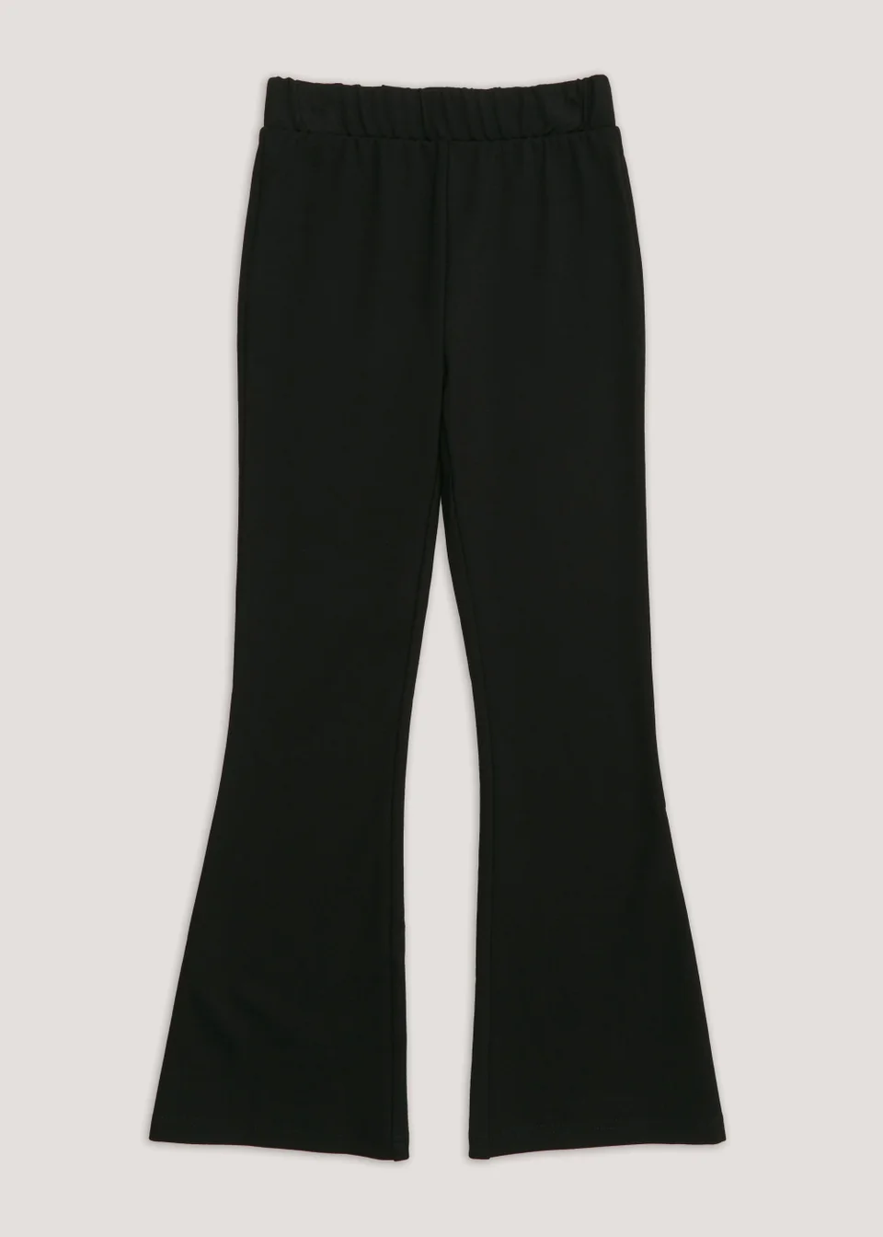
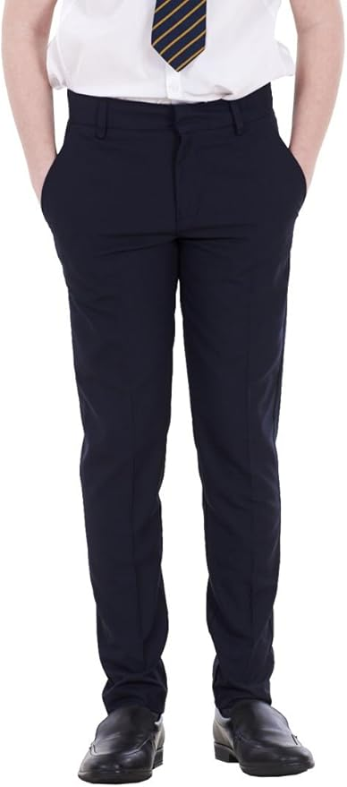
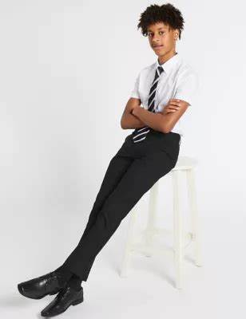
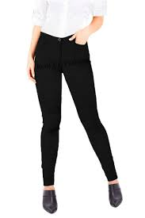
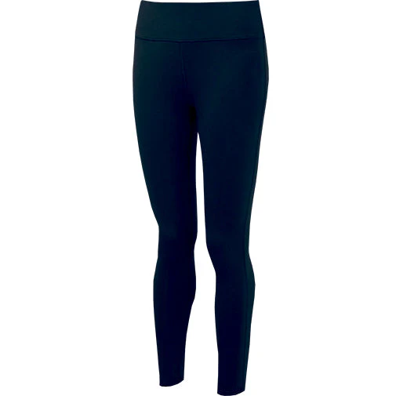
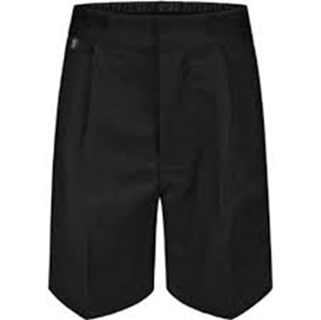
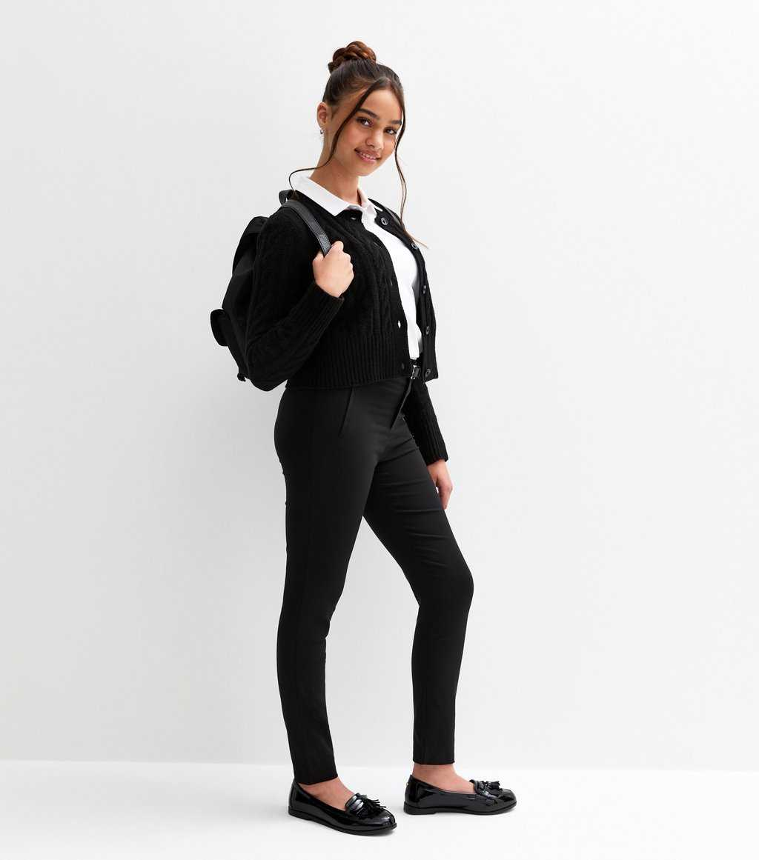

Slide 8
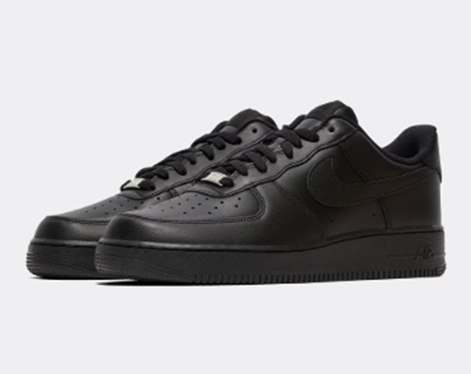
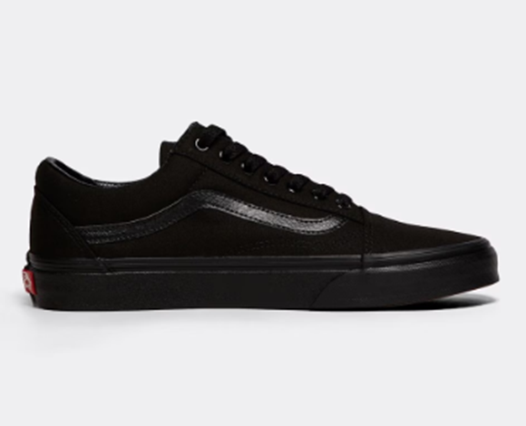
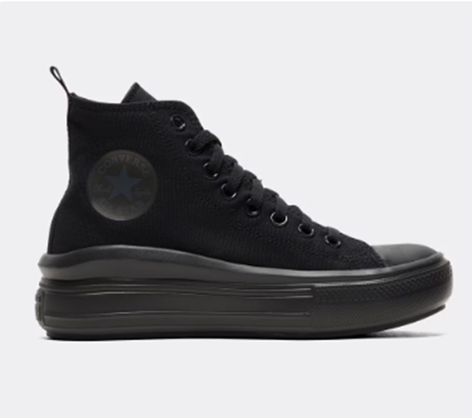
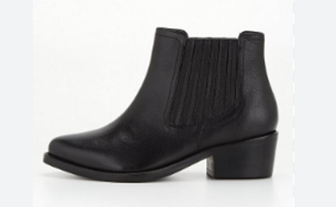
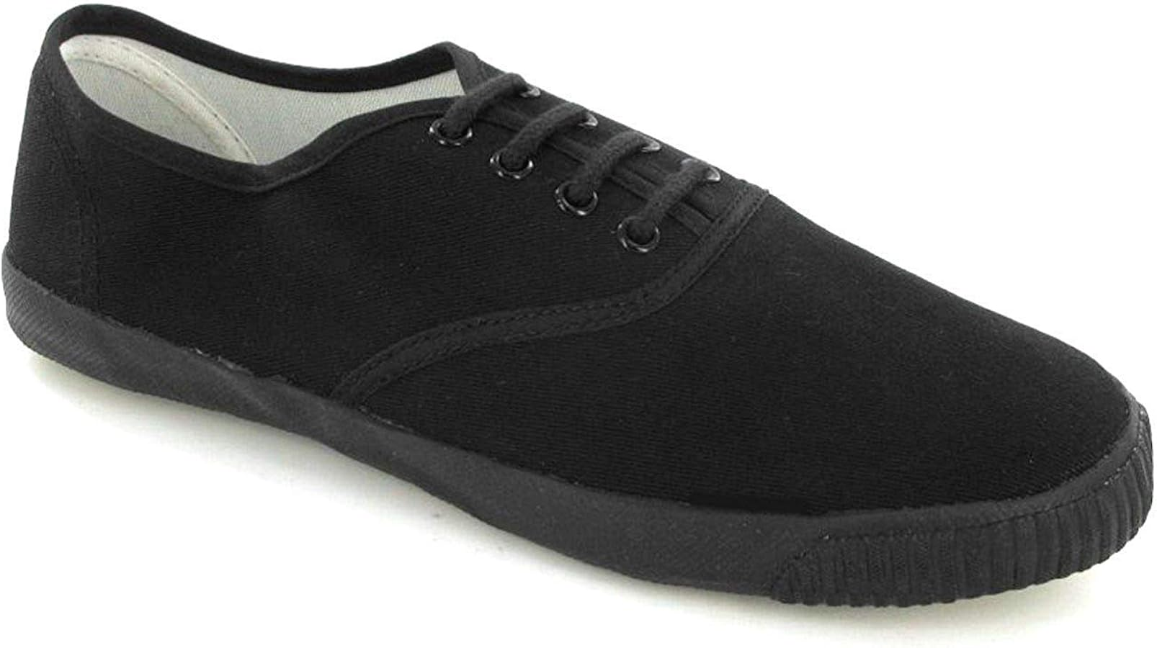
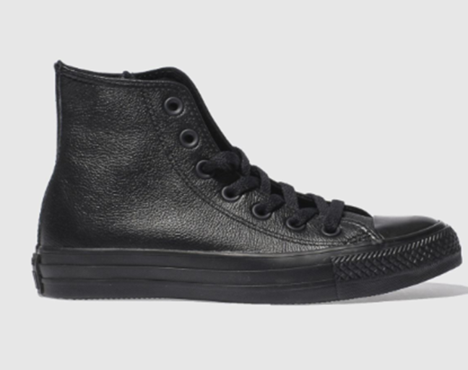
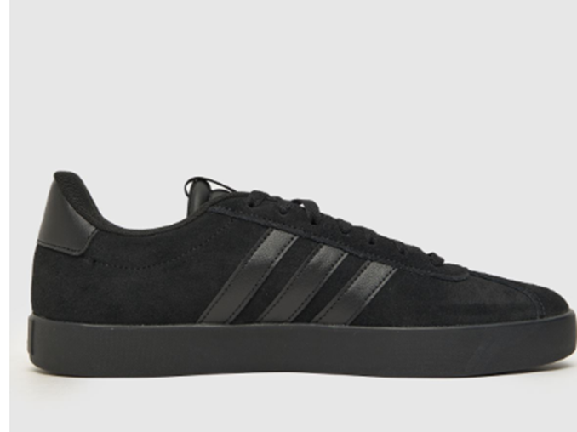

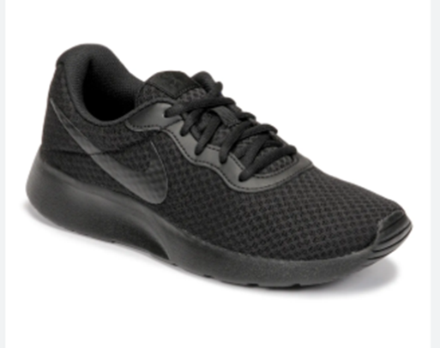
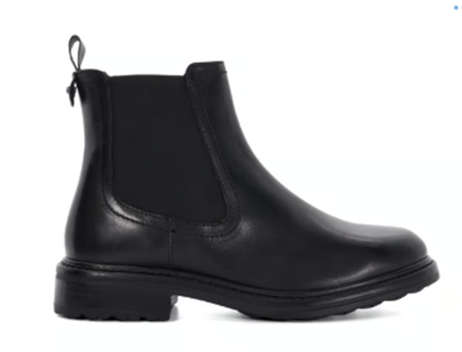
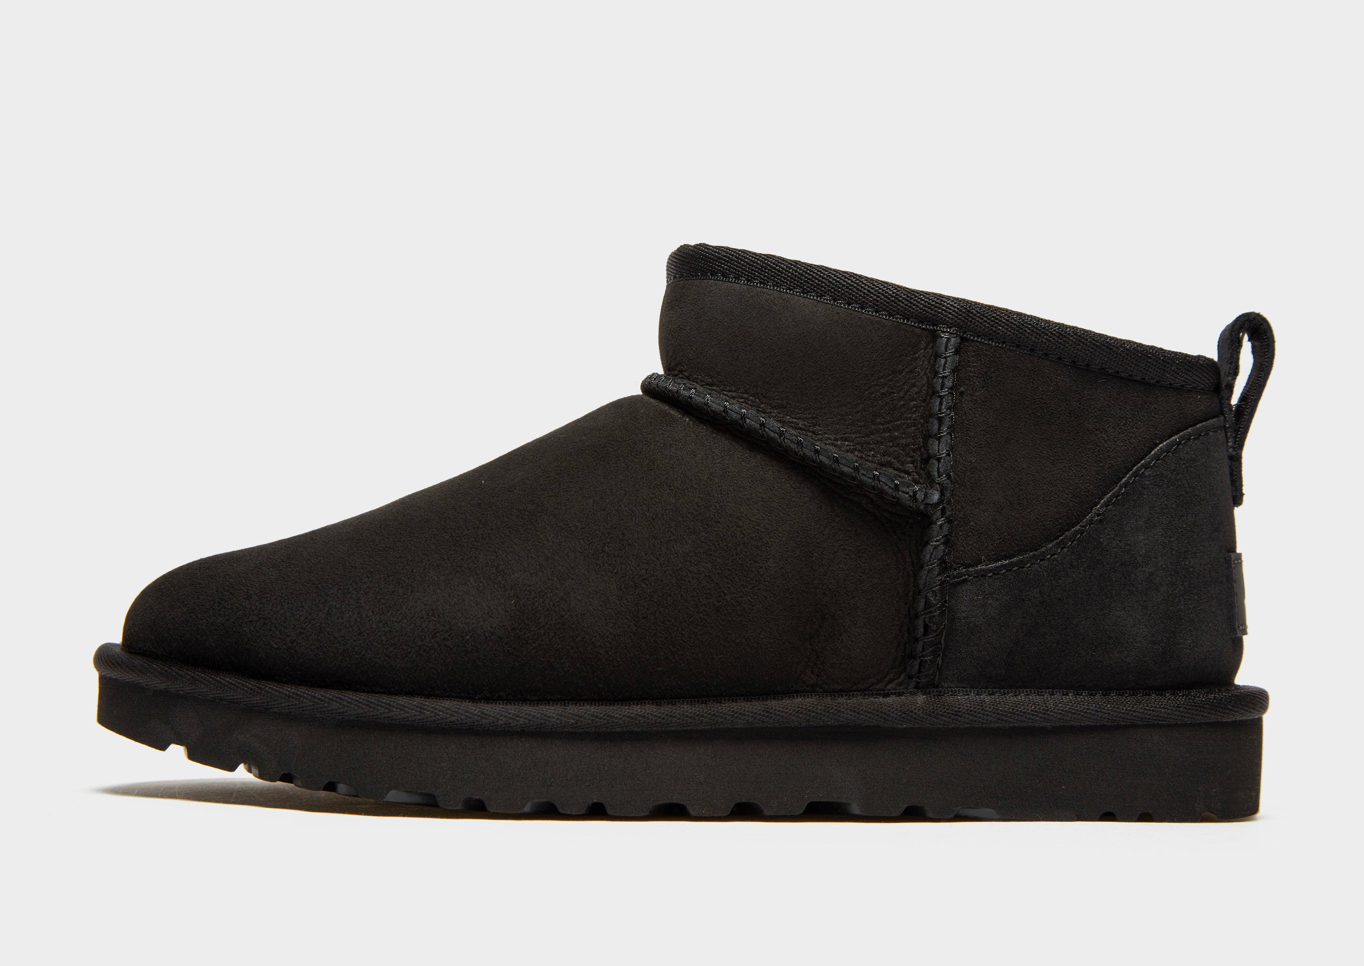
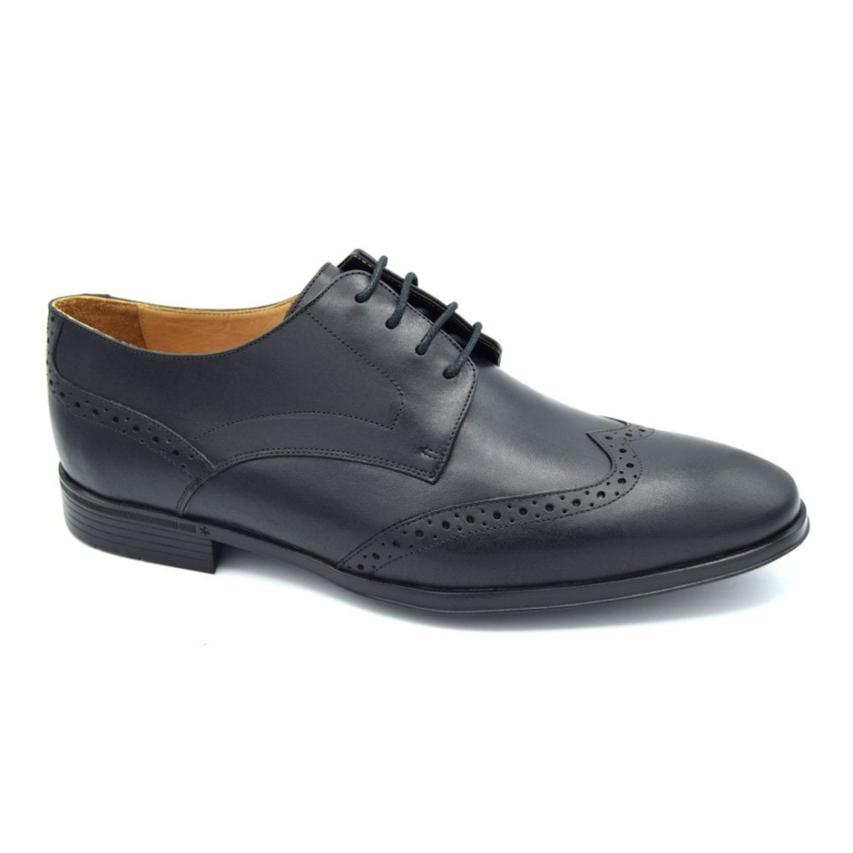
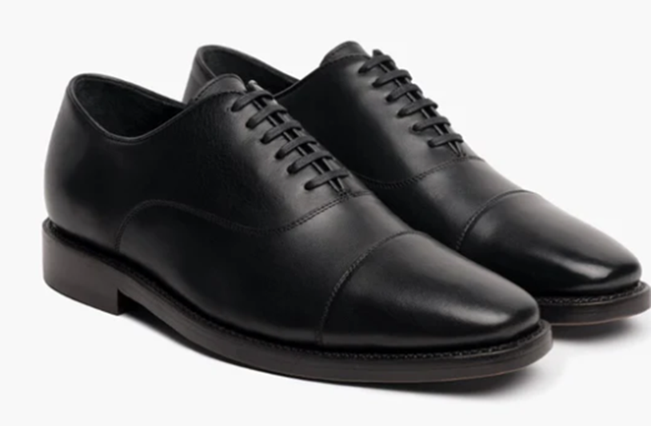
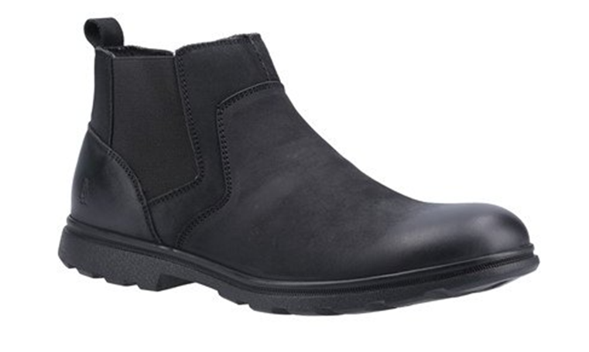
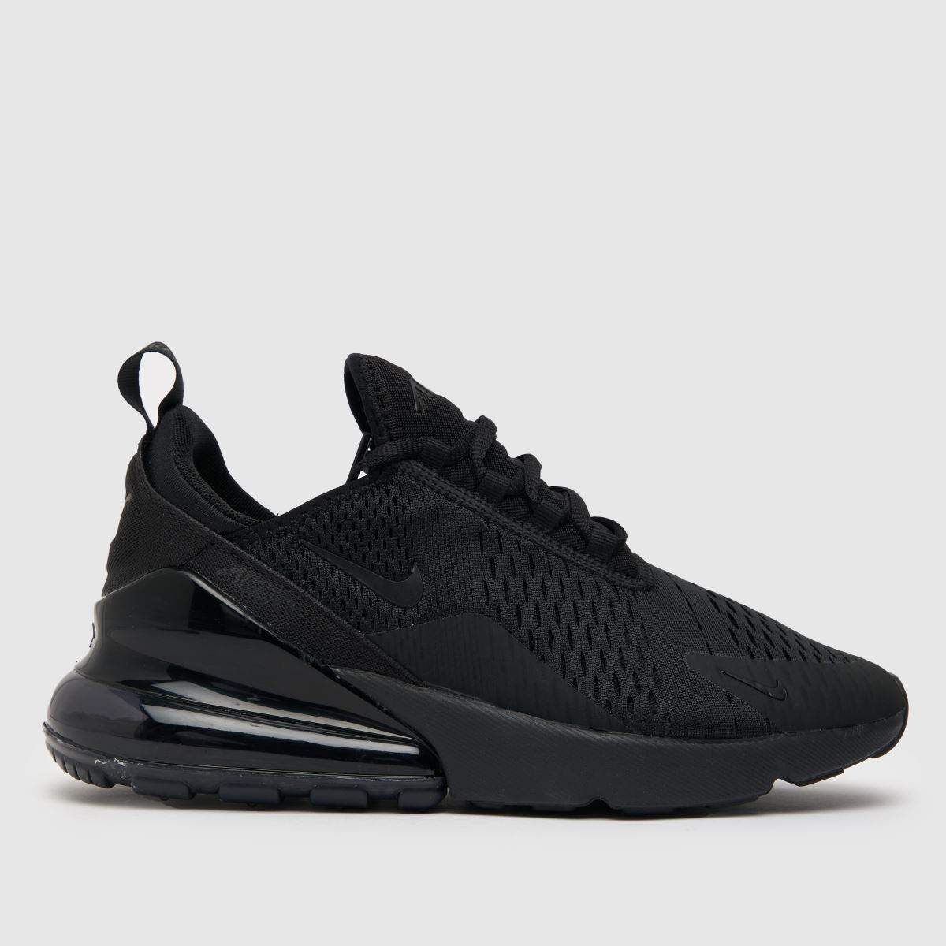
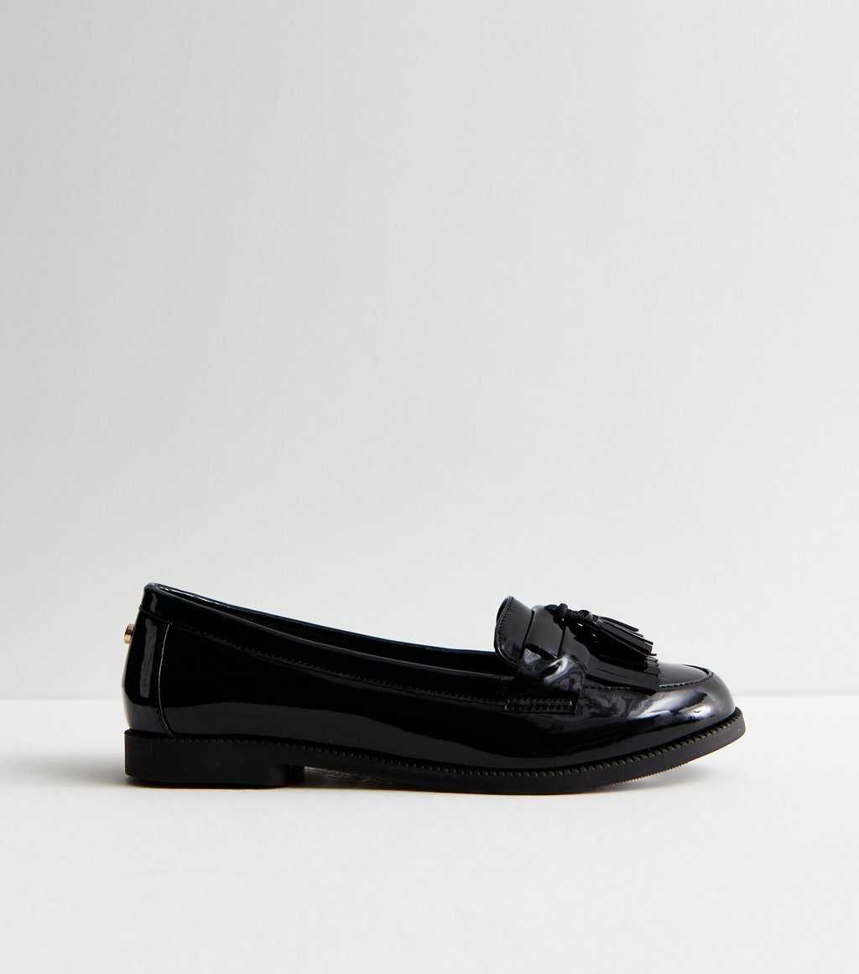
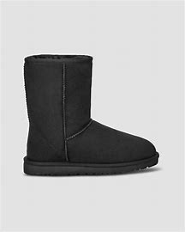
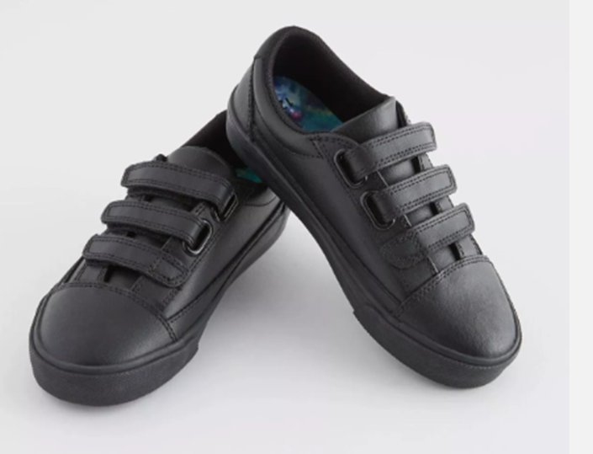
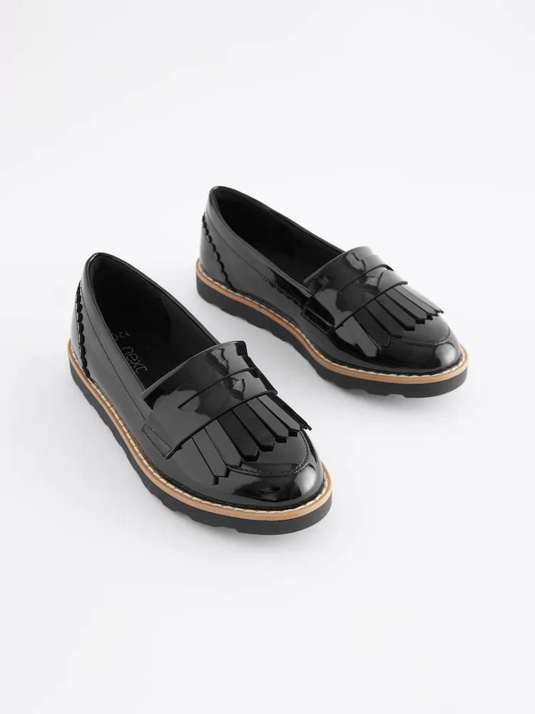
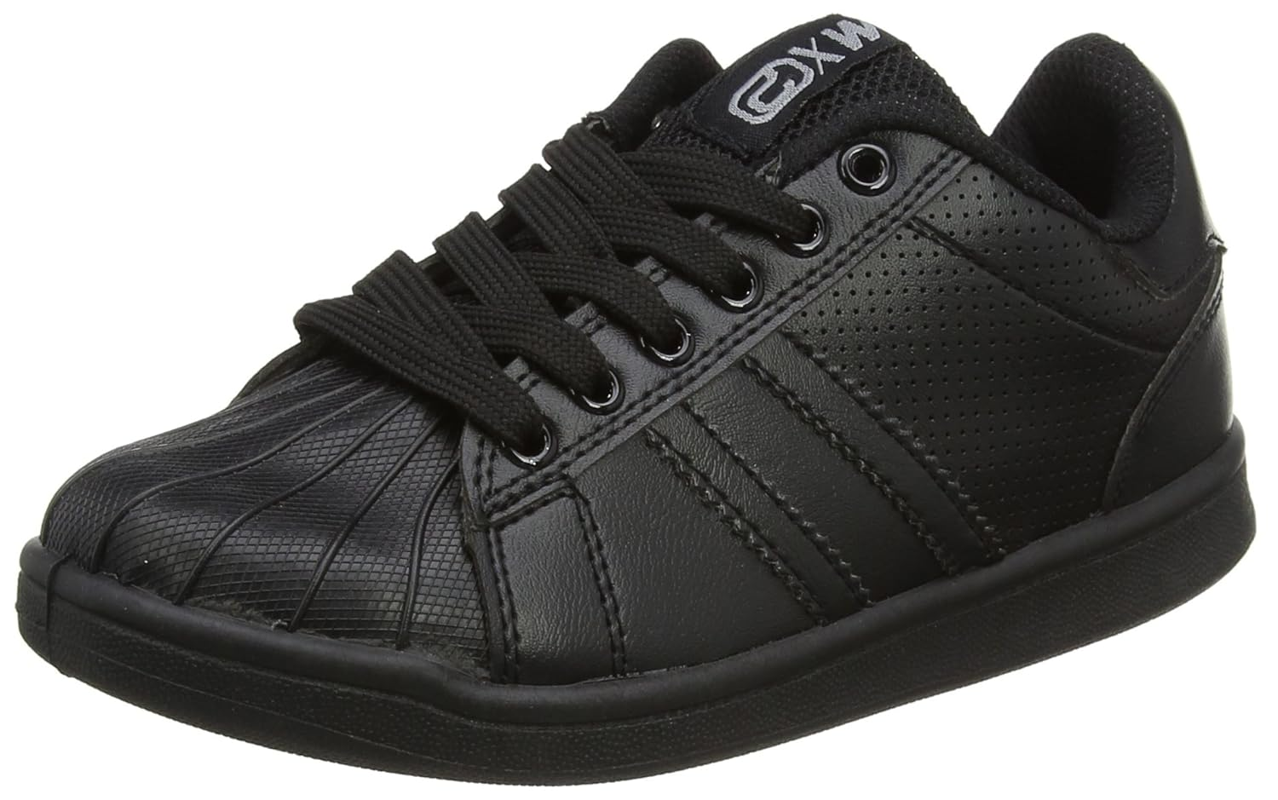

Slide 9
What’s not included
Coloured jumpers, hoodies etc
Any kind of writing, design or emblem on jumpers
Coloured, patterned or sports leggings
Joggers
Jeans
Tracksuits or track pants
T-shirts (including PE t-shirts outwith class)
Trainers/shoes with any colour of stripe or other colour/pattern
Hoods up, hats (no hoodies in practical classes)

Slide 10
Where can you get school uniform?
BE Uniforms- https://www.border-embroideries.co.uk/
Supermarkets - Asda, Tesco, Sainsbury’s etc
High Street stores - New Look, Next, H&M, Primark, Marks & Spencer, Castle Warehouse, River Island etc
Online - Amazon, Shein, Pretty Little Thing etc
PHS uniform bank
Peebles Sales and Wants
Ex pupils

Slide 11
Consequences
“Follow through. No one wears it coz nothing happens”
Young People Focus Group
SLT/Pastoral/PSAs at entrances
Conversation, uniform slip and demerit
Class teacher – uniform slip and demerit
Given uniform/email home
Phone call home/meeting with parents
Detention
Removed from participation in school events/representing the school

Slide 12
“You want to be part of something like that, that's something bigger than yourself, that's something you leave a legacy of being part of something special. It starts with myself.”
Saquon Barkley, Philadelphia Eagles

Slide 13
“I feel like when I dress smart, I feel like I’m portraying the best version of myself”
PHS Young Person

