Slide 1

National 5/4 Admin & IT
Course Support Information

Slide 2
Course Content Overview
Communication in Administration
  Internet Uses
  Electronic Mail
  Electronic Diaries
  PowerPoint Presentations
  Desk Top Publishing
Info Tech Solutions for Administrators
  Spreadsheets
  Databases
  Word Processing

Slide 3
Course Content Overview
Admin Practices
  Skills and Duties of Administrators
  Methods of Electronic Communication
  Value and Reliability of Internet Sources
  File Management
  Customer Service
  Health and Safety
  Security of People, Property and Information
  Corporate Image

Slide 4
Final Assessment overview
N5 Practical ICT Assignment – 70/110
  Assessed over 3 hours – 2 x 90 minute sessions March 2022.
N5 Practical ICT Question Paper - 40/110
  Assessed in 90 minute paper – 6 May 2022.
Theory is assessed in both papers.
N4 – learners will be continually assessed to overtake performance criteria in the 3 units of study. No Added Value assignment this year.

Slide 5
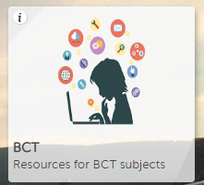
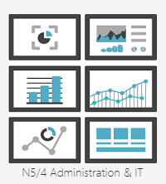
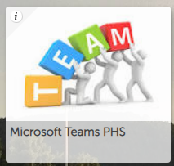
Out of class learning
Course notes for Admin Practices – a paper copy will be issued.
Practical activities –uploaded to the BCT Resources tile. Refer to Teams Assignments to catch up if absent – see support on return as necessary.
Homework activities issued and returned through Microsoft Teams / Homework channel.

Slide 6
Assessment for learning
SQA subject page
Understanding Standards
Topic assessments to exam standard – with feedback on next steps.
  E-communications (Theory and Practical)
  Word Processing
  Desk Top Publishing
  Presentations (PPT)
  Spreadsheets
  Databases
  Admin Practices (Theory)

Slide 7
LEARNER INTERVENTIONs
Opportunities to access department at lunch time/after school (open door policy).
Direct teacher support – Teams, lunchtimes by arrangements.
Written & verbal feedback in class and post assessment.
Study support will be offered at lunchtimes or after school at key points in the year.

Slide 8
How can you help?
Encourage students to check Microsoft Teams for homework and revision activities.
Encourage regular consolidation throughout the year using the materials in the BCT Resources tile.
Download Office 365 (free to glow email account).
Contact carolyn.futty@glow.sch.uk for further info.

