Slide 1
Higher Administration & IT
Supporting a Young Person in the Senior Phase

Slide 2
Course Content Overview
ICT Software – Practical Skills/Problem Solving:
  Using Internet Sources
  Outlook – E-mail, E-diary
  Presentation software (PowerPoint)
  Word Processing (Word)
  Spreadsheets (Excel)
  Databases (Access)

Slide 3
Course Content Overview
Admin Theory in the Workplace:
  Role of Admin / Time and Task Management
  Event Planning
  Workplace Legislation
  Impact of Digital Technologies on Working Practices
  Customer Care

Slide 4

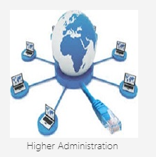
Course Assignments & Support
All course assignments are posted through Microsoft Teams – learners should attempt work at home if necessary.
Students receive papers copies of theory course notes and practical help guides.
All course materials will be posted in the BCT Resources tile within GLOW.
Students will be issued with a commercial H AIT Revision Guide.

Slide 5
Final Assessment Structure
Practical ICT – 60/110 of course.
  105 minute practical exam - March 2022.
Theory - 50/110 of course.
  90 minute written exam in the main exam diet – 6 May 2022.

Slide 6
Formative Assessment Timeline
Formative assessment to identify next steps:
  Topic assessments:
    Communication in Admin (PPT, E-Mail, E-Diary)
    Word Processing
    Spreadsheets
    Databases
    Admin Theory in the Workplace
  Assessment dates will be communicated through Microsoft Teams and Satchel One posts.

Slide 7
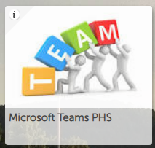
Out of Class Learning
Homework will be issued through Microsoft Teams Homework channel.
This will include:
  Theory exam style questions
  Practical tasks using Microsoft Office
  Preparation for unit assessments
Additional material for further self-directed learning can be accessed through the BCT Resources tile.
Students without access to compatible hardware/software can use school devices by arrangement.

Slide 8
What can you do to support?
Encourage students to check Microsoft Teams on a regular basis to access homework activities.
Encourage students to access the BCT Resources tile through GLOW for revision and additional self-directed study.
Contact the PT BCT – carolyn.futty@glow.sch.uk for further info.

Slide 9
Useful Websites
SQA H AIT Subject Page
https://www.sqa.org.uk/sqa/47918.html
SQA Understanding Standards Exemplification
SQA - Understanding Standards: Higher
You Tube Business Ed TV
https://www.youtube.com/channel/UCdB8itde5Qwa4FPK_0Xm14w

