Slide 1
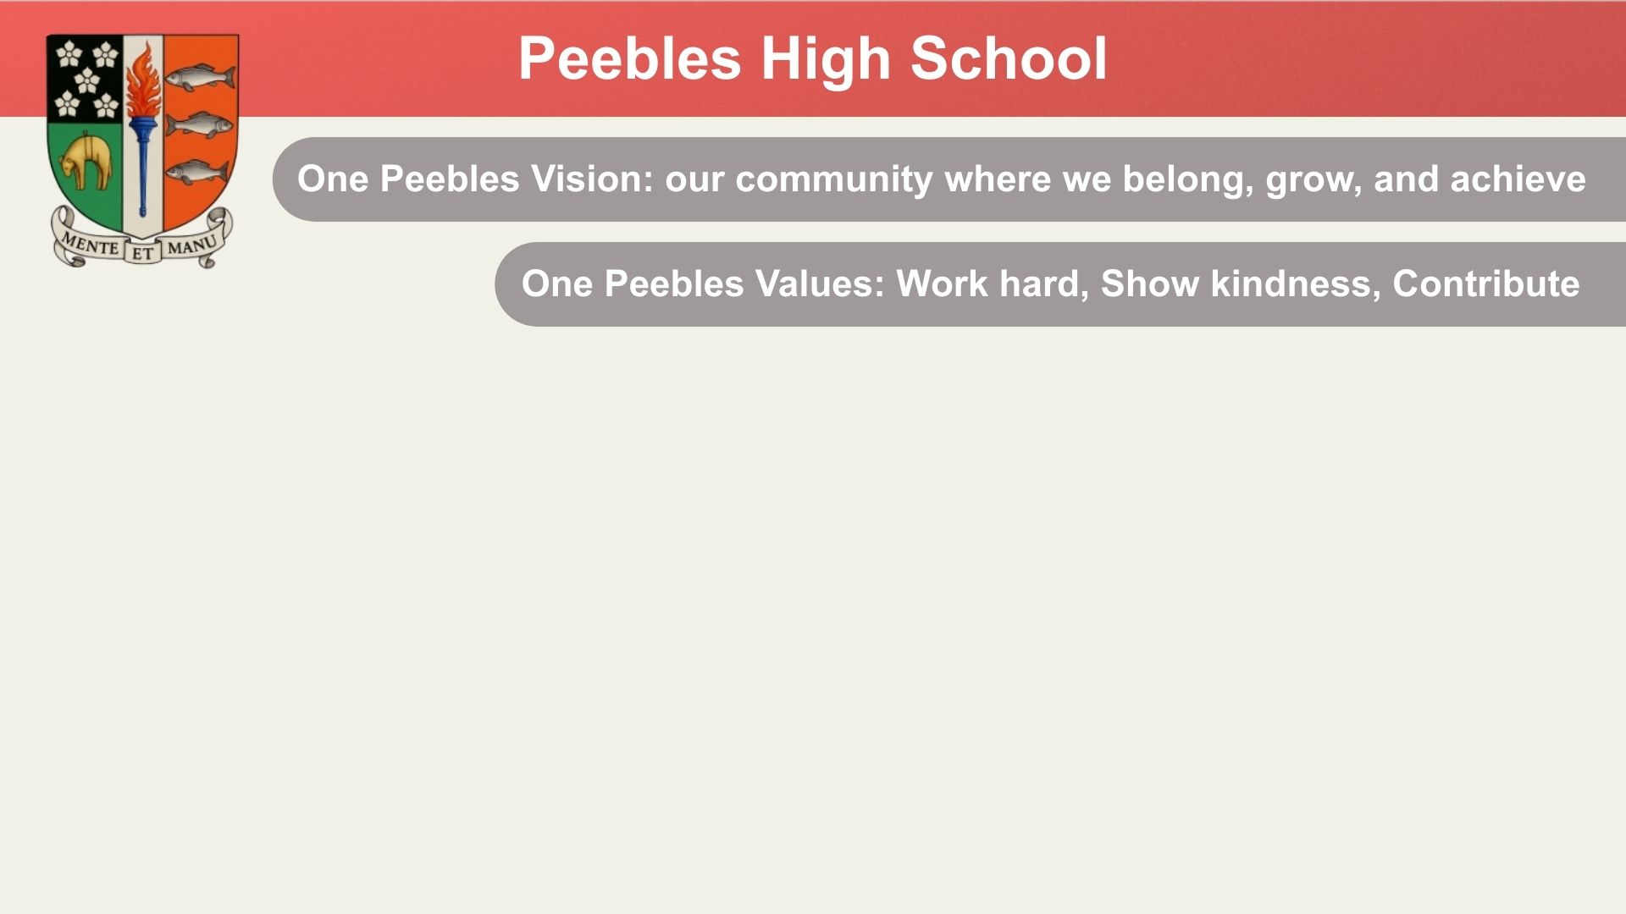

S1 Assembly 12th March, 2026 – Community Police Input

Slide 2
Notes:
Today I want to talk about something that affects every school and every year group.
But before we do that, I want to remind you of something important about our school.
At Peebles High School we talk about our One Peebles Vision: Our community where we belong, grow and achieve.
Those three words are powerful as nobody can grow or achieve if they don’t first feel that they belong. Part of belonging means feeling safe and feeling respected. It means feeling like you can walk into school without worrying about who might be targeting you that day.

Slide 3
Our values apply everywhere:
In classrooms
In corridors
At break and lunch
On the way home
Online
We aren’t just part of the One Peebles community during school hours. The way we behave when adults are not around shows what kind of community we really are.
Notes:
Our Values
Our school values are simple:
We Work Hard
We Show Kindness
We Contribute
Those values apply everywhere:
in classrooms
in corridors
at lunch
on the way home
and online.
Because the way we behave when adults are not around shows what kind of community we really are.

Slide 4
Why we are talking about this
Recently we have seen some behaviours towards individuals and between groups of pupils that are causing problems. These behaviours don’t fit with our school values.

Slide 5
Behaviours:
following people around school
staring people down
shouting across corridors
Spreading rumours about people
Spreading rumours that people want to fight each other
trying to provoke reactions.
Racist abuse

Slide 6
A lot of this behaviour is fuelled by what’s going on online.
In group chats and in calls.
Adding people into conversations where others already know it’s going to cause conflict.
Sometimes people are invited into calls just to watch arguments happen.
Sometimes screenshots are shared or recordings are made of things being said that are passed on and cause upset.
Sometimes rumours are started.
This may all begin as gossip or drama but it quickly turns into something much more serious.

Slide 7
What is bullying?
It is often:
repeated behaviours that cause harm
targeting someone
excluding someone
encouraging others to join in
embarrassing someone publicly.
Bullying can be:
verbal
social
online
or all three at the same time.

Slide 8
The reality in Scotland
Across Scotland:
About 29% of S1 pupils say they have experienced bullying.
Around 1 in 5 young people experience online bullying.
That is not just statistics. That is real people.
Notes:
Across Scotland:
About 29% of S1 pupils say they have experienced bullying.
Around 1 in 5 young people experience online bullying.
That is not just statistics. That is real people.
People sitting in classrooms, walking through the corridors, opening their phones at night. People trying to ignore requests to join chats but being bombarded with alerts. That’s not what showing kindness looks like.
Bullying happens. We are human beings, people make mistakes. By being aware of the consequences of bullying behaviour it is more likely that our One Peebles community is a place where…

Slide 9
The impact of bullying
Young people who experience bullying are more likely to:
feel anxious
lose confidence
avoid school
struggle with friendships
feel like they don’t belong.
And that is the opposite of what we want at Peebles High School.

Slide 10
What to do
Tell a trusted adult
Not Alone

Slide 11
Various sanctions: warnings, detentions, parents involved etc.
Restorative approach is often best
Sometimes an instruction to stay away is best. Over time by following that instruction, those involved see that they are being respected and start to feel safe again.
How we address bullying behaviour
Staff training
Educate young people e.g. Safer Scotland Online
Record and monitor
Listen to the young people
Notes:
Difficult for those most involved to do that and move on when things are stoked by others through social media.
We always try to resolve things quickly as we know the impact that bullying can have…

Slide 12
The role of ‘the audience’
‘The audience’ might:
watch
laugh
share screenshots, forward messages etc.
But the audience also has the power to help stop it by not feeding the drama.
Notes:
When bullying happens there are usually three groups of people.
The person or people being targeted.
The person or people doing the targeting.
And ‘the audience’.

Slide 13
Social media age limits
Most social media platforms have an age limit of 13 years old.
This includes:
Snapchat
TikTok
Instagram
WhatsApp
These limits exist for a reason.
Younger people are more vulnerable to:
peer pressure
online bullying
manipulation
harmful content
Social media companies know that managing conflict online requires maturity

Slide 14
A hard truth about online behaviour
Messages and behaviour online feel temporary but they are not.
Screenshots exist, Messages can be recovered. Conversations can be saved. In group chats, conversations can be recorded.
Police Scotland regularly deal with situations that start or are escalated on social media.
harassment
threats
sharing harmful messages.

Slide 15
PC Carsley

Slide 16
What positive behaviour looks like
Being part of One Peebles means making the positive choices.
Positive choices look like:
leaving group chats where people are being targeted
refusing to share screenshots
not adding people into arguments
not encouraging drama.
Sometimes the strongest thing someone can say is, “I’m not getting involved in that.”

Slide 17
The kind of school we want
Think about the kind of school you want Peebles High School to be….
A place where people feel targeted or a place where people feel safe and supported?
Because every message you send…Every comment you make…The group chats you join…helps to decide whether we are a school where everyone can belong, grow and achieve.

