Slide 1
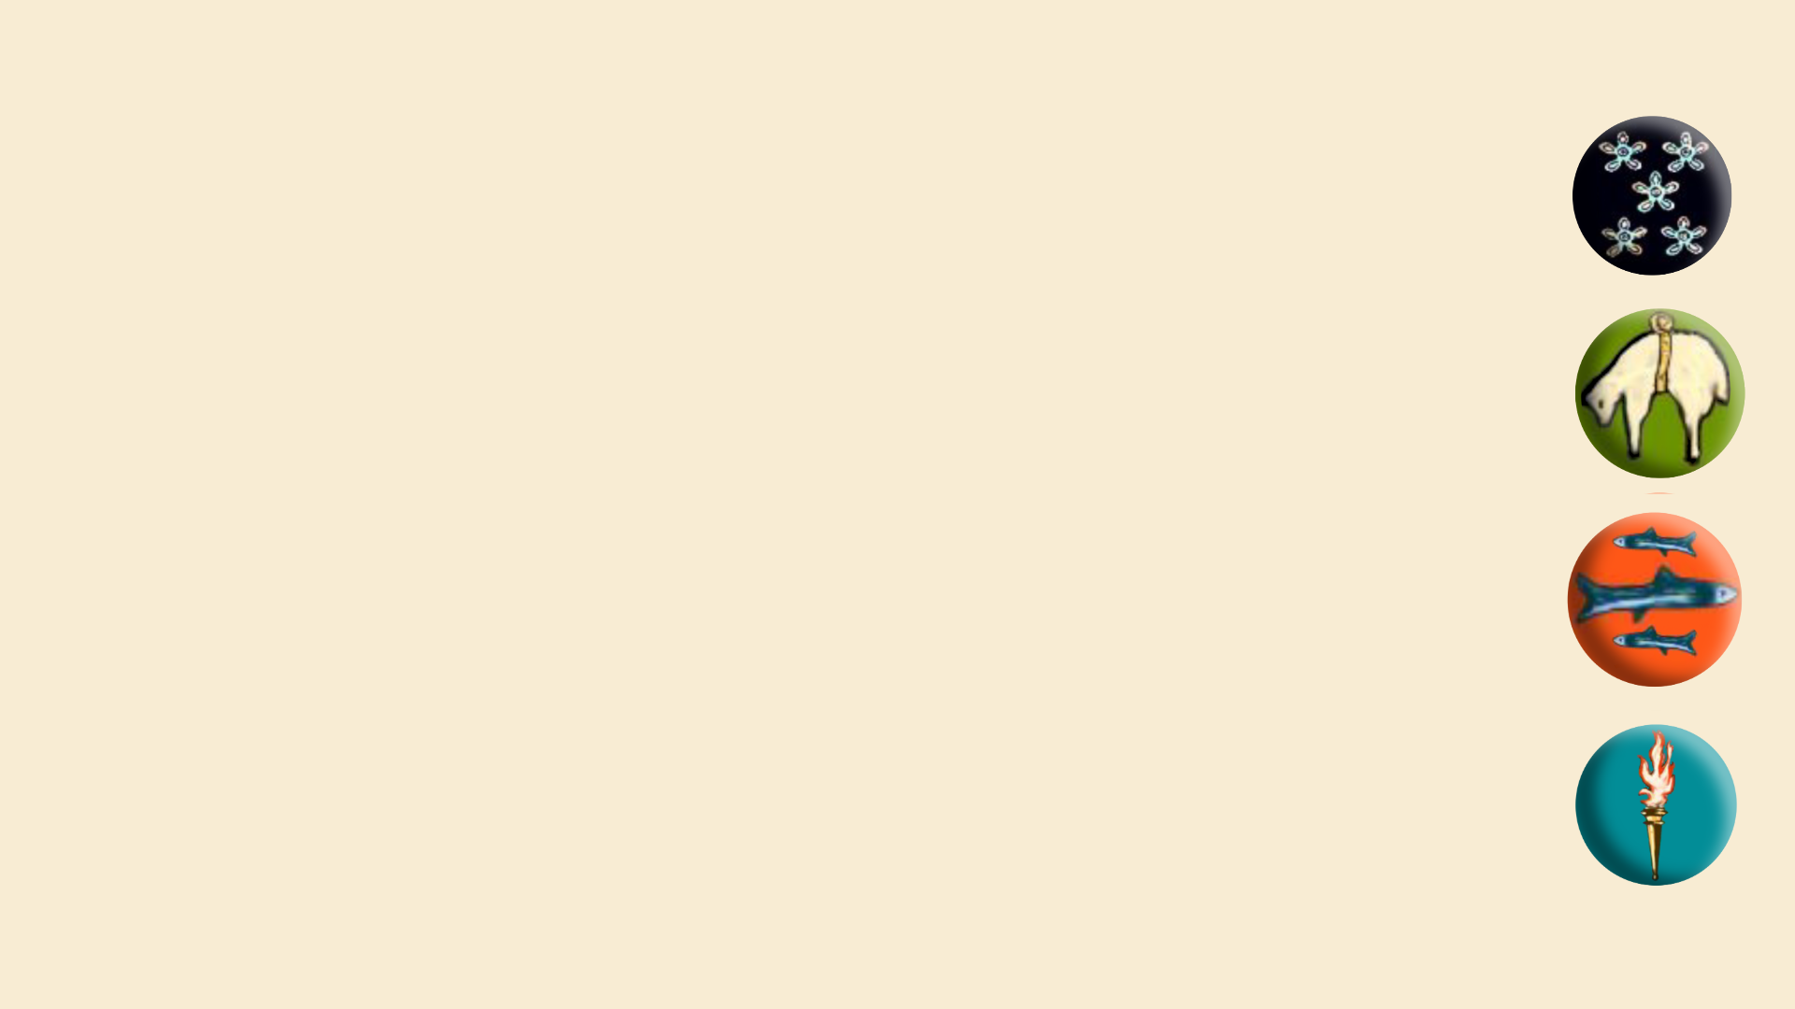

School Vision:-
One Peebles –
our community where we
belong, grow and achieve
Agenda-
Growth Mindset
Chat Health
Contribute Day

Slide 2
School values:-
Work hard
Do you have high expectations of yourself especially when faced with challenges?
Show kindness
Contribute

Slide 3
Do you have a Growth Mindset?
If something is wrong, do you …
say you can’t do it or see it as an opportunity to learn and get better?
blame other people or try to fix it yourself?

Slide 4
Do you have a Growth Mindset?
Our expectations are that you do not blame others or give up but you ask yourself – what can I do?
This applies to disagreements, and also in your learning and exam preparation.

Slide 5
Do you have a Growth Mindset?
Ask for help and act on the advice.
Working hard =
thinking about what you can do first

Slide 6
Hard work beats talent!

Slide 7
Message to S4-6
More teachers than normal saying they are working harder than their classes.
Too many pupils are expecting teachers to do everything for them.
You need to attend, listen, do all the work and ask questions.
Your teachers go above and beyond!

Slide 8
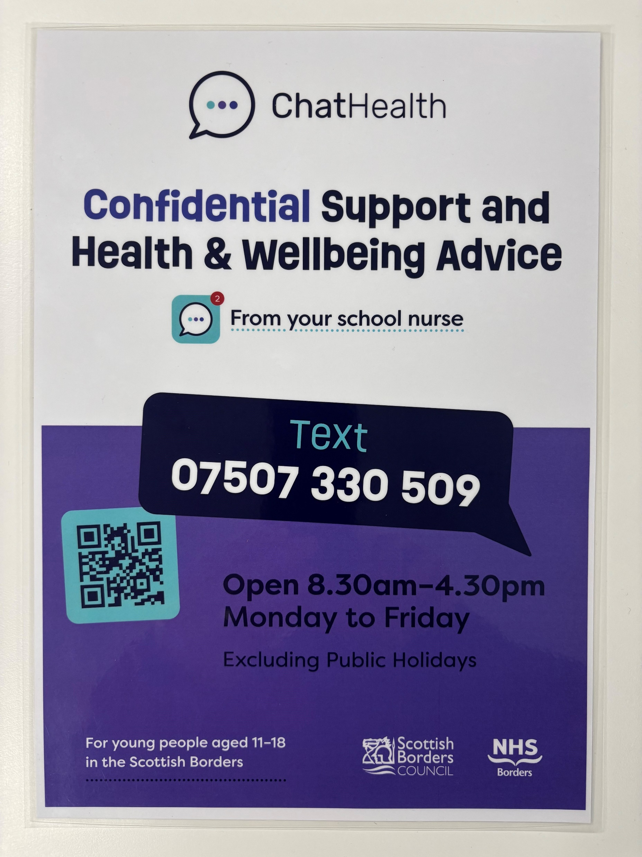

Slide 9
Contribute Day on Friday
Bring a donation for the Foodbank

