Slide 1

One Peebles:-
Our community where we grow, belong and achieve
School values:-
Work hard
Show Kindness
Contribute
  Do you add value to our school community?

Slide 2
Fire Drill
Well done – follow instructions
5 mins to get out and 5 mins back in
Important reminder to S6 – in class, out of school or in library - for the whole period
Line up in alphabetical order – orderly manner
Place of Shelter – Parish Church

Slide 3
New building
Great job – thank you to everyone
Together, we have got the school working very well
We are getting to class quickly and quietly
Visitors have been very impressed
We are respecting the building and enjoy the fact that it is more like a college or university than a school

Slide 4
New building – reminders
Do not be in the corridor
Do not leave class early
Respect the open classrooms
Wait outside CDT/Science/Art areas
Toilets – hand towels in bin, not down toilet
Use the new bins including recycling bins
No eating upstairs because we want the furniture and carpets to be clean
Avoid staff lounge corridors because this helps staff have some space

Slide 5
Still to come
Extra food outlet
Dux board
S6 photos
Hall of Heroes
Privacy glass on meeting rooms
New signage
School badge at front door
Displays
Vision and Values Mural

Slide 6
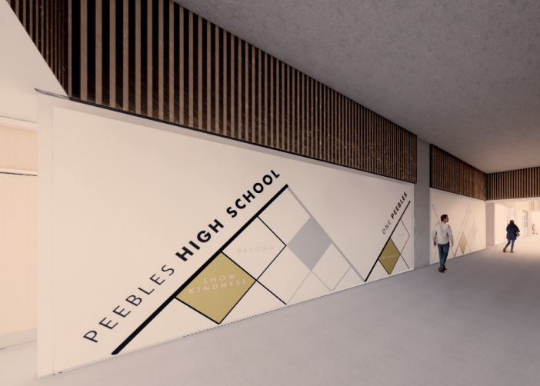

Slide 7
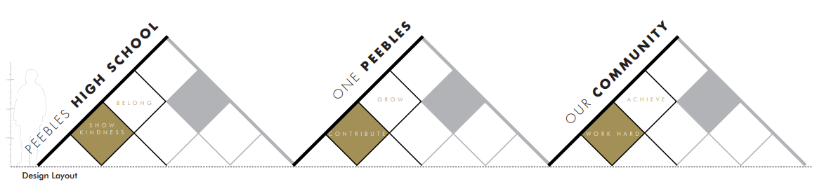

Slide 8
One Peebles:-
Our community where we grow, belong and achieve
School values:-
Work hard
Show Kindness
Contribute
  Do you add value to our school community?

