Slide 1
PHS 2026 Prelim Exams
Study leave
Exam timings
Exam locations
Coming into school to study
Be Prepared - What must I bring in?
What can't you bring in?
What if something goes wrong?

Slide 2
It is difficult and tough to be organised and prepared and find time/focus to study.
It is difficult and tough to be unprepared and anxious, worried and stressed.
Choose your difficult / tough.

Slide 3

STUDY LEAVE
The Exam diet and study leave will run from
Thursday 8th January – Friday 23rd January.

Slide 4
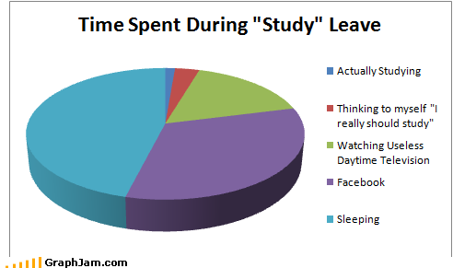

Slide 5
STUDY LEAVE
The clue is in the title…STUDY LEAVE!
Use it wisely; plan, practise, prepare
Think about revision techniques – use whatever works for you
Take (reasonable) breaks!
Eat and drink well
Talk to your teachers

Slide 6

SQA
Your National Qualifications (AI)

Slide 7
Peebles High School Policy on Artificial Intelligence
Permitted Use & Tools:
Departments will specify which AI tools are approved for use by staff and students, focusing on those with appropriate safety and filtering features.
Academic Integrity & Assessment:
It is vital that AI should not replace independent thought or be used to circumvent learning. If used in classwork students must properly cite AI this, and be supported to do so.
To check for AI use in school assessments, educators can use AI detection tools, though human judgment remains crucial. By utilizing diverse assessment strategies, teaching staff can verify pupils' comprehension beyond what AI tools can assess.

Slide 8

Do…
Check that all the details on your exam timetable are accurate.
Let me know ASAP of any changes that need to be made
Wear your school uniform
Check that you are sitting at the right desk, with the right subject exam paper in front of you!
Speak up if you have any questions or concerns, as soon as you think of them. Either find me or put your hand up and an invigilator will come to you

Slide 9
On exam day
DO be outside the exam room at least 10 minutes before the exam is due to begin. Drama 1/2, Business department or Library.
DO check the lists to be SURE of your room and seat number. (Assessment Arrangements).
If you can’t see your name, or think something is not right– DON’T PANIC! Speak with an invigilator or come and find me
If you have as assessment arrangement, or have elected to use a pc, check your letter.

Slide 10
Allowable equipment
All writing should be in blue or black pen. NO GEL PENS!
Diagrams, graphs, etc in HB pencil (nice & sharp)
Bottle of water
Rulers, rubbers, calculators, highlighters, protractors, etc
No pencil cases & please ask invigilators to check your glasses case
No phones, iPods, earphones, smart watches etc

Slide 11
During the exam
Be considerate of others.
Check you have been given the correct papers.
Question sheet is yours.
If you need assistance raise your hands.
If finished, triple check your work.
Hand everything back to the invigilator before your leave

Slide 12





Leaving the Exam Room

Slide 13
What if…?
I don’t have an exam but I want to come into school to study?
My bus is running late?
I sleep in or I am late for any other reason?
I am unwell on the day of an exam?
The Fire Alarm sounds?
I get hungry?
I finish the exam early?

Slide 14
Please remember
School still happens!
The rules are the same for each exam, no matter which room you are seated in
Most problems can be fixed, if we are alerted to them. SPEAK UP!

