Slide 1

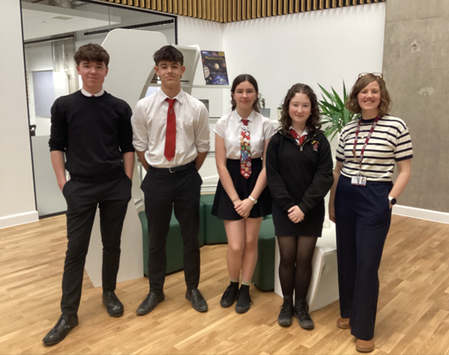

Residential 2027

Slide 2
Residential 2027
May 2027

Slide 3
Why go on S2 Residential
S2 residential is the very last week of S2, and the last week before you start your new subjects. It is also part of your Outdoor Education. In school we mostly concentrate on traditional subjects but Outdoor Education is also a key part of the Scottish Curriculum.
It is a fun, adventurous and challenging week, with lots of time for socialising together too. A chance to try new things and see what amazing things you can do!
Many senior pupils say they met their closest friends on their residential trip.
We hope ALL of you will be able to come next year!

Slide 4
Why go on S2 Residential
https://www.outwardbound.org.uk/come-to-outward-bound/help-centre/education-help-centre/

Slide 5
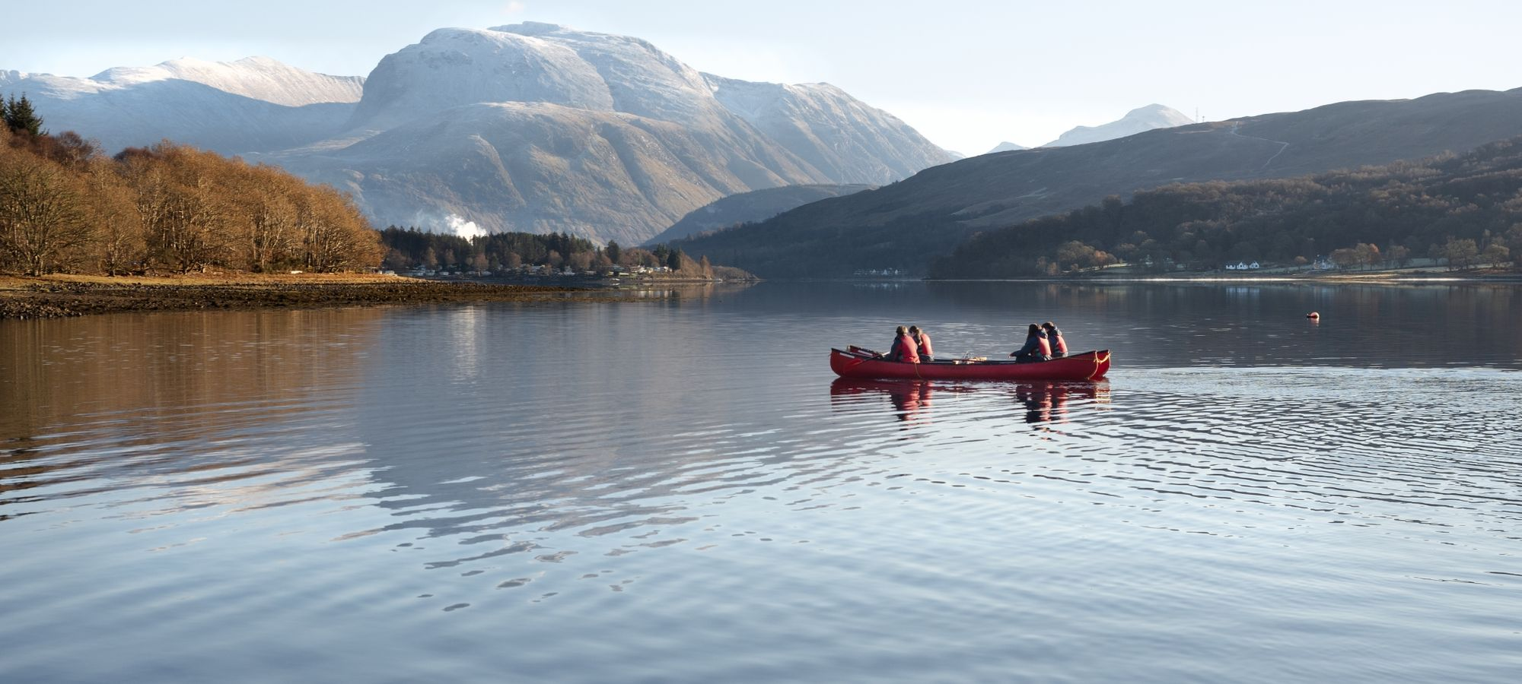
Where is it: Loch Eil, Scotland
Outward Bound Loch Eil, Scotland
This centre will be host to 120 pupils and 13 members of PHS staff

Slide 6
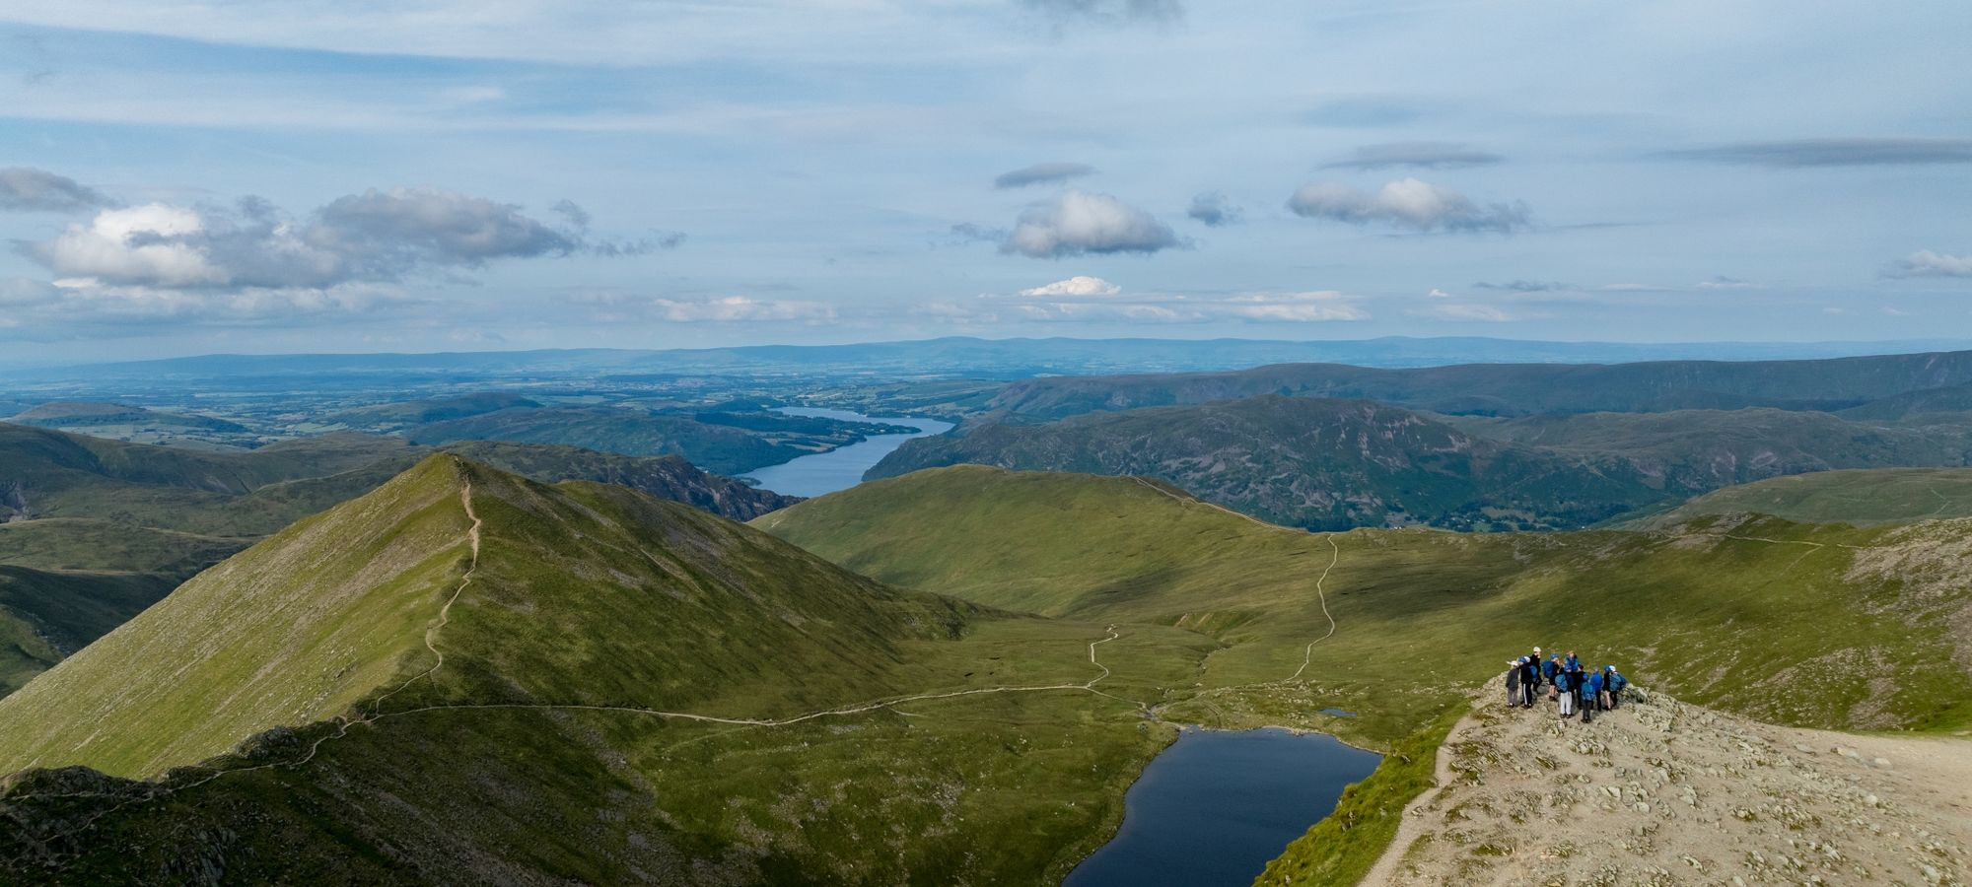
Where is it: Ullswater, Lake District
Outward Bound in the Lake District.
This centre will be host to 40 pupils and 3 members of PHS staff

Slide 7
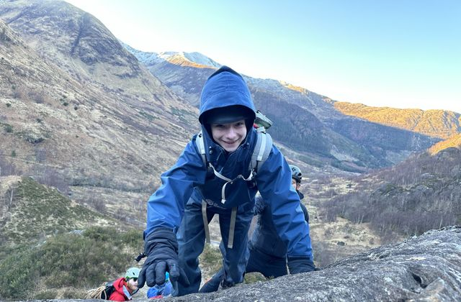
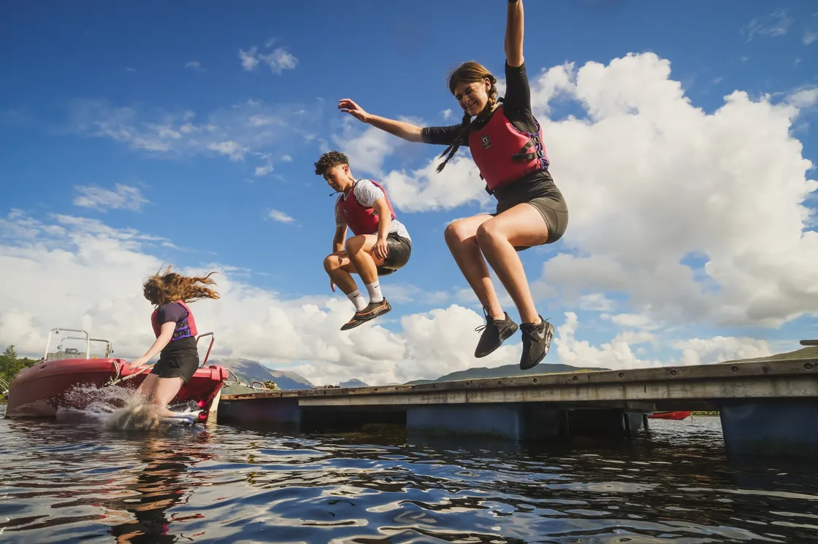
What do we do?

Slide 8
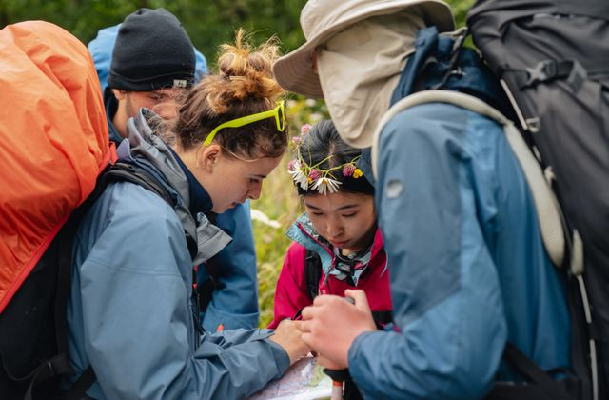
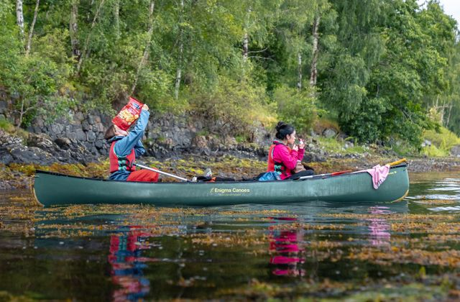
What do we do?

Slide 9
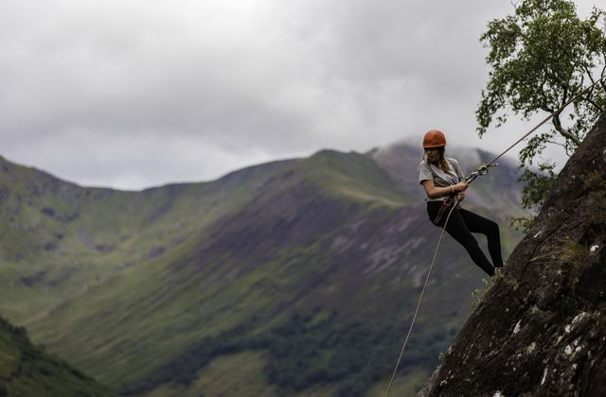
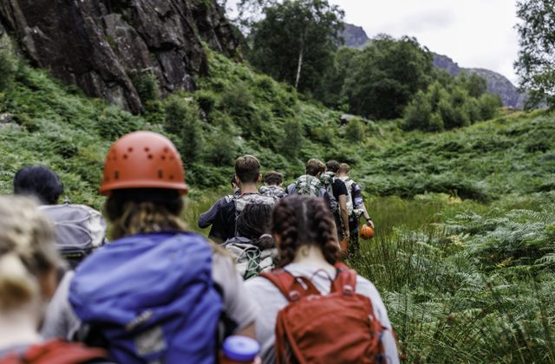
What do we do?

Slide 10
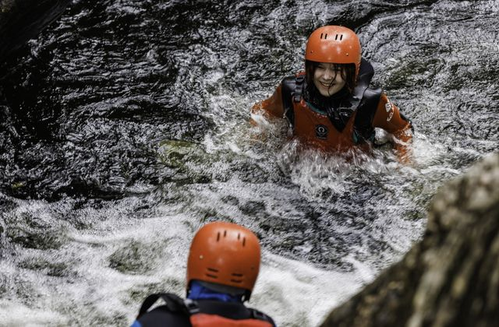
What do we do?
https://www.outwardbound.org.uk/come-to-outward-bound/help-centre/education-help-centre/

Slide 11
Possible Activities Include
Kayaking
Sailing
Gorge-Walking
Campfires
Pier Jumping
Camping
Hiking
Rock-Climbing
Scrambling
Canoeing

Slide 12
Activities throughout the week
It’s important to stress that no two groups will have the same experience throughout the week. OB instructors are skilled in creating unique activity plans that meet the needs of and challenge the group they have.
While not every group will do the same activities, activities will be almost exclusively outdoors.
All groups will have an expedition activity, and at least one water based activity.

Slide 13
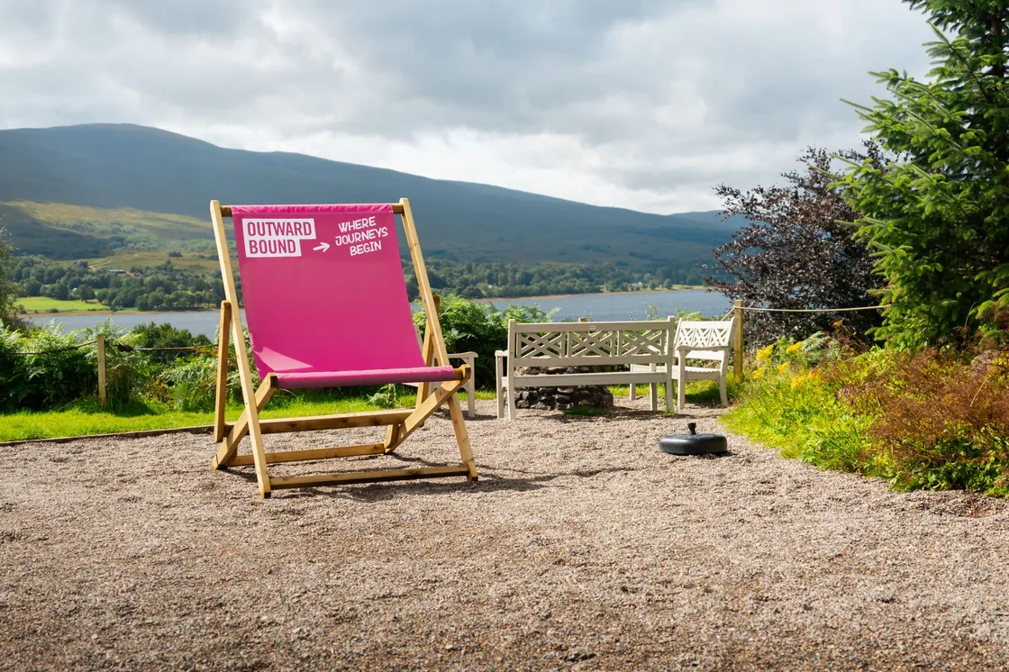
What is the centre like?
https://www.outwardbound.org.uk/come-to-outward-bound/help-centre/education-help-centre/

Slide 14
Monday
Leave PHS
Arrive at OB Centre and Welcome
Group/Dorm Allocation and Meet Instructor
Team Building Exercises
Expectations and Plan Week
Dinner
Plan tomorrow’s activities
Hot Chocolate and Bed

Slide 15

Tuesday
7.00am-7.30am Breakfast
Pack Items and Travel
Walk to campsite and have lunch en route
Pitch tents and set up camp, campfire etc.
Cook dinner and play games
Reflect on the challenges of the day
Bed

Slide 16
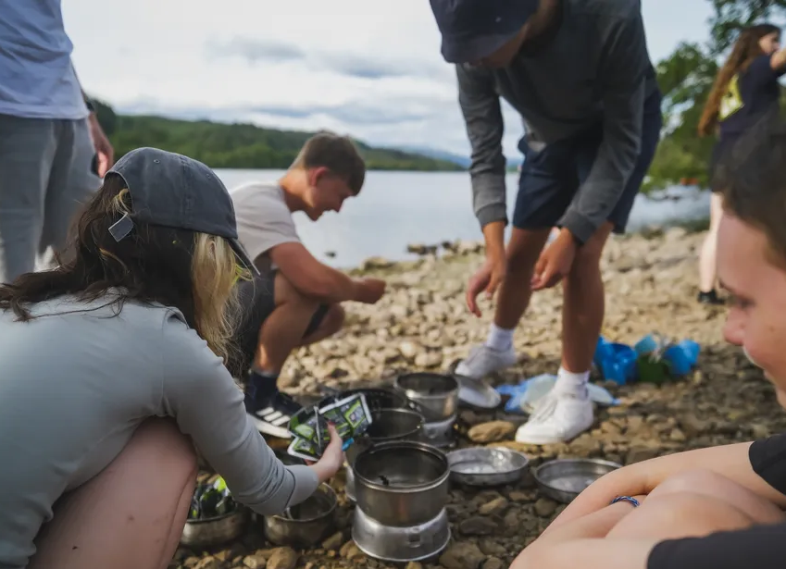
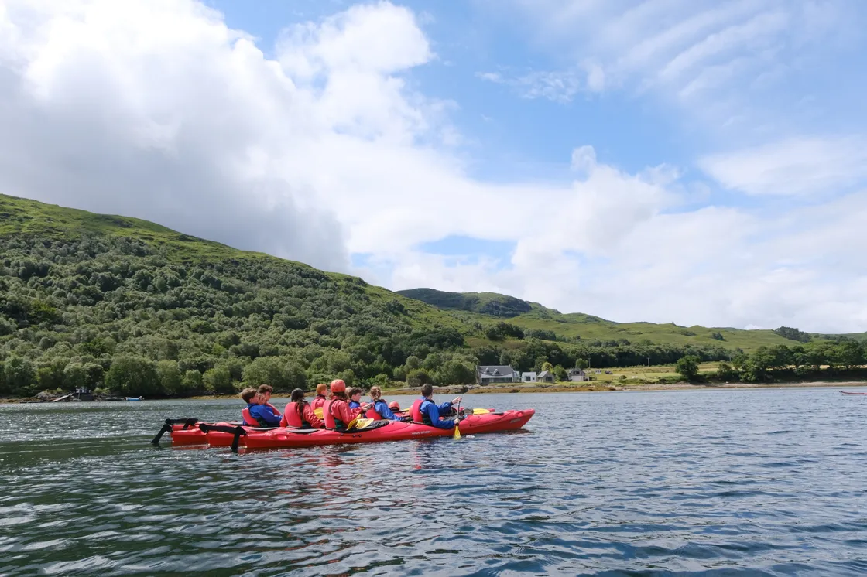
Wednesday
Early wake up and cook breakfast
Clean camp and pack items away ready to leave
Walk to train station/canoe and travel back by rail/canoe to centre
Lunch and Canoe Slide
Dinner
Evening activity such as rock-climbing
Hot Chocolate and Bed

Slide 17
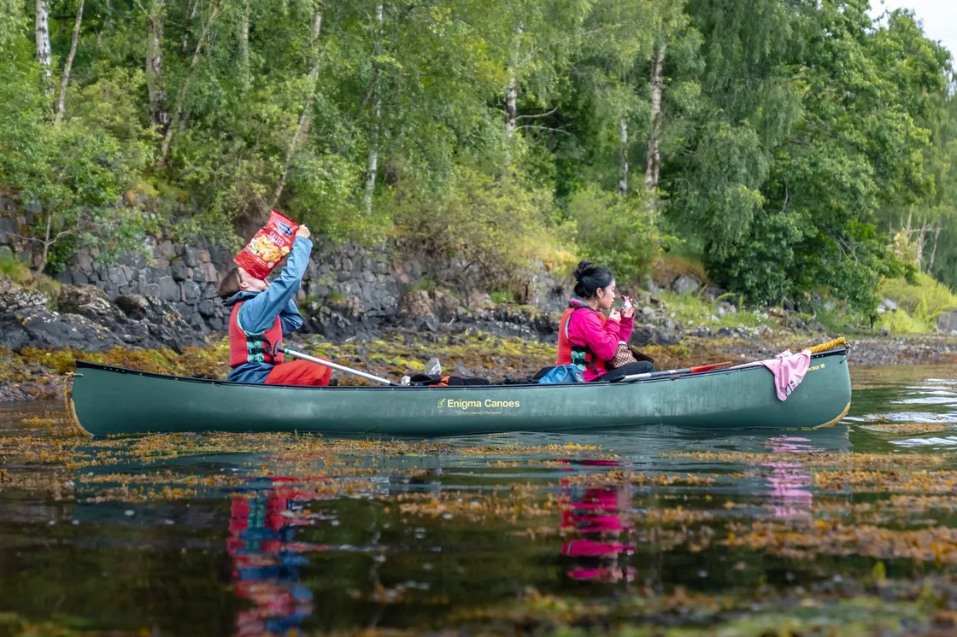
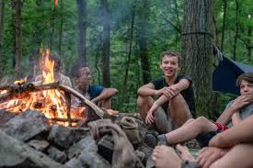
Thursday
Breakfast
Get ready and head out for a day’s water activity
Gorge-walking, canoeing, kayaking, sailing
Have lunch on the beach
Pier Jump
Back to centre and have dinner
Ice-cream and marshmallows by campfire on the beach.
Hot Chocolate and Bed

Slide 18
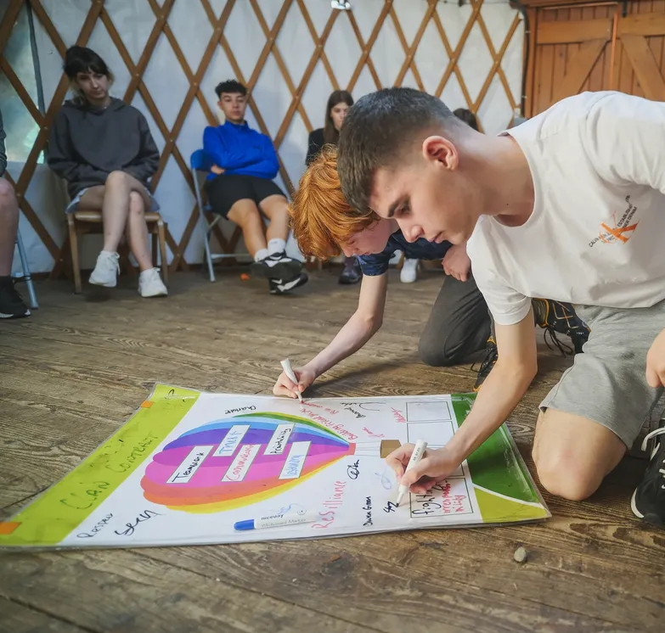
Friday
Breakfast
Morning Activity
Time for reflection, evaluation and feedback
Certificates
Goodbyes
Tears
Have lunch and Head Home

Slide 19
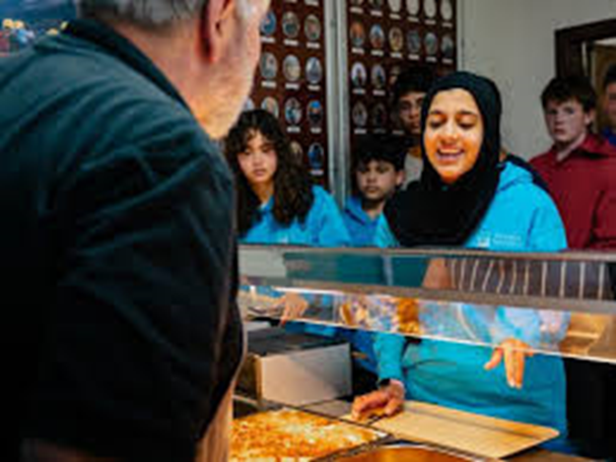
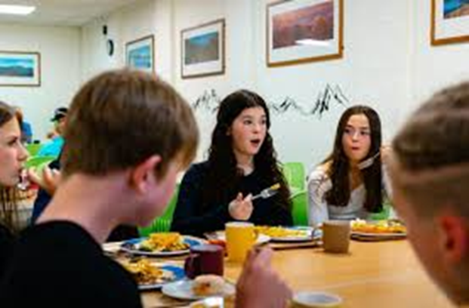
Food
Breakfast
Cereals, Porridge, Toast, Yoghurts, Fruits. Cooked options, including sausages, bacon, eggs, hash browns.
Lunch
Packed lunch. Choice of sandwiches, wraps, baguettes; ham, cheese, tuna, chicken etc. Crisps, biscuits, cakes, traybakes, fruit and juice.
Dinner
A range of hot meals; pizza, curry, pasta, casseroles, chilli, fish fingers, sausages etc. Vegetables, bread, salad, potatoes, chips, wedges. Choice of pudding.
Any and all dietary requirements and/or allergies will be catered for.

Slide 20
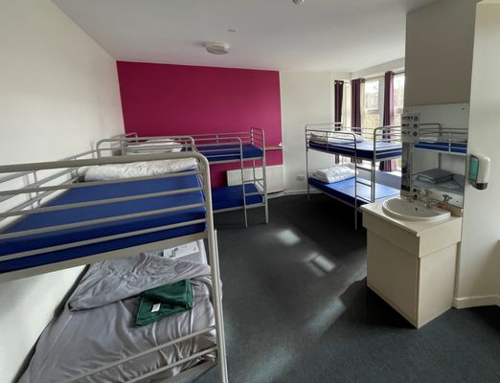
How are the groups made?
You will choose a few people you would like to be with and you in your group you will get at least 1 of those people. You are not guaranteed all of them!
Rooming will also be with the people in your activity group (split into boys and girls)
Meals and social time you can hang out with whoever you want.

Slide 21
Questions
Happy to answer any questions you may have about anything contained in this presentation, or anything I have not covered.

