Slide 1



8th December 2025
PHS
Business Afternoon Tea
Notes:
Improve on levels of anxiety for learners and parents.
Improve the integrity of our system especially for those who lack strong advocates at home.
Reduce the wasted resources of setting up supports that are not needed, wanted or sometimes not expected.
Increase accountability, responsibility and support for classroom teachers in meeting learners needs.

Slide 2
One Peebles - our Community
where we belong, grow and achieve
values - show kindness, contribute and work hard
If anyone can do this – we can
We have a strong community
We can realise this together
As an employer you can change a young person’s life
Notes:
Improve on levels of anxiety for learners and parents.
Improve the integrity of our system especially for those who lack strong advocates at home.
Reduce the wasted resources of setting up supports that are not needed, wanted or sometimes not expected.
Increase accountability, responsibility and support for classroom teachers in meeting learners needs.

Slide 3
Purpose:
  To show you how important local business experiences are for us
  To tell you about ways you can get involved with the school
  To let you know the role that DYW can play in helping with this
Notes:
Improve on levels of anxiety for learners and parents.
Improve the integrity of our system especially for those who lack strong advocates at home.
Reduce the wasted resources of setting up supports that are not needed, wanted or sometimes not expected.
Increase accountability, responsibility and support for classroom teachers in meeting learners needs.

Slide 4
School Context:
Vision and Values – The Curriculum as a Vehicle for Change
With the largest school and catchment of the Scottish Borders, Peebles High School is recognised at a local authority level as having a complex demographic. To plan a curriculum that caters for all, it is important to use data to understand both who we are as a school, and what destinations our young people reach upon leaving school.
We use a range of data to inform decisions about our curriculum
Notes:
Improve on levels of anxiety for learners and parents.
Improve the integrity of our system especially for those who lack strong advocates at home.
Reduce the wasted resources of setting up supports that are not needed, wanted or sometimes not expected.
Increase accountability, responsibility and support for classroom teachers in meeting learners needs.

Slide 5
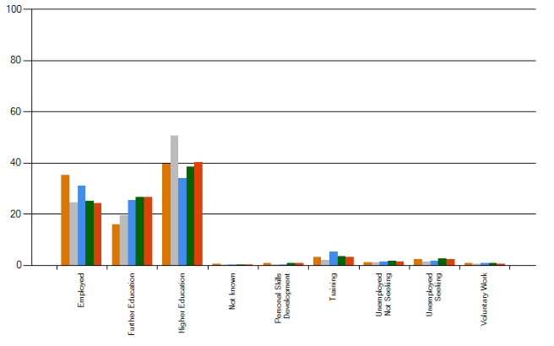
School Context:
PHS Typical Leaver Destinations
Notes:
Improve on levels of anxiety for learners and parents.
Improve the integrity of our system especially for those who lack strong advocates at home.
Reduce the wasted resources of setting up supports that are not needed, wanted or sometimes not expected.
Increase accountability, responsibility and support for classroom teachers in meeting learners needs.

Slide 6
School Context:
Pupil Subject Choices
Notes:
Improve on levels of anxiety for learners and parents.
Improve the integrity of our system especially for those who lack strong advocates at home.
Reduce the wasted resources of setting up supports that are not needed, wanted or sometimes not expected.
Increase accountability, responsibility and support for classroom teachers in meeting learners needs.

Slide 7
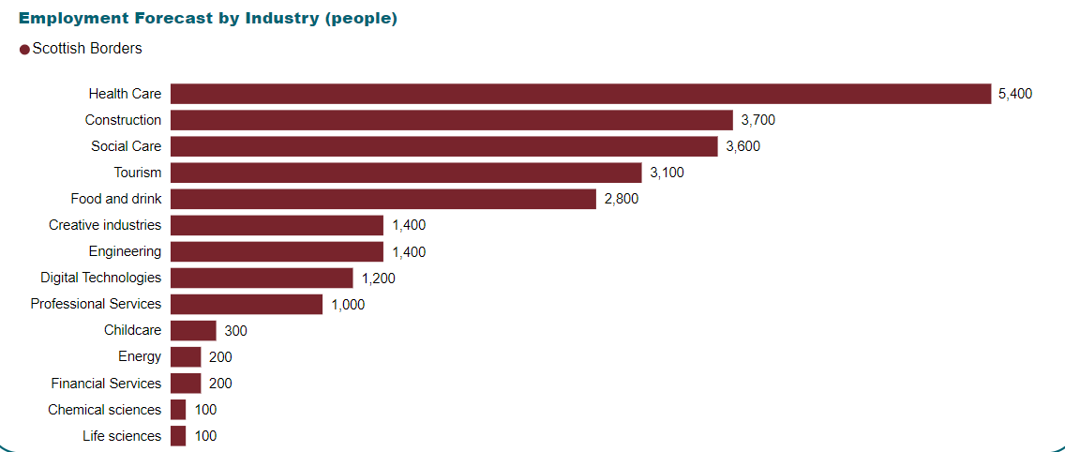

School Context:
Predicted Sector Needs
Notes:
Improve on levels of anxiety for learners and parents.
Improve the integrity of our system especially for those who lack strong advocates at home.
Reduce the wasted resources of setting up supports that are not needed, wanted or sometimes not expected.
Increase accountability, responsibility and support for classroom teachers in meeting learners needs.

Slide 8
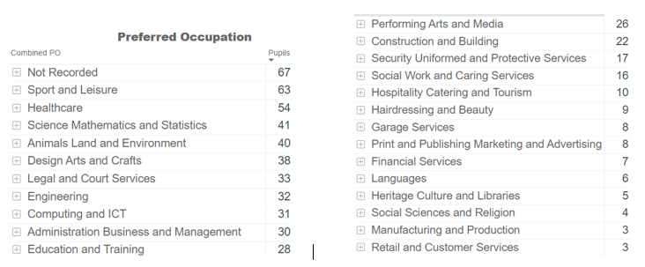
School Context:
PHS Recorded Preferred School Leaver Destinations (2024 data)
Notes:
Improve on levels of anxiety for learners and parents.
Improve the integrity of our system especially for those who lack strong advocates at home.
Reduce the wasted resources of setting up supports that are not needed, wanted or sometimes not expected.
Increase accountability, responsibility and support for classroom teachers in meeting learners needs.

Slide 9
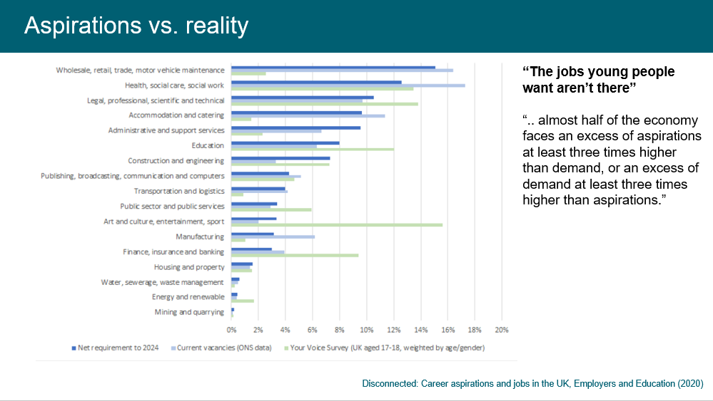
School Context:
Regional Skills Index of Sector Aspirations of Young People vs Reality
Notes:
Improve on levels of anxiety for learners and parents.
Improve the integrity of our system especially for those who lack strong advocates at home.
Reduce the wasted resources of setting up supports that are not needed, wanted or sometimes not expected.
Increase accountability, responsibility and support for classroom teachers in meeting learners needs.

Slide 10
School Context:
PHS Recorded Actual Learner Destinations (2024 data)
Job Title
Activities Assistant | Food and Beverage Assistant | Mobile Catering assistant
Apprentice pastry chef | Food factory worker | Porter
Apprentice Roofer | House Keeping | Professional Footballer
Bar staff | Kitchen Porter | Sales assistant
Biking | Kitchen staff | Team member
Cleaner | Labourer | Tesco colleague
Commis chef | Landscaper | Waiter/waitress
Customer support | Leisure Assitant | Waiter, Chef, Admin
Dance teacher | Live Borders | Waiter/Bike Maintenance
Notes:
Improve on levels of anxiety for learners and parents.
Improve the integrity of our system especially for those who lack strong advocates at home.
Reduce the wasted resources of setting up supports that are not needed, wanted or sometimes not expected.
Increase accountability, responsibility and support for classroom teachers in meeting learners needs.

Slide 11
School Context:
UCAS Destinations (2024)
Notes:
Improve on levels of anxiety for learners and parents.
Improve the integrity of our system especially for those who lack strong advocates at home.
Reduce the wasted resources of setting up supports that are not needed, wanted or sometimes not expected.
Increase accountability, responsibility and support for classroom teachers in meeting learners needs.

Slide 12
Where are we going now?
Employment-focused Curriculum Changes
S6 School Service | Recognition of existing achievements Raising expectation of senior phase | S6s wishing to undertake School Service rather than an additional subject asked to apply with a robust plan to explain how School Service would serve them better in their chosen pathway
Broadening of the Curriculum | Recognition of destination trends of our young people | Furniture Making Mountainbiking Skills for Work Courses Comms/Lit
Notes:
Improve on levels of anxiety for learners and parents.
Improve the integrity of our system especially for those who lack strong advocates at home.
Reduce the wasted resources of setting up supports that are not needed, wanted or sometimes not expected.
Increase accountability, responsibility and support for classroom teachers in meeting learners needs.

Slide 13
Where are we going now?
Employment-focused Curriculum Changes
DYW & Metaskills:
  The BGE Curriculum of Experiences
  S2 Academies Vision
Enhanced Transition Support - School Leaver Programme
Notes:
Improve on levels of anxiety for learners and parents.
Improve the integrity of our system especially for those who lack strong advocates at home.
Reduce the wasted resources of setting up supports that are not needed, wanted or sometimes not expected.
Increase accountability, responsibility and support for classroom teachers in meeting learners needs.

Slide 14
DYW Experience
Young People Involved
Notes:
Improve on levels of anxiety for learners and parents.
Improve the integrity of our system especially for those who lack strong advocates at home.
Reduce the wasted resources of setting up supports that are not needed, wanted or sometimes not expected.
Increase accountability, responsibility and support for classroom teachers in meeting learners needs.

Slide 15
DYW Experience
Local Businesses Involved
Notes:
Improve on levels of anxiety for learners and parents.
Improve the integrity of our system especially for those who lack strong advocates at home.
Reduce the wasted resources of setting up supports that are not needed, wanted or sometimes not expected.
Increase accountability, responsibility and support for classroom teachers in meeting learners needs.

Slide 16
How can you help support PHS?
Careers’ Fair
Talking to Young People in Subjects
Offering Workshops to Young People
Work Placements
Steering Group – different sector representatives
It can seem daunting– but you’re not on your own!
Notes:
Improve on levels of anxiety for learners and parents.
Improve the integrity of our system especially for those who lack strong advocates at home.
Reduce the wasted resources of setting up supports that are not needed, wanted or sometimes not expected.
Increase accountability, responsibility and support for classroom teachers in meeting learners needs.

Slide 17
Questions – and more snacks!
Notes:
Improve on levels of anxiety for learners and parents.
Improve the integrity of our system especially for those who lack strong advocates at home.
Reduce the wasted resources of setting up supports that are not needed, wanted or sometimes not expected.
Increase accountability, responsibility and support for classroom teachers in meeting learners needs.

