Slide 1

Baffles

Slide 2
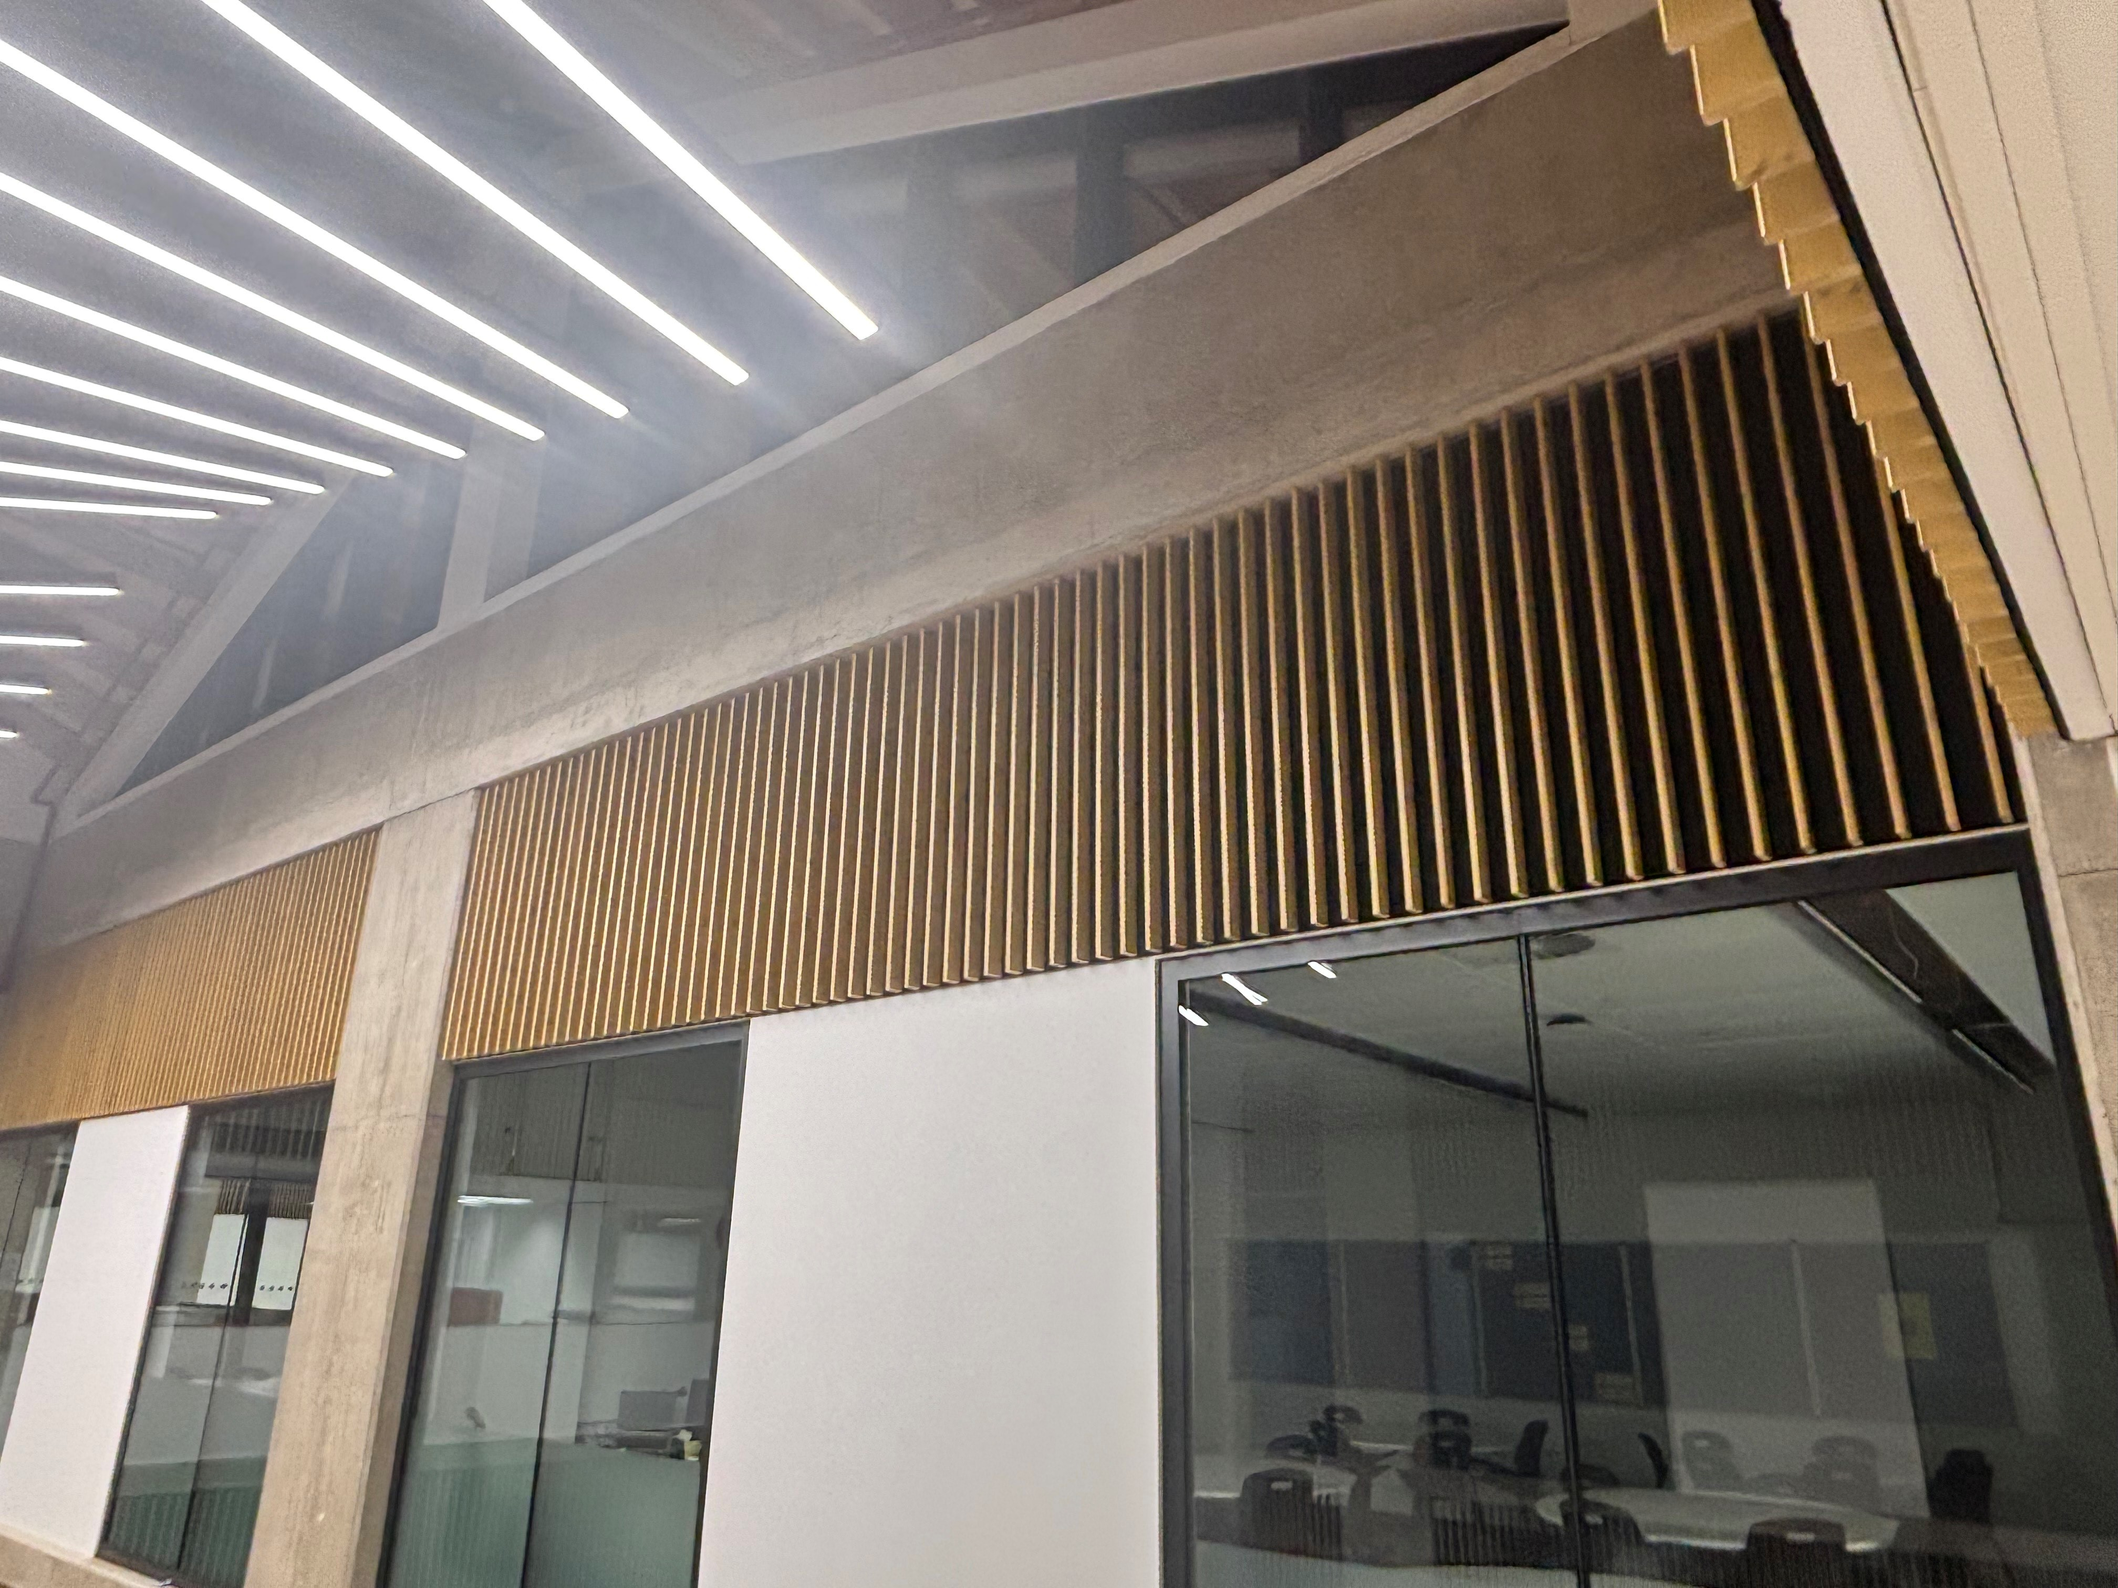

Slide 3
Assembly 21.11.25
New School is now OUR school!
We all need to be very proud of what we have achieved.
One Peebles in action.
Updates and expectations

Slide 4
One Peebles: our community where we belong, grow and achieve.
Notes:
As we settle in, there will be lots to get used to. This presentation and the accompanying information sheet is intended to cover the essentials for the first few days.

Slide 5
Contribute – even more!
Do you add value to our school community?
Work hard – even more!
Do you work the hardest on the things that make the biggest difference?
Show kindness – even more!
Have you noticed when someone might need support and tried to help?
Notes:
Movement around the school
There will be no bells to indicate the end of lessons.
Pupils will be released by teachers and need a permission slip to be out of class during lessons.
During lessons, the main entrance and exits are secured. At break and lunchtime, and during lessons if needed, all doors can be used to exit the building, but only the main entrance can be used to enter.
There is no one-way system, but we will all keep left to help the flow of people at busy times.
Move calmly and quietly around the building. High levels of noise can be overwhelming to some in our community, so show consideration and kindness by using a moderate volume at all times.
Be courteous and show consideration for others by holding doors and passing in single file when needed.
Use the four main staircases to move between floors. The amphitheatre steps are narrow, so avoid these as a route between floors between lessons.

Slide 6
Thank you for...
Adapting so well to our new building
Being calm and courteous in almost all cases
Working with us as we find the best ways to do things
Notes:
Movement around the school
There will be no bells to indicate the end of lessons.
Pupils will be released by teachers and need a permission slip to be out of class during lessons.
During lessons, the main entrance and exits are secured. At break and lunchtime, and during lessons if needed, all doors can be used to exit the building, but only the main entrance can be used to enter.
There is no one-way system, but we will all keep left to help the flow of people at busy times.
Move calmly and quietly around the building. High levels of noise can be overwhelming to some in our community, so show consideration and kindness by using a moderate volume at all times.
Be courteous and show consideration for others by holding doors and passing in single file when needed.
Use the four main staircases to move between floors. The amphitheatre steps are narrow, so avoid these as a route between floors between lessons.

Slide 7
Reminders...
Movement round school
Remember to keep left, especially on stairs
Move calmly and quietly – Show consideration to those in double periods
Use 4 main staircases to move between floors
Avoid Amphitheatre steps – safety concern
At break, lunch and end of day, use external doors to leave the building
Notes:
Movement around the school
There will be no bells to indicate the end of lessons.
Pupils will be released by teachers and need a permission slip to be out of class during lessons.
During lessons, the main entrance and exits are secured. At break and lunchtime, and during lessons if needed, all doors can be used to exit the building, but only the main entrance can be used to enter.
There is no one-way system, but we will all keep left to help the flow of people at busy times.
Move calmly and quietly around the building. High levels of noise can be overwhelming to some in our community, so show consideration and kindness by using a moderate volume at all times.
Be courteous and show consideration for others by holding doors and passing in single file when needed.
Use the four main staircases to move between floors. The amphitheatre steps are narrow, so avoid these as a route between floors between lessons.

Slide 8
Reminders...
Movement round school
Room 128 and Room 131
Thank you for not walking through during a period
Thank you for not using the amphitheatre steps as room 128 is at the top of the amphitheatre and this is disruptive
Out of class slips and no phones
Notes:
Movement around the school
There will be no bells to indicate the end of lessons.
Pupils will be released by teachers and need a permission slip to be out of class during lessons.
During lessons, the main entrance and exits are secured. At break and lunchtime, and during lessons if needed, all doors can be used to exit the building, but only the main entrance can be used to enter.
There is no one-way system, but we will all keep left to help the flow of people at busy times.
Move calmly and quietly around the building. High levels of noise can be overwhelming to some in our community, so show consideration and kindness by using a moderate volume at all times.
Be courteous and show consideration for others by holding doors and passing in single file when needed.
Use the four main staircases to move between floors. The amphitheatre steps are narrow, so avoid these as a route between floors between lessons.

Slide 9
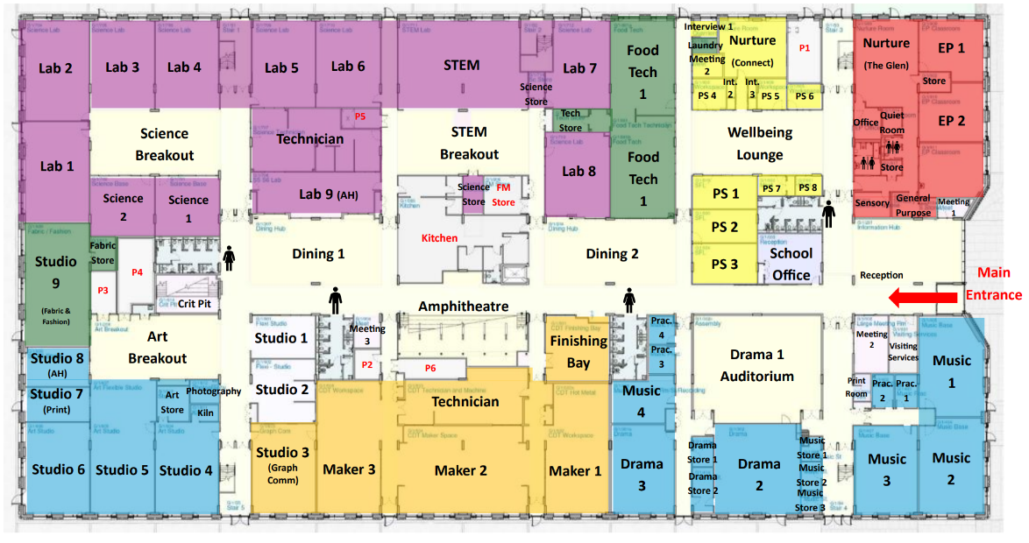


Movement round school - staircases
Ground Floor
Notes:
Use 4 main staircases.
Avoid Amphitheatre steps for moving between floors.

Slide 10
Out of class
Minimise time out of class during lessons
Minimise distance travelled
Avoid passing by open classrooms if possible
Notes:
Movement around the school
There will be no bells to indicate the end of lessons.
Pupils will be released by teachers and need a permission slip to be out of class during lessons.
During lessons, the main entrance and exits are secured. At break and lunchtime, and during lessons if needed, all doors can be used to exit the building, but only the main entrance can be used to enter.
There is no one-way system, but we will all keep left to help the flow of people at busy times.
Move calmly and quietly around the building. High levels of noise can be overwhelming to some in our community, so show consideration and kindness by using a moderate volume at all times.
Be courteous and show consideration for others by holding doors and passing in single file when needed.
Use the four main staircases to move between floors. The amphitheatre steps are narrow, so avoid these as a route between floors between lessons.

Slide 11
Social Areas
7 Social spaces on Ground Floor
Stay in these spaces until 8.45am
Food and water allowed at break and lunch
Tidy up behind you – leave no trace!
Notes:
Social areas
During periods of good weather, pupils are encouraged to move outside during social times. This will be made easier on completion of the demolition and landscaping phase.
Pupils may use the two Dining areas, Amphitheatre, front door Information Hub area and Wellbeing Lounge during break and lunch.
Food is allowed in these areas. All litter must be put in bins. Leave no trace!
Prefects will supervise these five social spaces.
The Wellbeing Lounge is a quiet zone.
No food should be eaten out with these areas, unless attending a supervised club or activity.
Pupils can also use the Library during break and lunch, but no food or water is allowed in this space.
The Hub space beside the Library is for S6 only during break and lunchtime. Food can be consumed here at these times as long as no mess is left. This will be under review.
Social spaces are for everyone to enjoy so treat them and the people in them with consideration and respect.

Slide 12


Social Areas – Food and drink allowed
Ground Floor
Notes:
Information Hub, Wellbeing Lounge, Dining areas and amphitheatre – food and drink allowed

Slide 13
Social Areas
6 Social spaces on First Floor
Stay in these spaces until 8.45am
No food and water allowed
Prefects may have lunch as they are working
Minimising mess - under review
Notes:
Social areas
During periods of good weather, pupils are encouraged to move outside during social times. This will be made easier on completion of the demolition and landscaping phase.
Pupils may use the two Dining areas, Amphitheatre, front door Information Hub area and Wellbeing Lounge during break and lunch.
Food is allowed in these areas. All litter must be put in bins. Leave no trace!
Prefects will supervise these five social spaces.
The Wellbeing Lounge is a quiet zone.
No food should be eaten out with these areas, unless attending a supervised club or activity.
Pupils can also use the Library during break and lunch, but no food or water is allowed in this space.
The Hub space beside the Library is for S6 only during break and lunchtime. Food can be consumed here at these times as long as no mess is left. This will be under review.
Social spaces are for everyone to enjoy so treat them and the people in them with consideration and respect.

Slide 14
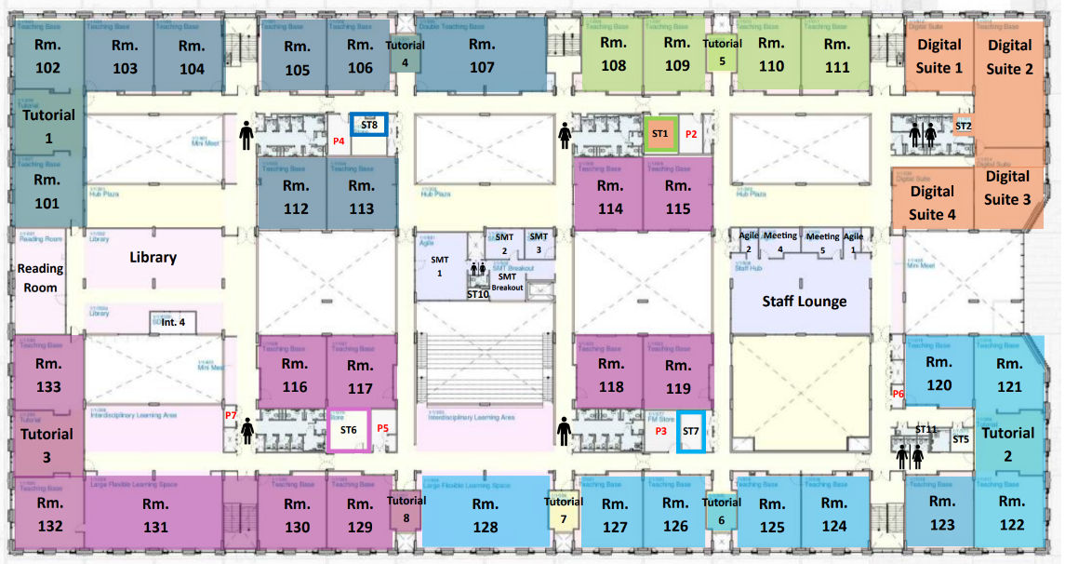
Social Areas – no food or drink allowed
First Floor
Notes:
For everyone at break and lunch Library – no food or drink allowed

Slide 15
Canteen
Single morning break 10.30-10.45
Busier but generally working well
Move on after eating? – make space for others
Go outside for fresh air for 15 minutes?
Consider "Grab & Go"
Bring snack as back up just in case
Notes:
Canteen
There will be a single morning break from 10.30-10.45 Monday to Thursday and 10.30-10.50 on Friday.
The canteen is likely to be busier than usual while we establish new routines.
There are two serving areas in the canteen and queuing systems will be in place. Follow instructions from Prefects regarding queueing. Pupils not willing to wait their turn will be asked to leave the canteen.
Pupils are requested to sit down when eating in the canteen. Tables should be cleared of plates, litter etc after use.
The Grab and Go system is worth considering, to minimise your queueing time.
Please be patient while our SLT, Prefect and Canteen teams establish the best way to organise queueing and distribution of Grab and Go in our new space.
The canteen will be busy, especially at morning break so it may be worth bringing a snack to ensure you will have something to eat until we can establish a reliable routine.

Slide 16
Toilets
Issue with bins – more are coming
Sanitary products available in accessible female toilets (more space)
No sanitary bins – instead, use bags provided and deposit in normal bin
Notes:
Toilets
All cubicles are fully self-contained with a toilet and sink.
Pupils wanting to use the toilets during lesson time require a permission slip (or toilet card) to be out of class.
There are four male and four female blocks of toilets (two of each on each floor) as well as gender neutral toilets on the first floor by Social Subjects.
Accessible toilets are located in all toilet blocks, and available for pupils and staff.
The toilets next to BCT are for staff only.
Look after your brand-new toilets, as we’ve waited a long time to get them!
CCTV monitors the corridor entry to toilet blocks.

Slide 17


Toilets – Ground Floor
Ground Floor
Notes:
Ground floor toilets

Slide 18


Toilets – First Floor – BCT toilets for staff use
First Floor
Notes:
First floor toilets

Slide 19
S5/6 Study Spaces – Quiet areas
S5 – Supervised study in Dining areas
S6 – Study areas
    Library
    Reading Room (silent)
    Library Plaza
Quiet study important to minimise disturbance to open classrooms
Notes:
Study spaces
The S6 study spaces are the Library, Reading Room and Library Hub during lesson time.
The S5 supervised study space is the Dining Areas. This will be a silent study space.
S5/6 Parking
There is very limited parking on site due to the demolition of the old building.
No pupil cars permitted on school grounds at any time and should not be parked near the school on Springwood Road for safety reasons.

Slide 20
Litter and Chewing Gum
More bins are coming
No litter and no chewing gum
Keep our new building looking good for everyone to enjoy
Notes:
Litter
Our new school is a chance to raise our standards.
We all deserve to have a clean and inviting environment, inside and outside school.
Please use the litter bins provided and encourage each other to do the same.
It is your school so have high expectations of each other and challenge those who fall short of our shared values.
Chewing gum
Chewing gum is not allowed in the new building. Please help us to keep the building looking good for everyone to enjoy.

Slide 21
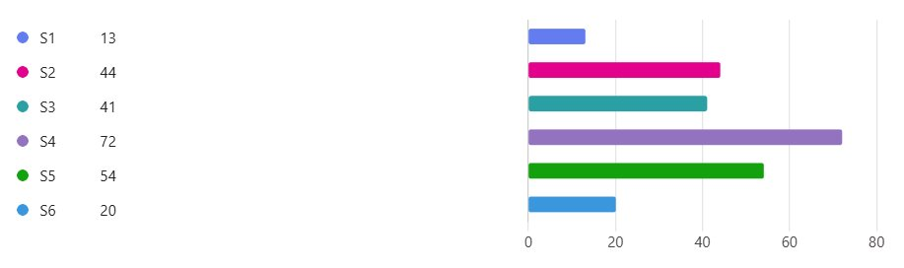
Review process
Ongoing review to tweak processes
244 pupils completed Form so far (on Teams)
Notes:
Review process
It will take time to iron out some of the details of how we use our new school.
The plans above will be reviewed at the end of November, and sooner if particular issues are identified.
Your feedback on what is working well, what is not working as we had hoped, and suggested solutions will be welcome from day 1.
A QR code and link to a Feedback Form will be shared on year group Teams, and with parents and carers, and a drop box will be placed at reception for those who like to do things old school!
Change can sometimes be a challenge. You can contact your Pastoral teacher, or any member of staff, if you need support at any time.
Prefects will also be on hand to offer day-to-day support and directions. You may well get lost at some point over the next few weeks, but we’ll all be lost together!

Slide 22
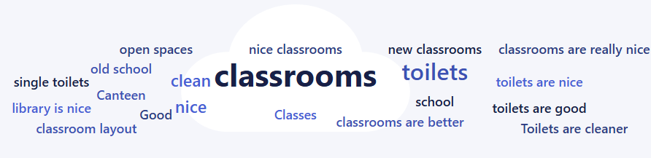
Review process – Working well?
Notes:
Review process
It will take time to iron out some of the details of how we use our new school.
The plans above will be reviewed at the end of November, and sooner if particular issues are identified.
Your feedback on what is working well, what is not working as we had hoped, and suggested solutions will be welcome from day 1.
A QR code and link to a Feedback Form will be shared on year group Teams, and with parents and carers, and a drop box will be placed at reception for those who like to do things old school!
Change can sometimes be a challenge. You can contact your Pastoral teacher, or any member of staff, if you need support at any time.
Prefects will also be on hand to offer day-to-day support and directions. You may well get lost at some point over the next few weeks, but we’ll all be lost together!

Slide 23
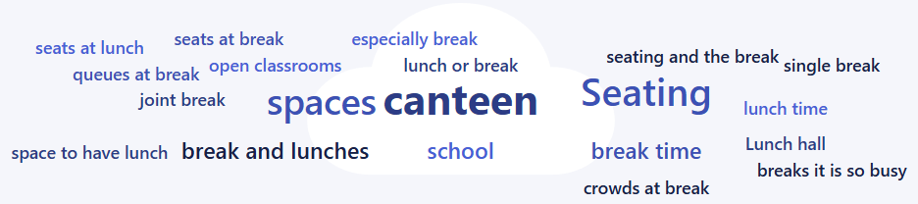
Review process – Not working as well?
Notes:
Review process
It will take time to iron out some of the details of how we use our new school.
The plans above will be reviewed at the end of November, and sooner if particular issues are identified.
Your feedback on what is working well, what is not working as we had hoped, and suggested solutions will be welcome from day 1.
A QR code and link to a Feedback Form will be shared on year group Teams, and with parents and carers, and a drop box will be placed at reception for those who like to do things old school!
Change can sometimes be a challenge. You can contact your Pastoral teacher, or any member of staff, if you need support at any time.
Prefects will also be on hand to offer day-to-day support and directions. You may well get lost at some point over the next few weeks, but we’ll all be lost together!

Slide 24
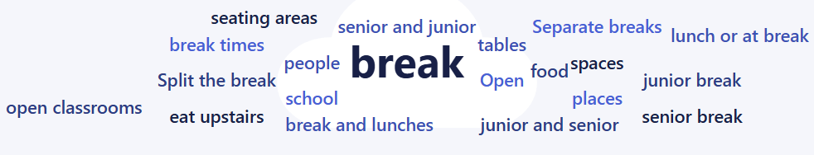
Review process – Suggestions?
Notes:
Review process
It will take time to iron out some of the details of how we use our new school.
The plans above will be reviewed at the end of November, and sooner if particular issues are identified.
Your feedback on what is working well, what is not working as we had hoped, and suggested solutions will be welcome from day 1.
A QR code and link to a Feedback Form will be shared on year group Teams, and with parents and carers, and a drop box will be placed at reception for those who like to do things old school!
Change can sometimes be a challenge. You can contact your Pastoral teacher, or any member of staff, if you need support at any time.
Prefects will also be on hand to offer day-to-day support and directions. You may well get lost at some point over the next few weeks, but we’ll all be lost together!

Slide 25
We will stick with one break:-
It is much easier to run the school.
There are actually more seats than in old school.
There are more open spaces so not a good idea to have pupils on break while other pupils are learning.
Other big schools can manage.
We are getting a 3rd servery in canteen.
What can you do? Go outside for a walk, bring a snack
Notes:
Review process
It will take time to iron out some of the details of how we use our new school.
The plans above will be reviewed at the end of November, and sooner if particular issues are identified.
Your feedback on what is working well, what is not working as we had hoped, and suggested solutions will be welcome from day 1.
A QR code and link to a Feedback Form will be shared on year group Teams, and with parents and carers, and a drop box will be placed at reception for those who like to do things old school!
Change can sometimes be a challenge. You can contact your Pastoral teacher, or any member of staff, if you need support at any time.
Prefects will also be on hand to offer day-to-day support and directions. You may well get lost at some point over the next few weeks, but we’ll all be lost together!

Slide 26
Next:- we will live in the place for a while before making decisions about things
Still to come:-
Getting the screens in reception and amphitheatre set up
More furniture
Dux Board coming over
A new trophy cabinet
A new mural in reception corridor
Notes:
Review process
It will take time to iron out some of the details of how we use our new school.
The plans above will be reviewed at the end of November, and sooner if particular issues are identified.
Your feedback on what is working well, what is not working as we had hoped, and suggested solutions will be welcome from day 1.
A QR code and link to a Feedback Form will be shared on year group Teams, and with parents and carers, and a drop box will be placed at reception for those who like to do things old school!
Change can sometimes be a challenge. You can contact your Pastoral teacher, or any member of staff, if you need support at any time.
Prefects will also be on hand to offer day-to-day support and directions. You may well get lost at some point over the next few weeks, but we’ll all be lost together!

Slide 27
We are still working out where to put:-​
Hall of Heroes​
S6 photos
Notes:
Review process
It will take time to iron out some of the details of how we use our new school.
The plans above will be reviewed at the end of November, and sooner if particular issues are identified.
Your feedback on what is working well, what is not working as we had hoped, and suggested solutions will be welcome from day 1.
A QR code and link to a Feedback Form will be shared on year group Teams, and with parents and carers, and a drop box will be placed at reception for those who like to do things old school!
Change can sometimes be a challenge. You can contact your Pastoral teacher, or any member of staff, if you need support at any time.
Prefects will also be on hand to offer day-to-day support and directions. You may well get lost at some point over the next few weeks, but we’ll all be lost together!

Slide 28
The old school:-
Friends of PHS Charity
Auctioned and sold hundreds of items from the old school
Keeping parts of PHS in the community
Raised a lot of money for you already!!
A great story of recycling and raising money
We gave a lot of furniture and equipment to other schools and local groups
Notes:
Review process
It will take time to iron out some of the details of how we use our new school.
The plans above will be reviewed at the end of November, and sooner if particular issues are identified.
Your feedback on what is working well, what is not working as we had hoped, and suggested solutions will be welcome from day 1.
A QR code and link to a Feedback Form will be shared on year group Teams, and with parents and carers, and a drop box will be placed at reception for those who like to do things old school!
Change can sometimes be a challenge. You can contact your Pastoral teacher, or any member of staff, if you need support at any time.
Prefects will also be on hand to offer day-to-day support and directions. You may well get lost at some point over the next few weeks, but we’ll all be lost together!

Slide 29
Coming up ...
Concert
Dances
We are One Peebles: our community where we belong, grow and achieve.
Notes:
Review process
It will take time to iron out some of the details of how we use our new school.
The plans above will be reviewed at the end of November, and sooner if particular issues are identified.
Your feedback on what is working well, what is not working as we had hoped, and suggested solutions will be welcome from day 1.
A QR code and link to a Feedback Form will be shared on year group Teams, and with parents and carers, and a drop box will be placed at reception for those who like to do things old school!
Change can sometimes be a challenge. You can contact your Pastoral teacher, or any member of staff, if you need support at any time.
Prefects will also be on hand to offer day-to-day support and directions. You may well get lost at some point over the next few weeks, but we’ll all be lost together!

Slide 30
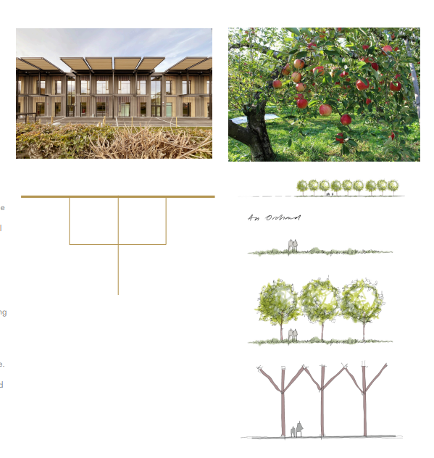
Tree of learning in an orchard of learning
Tree of learning
We are One Peebles: our community where we belong, grow and achieve.
Notes:
Review process
It will take time to iron out some of the details of how we use our new school.
The plans above will be reviewed at the end of November, and sooner if particular issues are identified.
Your feedback on what is working well, what is not working as we had hoped, and suggested solutions will be welcome from day 1.
A QR code and link to a Feedback Form will be shared on year group Teams, and with parents and carers, and a drop box will be placed at reception for those who like to do things old school!
Change can sometimes be a challenge. You can contact your Pastoral teacher, or any member of staff, if you need support at any time.
Prefects will also be on hand to offer day-to-day support and directions. You may well get lost at some point over the next few weeks, but we’ll all be lost together!

Slide 31
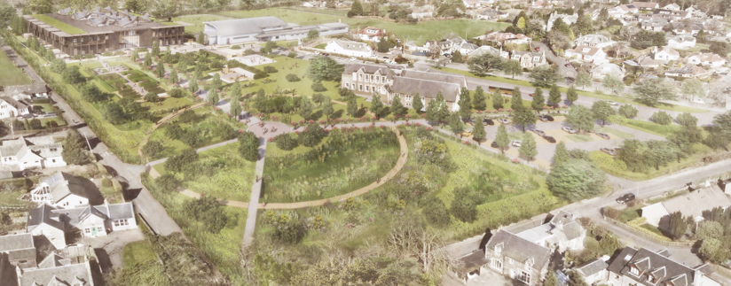
Phase 2
We are One Peebles: our community where we belong, grow and achieve.
Notes:
Review process
It will take time to iron out some of the details of how we use our new school.
The plans above will be reviewed at the end of November, and sooner if particular issues are identified.
Your feedback on what is working well, what is not working as we had hoped, and suggested solutions will be welcome from day 1.
A QR code and link to a Feedback Form will be shared on year group Teams, and with parents and carers, and a drop box will be placed at reception for those who like to do things old school!
Change can sometimes be a challenge. You can contact your Pastoral teacher, or any member of staff, if you need support at any time.
Prefects will also be on hand to offer day-to-day support and directions. You may well get lost at some point over the next few weeks, but we’ll all be lost together!

Slide 32
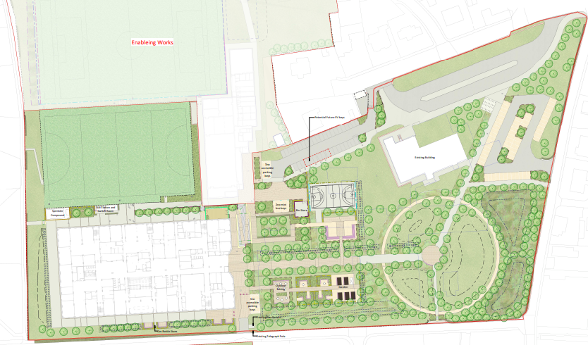
Phase 2
We are One Peebles: our community where we belong, grow and achieve.
Notes:
Review process
It will take time to iron out some of the details of how we use our new school.
The plans above will be reviewed at the end of November, and sooner if particular issues are identified.
Your feedback on what is working well, what is not working as we had hoped, and suggested solutions will be welcome from day 1.
A QR code and link to a Feedback Form will be shared on year group Teams, and with parents and carers, and a drop box will be placed at reception for those who like to do things old school!
Change can sometimes be a challenge. You can contact your Pastoral teacher, or any member of staff, if you need support at any time.
Prefects will also be on hand to offer day-to-day support and directions. You may well get lost at some point over the next few weeks, but we’ll all be lost together!

Slide 33

Questions?
We are One Peebles: our community where we belong, grow and achieve.
Notes:
Review process
It will take time to iron out some of the details of how we use our new school.
The plans above will be reviewed at the end of November, and sooner if particular issues are identified.
Your feedback on what is working well, what is not working as we had hoped, and suggested solutions will be welcome from day 1.
A QR code and link to a Feedback Form will be shared on year group Teams, and with parents and carers, and a drop box will be placed at reception for those who like to do things old school!
Change can sometimes be a challenge. You can contact your Pastoral teacher, or any member of staff, if you need support at any time.
Prefects will also be on hand to offer day-to-day support and directions. You may well get lost at some point over the next few weeks, but we’ll all be lost together!

