Slide 1

Assembly 5.11.25
New School,
New Chapter for PHS
Pupil Information and Expectations

Slide 2
One Peebles: our community where we belong, grow and achieve.
Notes:
As we settle in, there will be lots to get used to. This presentation and the accompanying information sheet is intended to cover the essentials for the first few days.

Slide 3
Day 1
Open as usual to pupils from 8am.
Enter the building through the main entrance. All other doors are exits only.
ASN drop off zone at the top of the car park Stick to the path and don't walk across it.
Maps of the school have been shared on year group Teams and GroupCall.
Notes:
Day 1
The new school will be open as usual to pupils from 8am.
You should enter the building through the main entrance. All other doors are exits only.
The top of the car park nearest the school is the new ASN drop off zone. Do not walk through the car park as vehicles will be manoeuvring and space is tight. Stay on the designated path from the Bus D to the main entrance.
Please remain in the lower floor social areas until 8.40am.
Maps of the school have been shared on year group Teams and GroupCall.

Slide 4
Readiness to learn
Bring your iPad fully charged and the resources you need for learning. Proxy reset needed.
Limited access to sockets for charging.
We always work hard, show kindness and contribute.
Notes:
Readiness to learn
Pupils should come to school each day with a charged iPad and the resources needed for learning.
You will likely need to rest your Proxy Settings the first time you connect to the new WiFi network.
We always work hard, show kindness and contribute.

Slide 5
Movement round school
No bells
Keep left
Move calmly and quietly
Be courteous and show consideration
Use 4 main staircases to move between floors
Avoid Amphitheatre steps
Notes:
Movement around the school
There will be no bells to indicate the end of lessons.
Pupils will be released by teachers and need a permission slip to be out of class during lessons.
During lessons, the main entrance and exits are secured. At break and lunchtime, and during lessons if needed, all doors can be used to exit the building, but only the main entrance can be used to enter.
There is no one-way system, but we will all keep left to help the flow of people at busy times.
Move calmly and quietly around the building. High levels of noise can be overwhelming to some in our community, so show consideration and kindness by using a moderate volume at all times.
Be courteous and show consideration for others by holding doors and passing in single file when needed.
Use the four main staircases to move between floors. The amphitheatre steps are narrow, so avoid these as a route between floors between lessons.

Slide 6
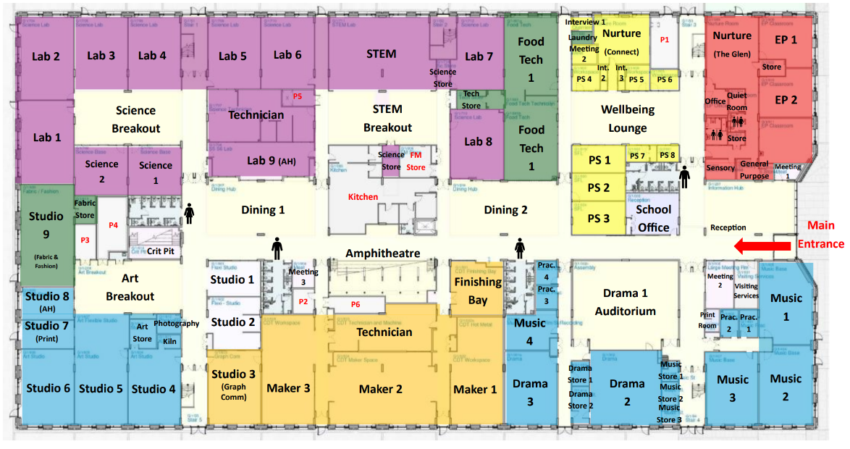


Movement round school - staircases
Ground Floor
Notes:
Use 4 main staircases.
Avoid Amphitheatre steps for moving between floors.

Slide 7
Social Areas
5 Social spaces on Ground Floor
Stay in these spaces until 8.40am
Food and water allowed at break and lunch
Tidy up behind you – leave no trace!
Library also available at break and lunch – no food and water allowed
Notes:
Social areas
During periods of good weather, pupils are encouraged to move outside during social times. This will be made easier on completion of the demolition and landscaping phase.
Pupils may use the two Dining areas, Amphitheatre, front door Information Hub area and Wellbeing Lounge during break and lunch.
Food is allowed in these areas. All litter must be put in bins. Leave no trace!
Prefects will supervise these five social spaces.
The Wellbeing Lounge is a quiet zone.
No food should be eaten out with these areas, unless attending a supervised club or activity.
Pupils can also use the Library during break and lunch, but no food or water is allowed in this space.
The Hub space beside the Library is for S6 only during break and lunchtime. Food can be consumed here at these times as long as no mess is left. This will be under review.
Social spaces are for everyone to enjoy so treat them and the people in them with consideration and respect.

Slide 8

Social Areas – Food and water allowed
Ground Floor
Notes:
Information Hub, Wellbeing Lounge, Dining areas and amphitheatre – food and water allowed

Slide 9
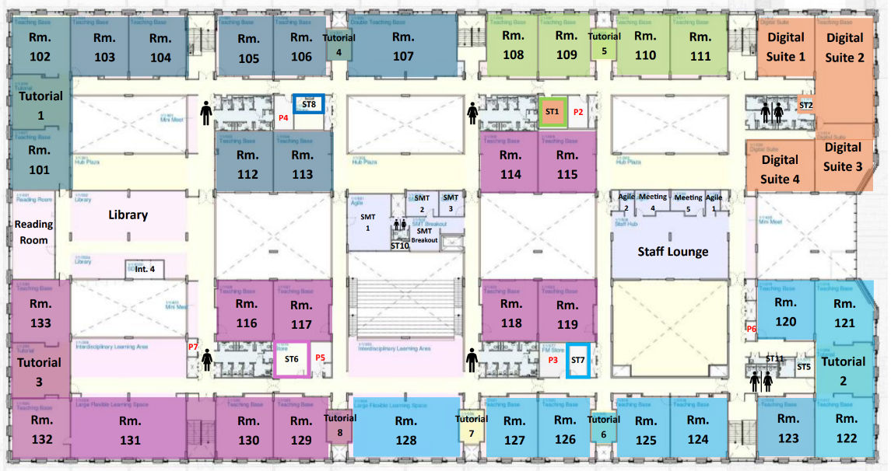
Social Areas – no food or water allowed
First Floor
Notes:
For everyone at break and lunch Library – no food or water allowed

Slide 10
Canteen
Single morning break 10.30-10.45
2 Canteen serving hatches
Queue along corridors as instructed
Always follow instructions from Prefects
Sit down at dining tables or in Amphitheatre when eating
Notes:
Canteen
There will be a single morning break from 10.30-10.45 Monday to Thursday and 10.30-10.50 on Friday.
The canteen is likely to be busier than usual while we establish new routines.
There are two serving areas in the canteen and queuing systems will be in place. Follow instructions from Prefects regarding queueing. Pupils not willing to wait their turn will be asked to leave the canteen.
Pupils are requested to sit down when eating in the canteen. Tables should be cleared of plates, litter etc after use.
The Grab and Go system is worth considering, to minimise your queueing time.
Please be patient while our SLT, Prefect and Canteen teams establish the best way to organise queueing and distribution of Grab and Go in our new space.
The canteen will be busy, especially at morning break so it may be worth bringing a snack to ensure you will have something to eat until we can establish a reliable routine.

Slide 11
Canteen
Consider "Grab & Go" to minimise queueing time?
Bring a snack for first few days until we can establish a new routine
Tidy up behind you – leave no trace
Notes:
Canteen
There will be a single morning break from 10.30-10.45 Monday to Thursday and 10.30-10.50 on Friday.
The canteen is likely to be busier than usual while we establish new routines.
There are two serving areas in the canteen and queuing systems will be in place. Follow instructions from Prefects regarding queueing. Pupils not willing to wait their turn will be asked to leave the canteen.
Pupils are requested to sit down when eating in the canteen. Tables should be cleared of plates, litter etc after use.
The Grab and Go system is worth considering, to minimise your queueing time.
Please be patient while our SLT, Prefect and Canteen teams establish the best way to organise queueing and distribution of Grab and Go in our new space.
The canteen will be busy, especially at morning break so it may be worth bringing a snack to ensure you will have something to eat until we can establish a reliable routine.

Slide 12
No-access areas
No access to teaching or break out spaces at break or lunch unless at club or supervised activity
No access to the first floor at break and lunch apart from Library and Toilets
We respect the community in which we live
Notes:
No-access areas
No pupils should be in any teaching or breakout learning space/classroom area at break or lunchtime unless they have an invitation and supervision from a member of staff.
There is no access to CDT, Science breakout or Art breakout spaces during break and lunchtime. There is no seating/furniture in the science and art breakout spaces at present so these will not be available as a social space to begin with.
Pupils should not gather near or sit on garden walls of neighbouring properties.
Neighbours’ gardens/properties are strictly out of bounds and should not be entered or passed through for any reason.
Ball games are allowed only in school sports fields where they do not pose a risk to windows or cars, and do not cause annoyance to our neighbours.
We respect the community in which we live at all times.

Slide 13
Toilets
2 male and 2 female toilet blocks on each floor
Gender neutral block on first floor at Social Subjects
Staff toilets at BCT
All cubicles self-contained with toilet and sink
Notes:
Toilets
All cubicles are fully self-contained with a toilet and sink.
Pupils wanting to use the toilets during lesson time require a permission slip (or toilet card) to be out of class.
There are four male and four female blocks of toilets (two of each on each floor) as well as gender neutral toilets on the first floor by Social Subjects.
Accessible toilets are located in all toilet blocks, and available for pupils and staff.
The toilets next to BCT are for staff only.
Look after your brand-new toilets, as we’ve waited a long time to get them!
CCTV monitors the corridor entry to toilet blocks.

Slide 14


Toilets – Ground Floor
Ground Floor
Notes:
Ground floor toilets

Slide 15


Toilets – First Floor
First Floor
Notes:
First floor toilets

Slide 16
S5/6 Study Spaces and Parking
S5 – Supervised study in Dining areas
S6 – Study areas
    Library
    Reading Room (silent)
    Library Plaza
No pupil cars on or near school grounds
Notes:
Study spaces
The S6 study spaces are the Library, Reading Room and Library Hub during lesson time.
The S5 supervised study space is the Dining Areas. This will be a silent study space.
S5/6 Parking
There is very limited parking on site due to the demolition of the old building.
No pupil cars permitted on school grounds at any time and should not be parked near the school on Springwood Road for safety reasons.

Slide 17
Fire Alarm
No bells – fire alarm will sound in an emergency
Fire curtains will drop in balcony areas
New evacuation routes will be shared
Same muster points on 2G pitch
First drill on Thursday 13th November
Notes:
Fire alarm
There are no bells so an alarm will only sound in an emergency.
During the fire alarm, fire curtains will drop from the ceiling in balcony areas.
For this reason, pupils should not lean on the balconies or place personal items on them at any time.
New evacuation routes will be shared.
Previous muster points on the 2G pitch remain unchanged.
There will be a fire drill on the Thursday of the first week.

Slide 18
Litter and Chewing Gum
The move to the new school is a chance to raise standards
No litter and no chewing gum
Keep our new building looking good for everyone to enjoy
Notes:
Litter
Our new school is a chance to raise our standards.
We all deserve to have a clean and inviting environment, inside and outside school.
Please use the litter bins provided and encourage each other to do the same.
It is your school so have high expectations of each other and challenge those who fall short of our shared values.
Chewing gum
Chewing gum is not allowed in the new building. Please help us to keep the building looking good for everyone to enjoy.

Slide 19
Review process
Plans will be reviewed at the end of November
Feedback welcome on -
    What's working well?
    What's not working as we'd hoped?
    Possible solutions?
QR code and Feedback Form link in Teams
Drop box in reception
Notes:
Review process
It will take time to iron out some of the details of how we use our new school.
The plans above will be reviewed at the end of November, and sooner if particular issues are identified.
Your feedback on what is working well, what is not working as we had hoped, and suggested solutions will be welcome from day 1.
A QR code and link to a Feedback Form will be shared on year group Teams, and with parents and carers, and a drop box will be placed at reception for those who like to do things old school!
Change can sometimes be a challenge. You can contact your Pastoral teacher, or any member of staff, if you need support at any time.
Prefects will also be on hand to offer day-to-day support and directions. You may well get lost at some point over the next few weeks, but we’ll all be lost together!

Slide 20

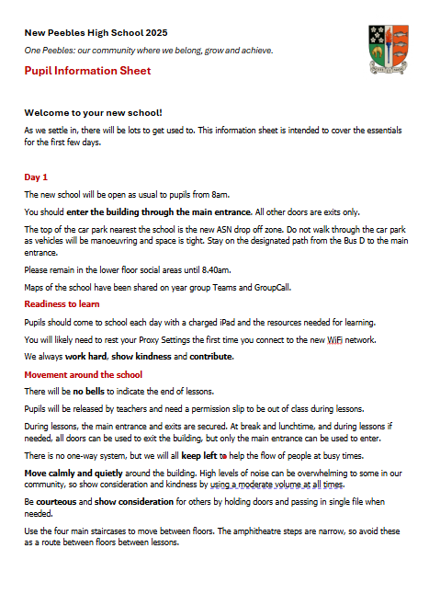
Questions?
PHS Pupil Information Sheet 2025
We are One Peebles: our community where we belong, grow and achieve.
Notes:
Review process
It will take time to iron out some of the details of how we use our new school.
The plans above will be reviewed at the end of November, and sooner if particular issues are identified.
Your feedback on what is working well, what is not working as we had hoped, and suggested solutions will be welcome from day 1.
A QR code and link to a Feedback Form will be shared on year group Teams, and with parents and carers, and a drop box will be placed at reception for those who like to do things old school!
Change can sometimes be a challenge. You can contact your Pastoral teacher, or any member of staff, if you need support at any time.
Prefects will also be on hand to offer day-to-day support and directions. You may well get lost at some point over the next few weeks, but we’ll all be lost together!

