Slide 1
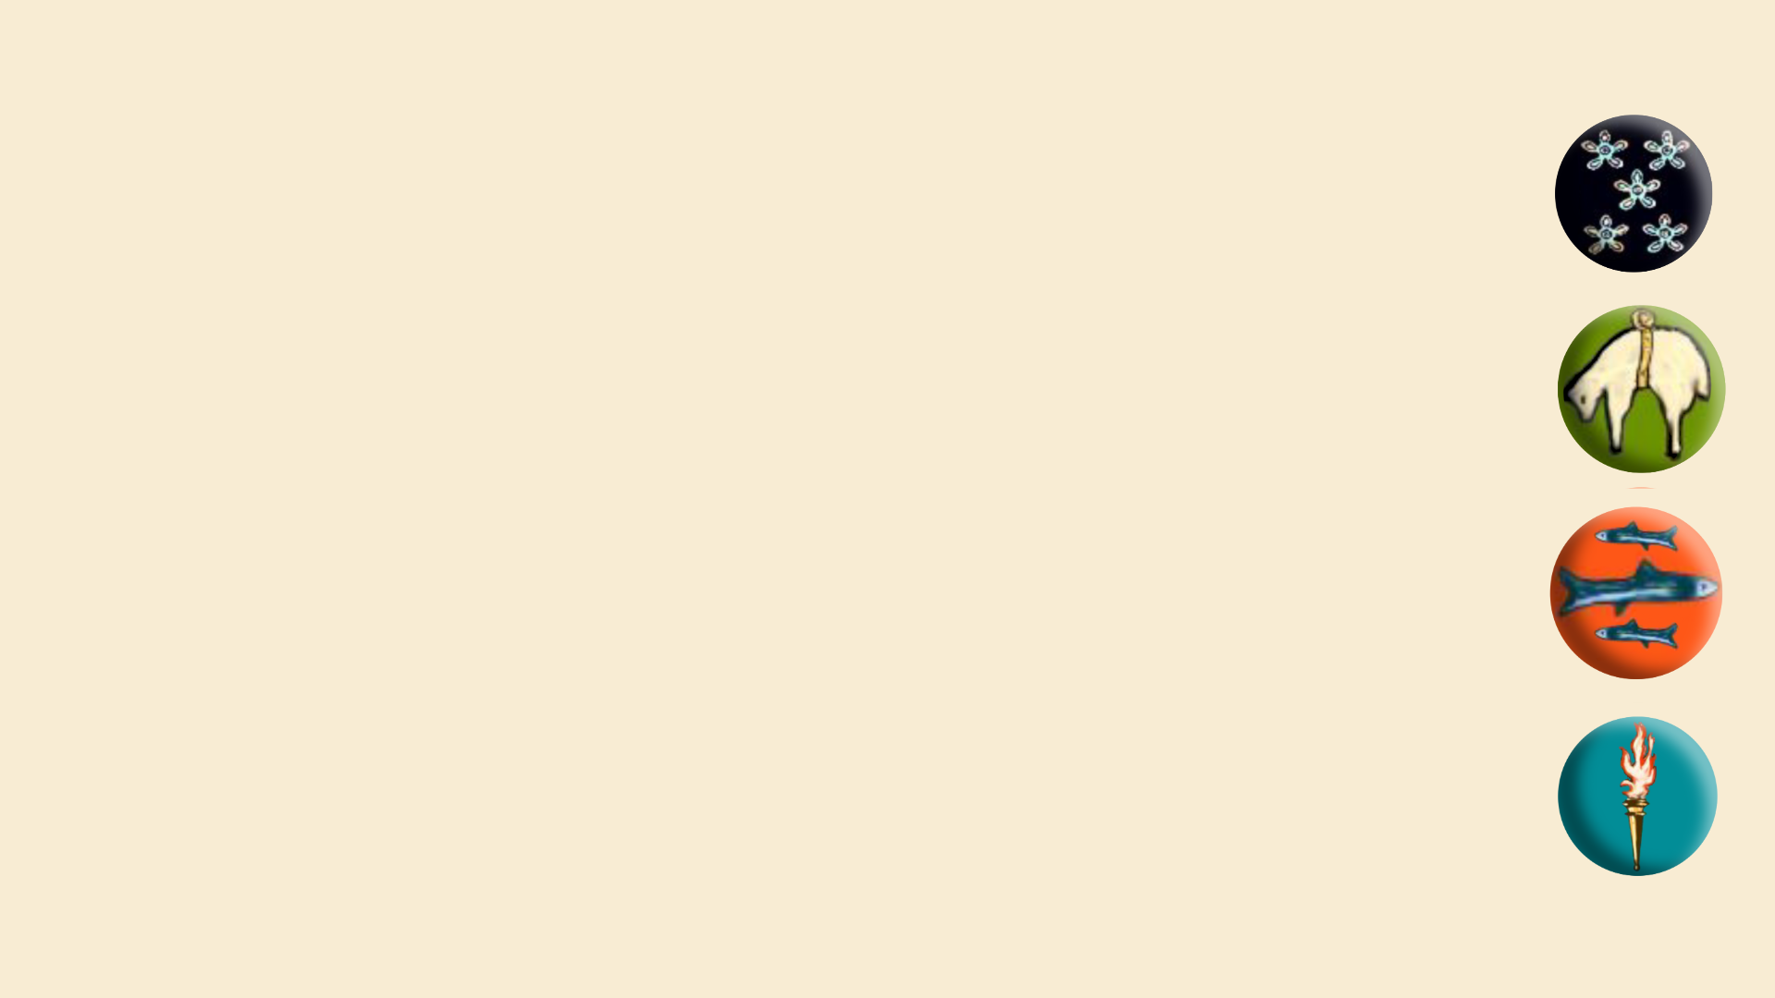

In class assembly 4.9.25
Uniform
Clubs
Prefects
Behaviour in town and school

Slide 2
Vision
One Peebles: our community where we belong, grow and achieve

Slide 3
Values
Work hard
Show kindness
Contribute

Slide 4
WORK HARD
Have you pushed yourself in everything you have done today, especially when it is challenging?

Slide 5
SHOW KINDNESS
Have you noticed when someone might need support and offered it?

Slide 6
CONTRIBUTE
Have you actively engaged in our school community today?

