Slide 1


Welcome to
Higher Politics!!

Slide 2
Course Structure
This course consists of three units:
Political Theories
  Direct and Representative Democracy
  Conservatism and Socialism
Political Systems
  Legislatures in the UK and the USA
  Executives in the UK and the USA
Political Parties and Elections
    Political campaigning
    Theories of voting behaviour
    Political ideas

Slide 3

1: Political Theories
In this unit we will study and compare different types of democracy. We will also consider the ideas of two political ideologies – Conservatism and Socialism - and ask how much these ideologies affect British politics today.

Slide 4

2: Political Systems
In this unit we will study and compare the political systems of the UK and the USA. After studying both constitutions we will consider the strengths and weaknesses of Parliament and Congress, the Prime Minister and the President.

Slide 5
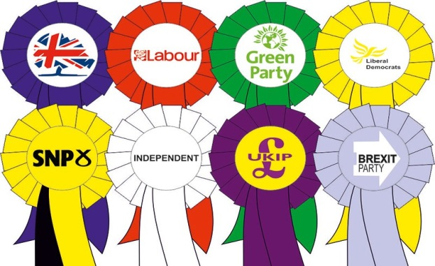
3: Political Parties + Elections
In this unit we will think about how elections are won. We will examine some of the main campaign methods used today, as well as some of the main theories that explain how people vote. Lastly we will consider the role of ideas. Ultimately we will ask, what makes a person vote the way they do?

Slide 6
Exam Structure
Question Paper 1 (essays) | 52 Marks | 1 hr 45 (SQA exam)
Question Paper 2 (skills) | 28 Marks | 1 hr 15 (SQA exam)
Assignment | 30 Marks | 1hr 30 (done in class)

Slide 7
The Question Papers
Paper 1:
Two 20 mark essay
One 12 mark essay (Political Parties Unit)
Paper 2:
One 8 mark question comparing & contrasting 2 sources
One 20 mark question interpreting, synthesising & evaluating up to 7 sources

Slide 8
Is Higher Politics Different?
There are some similarities to Higher Modern Studies:
Some crossover topics - US political systems and voting behaviour, political parties etc.
Independent research and reading required.
Knowledge Questions are 20/12 mark essays.
But there are some differences too:
No time period constraints (can use older case studies)
Focus on the “why” rather than just the “how” of politics.
Different skills questions.

Slide 9
Homework and Key Dates
Homework: mainly in the form of essays/source questions; preparing for timed essays/ Unit Assessments in class; past paper questions. Also, missed work due to absence. Extra reading is provided for each unit.
Assignment:
November - two weeks of prep followed by a write up on the topic of your choice.
Prelim(s):
January - Political Theory and Political Systems
March - Political Parties
Final Exam: Date tbc

Slide 10
Additional Support
Staff: Mr McMordie is always ready to help and can be contacted in person, via e-mail or via Teams. All course notes are accessible through One Note and supported study is available one afternoon per week.
SQA: past papers/marking instructions available online at SQA Politics Homepage and SQA Understanding Standards
Parents: can encourage students by encouraging news watching, discussing topics studied in class and by reading essays. Detailed written reports will also be issued and feedback sheets will be shared via showbie.

Slide 11
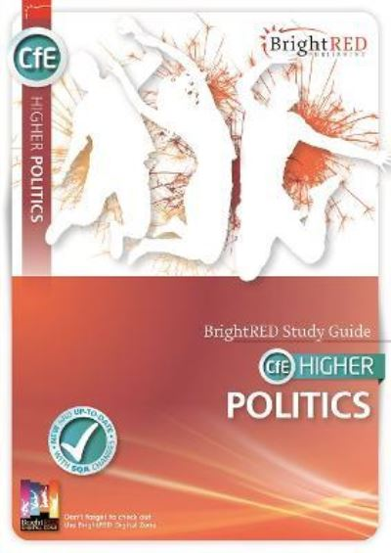
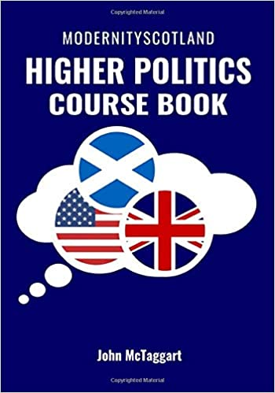
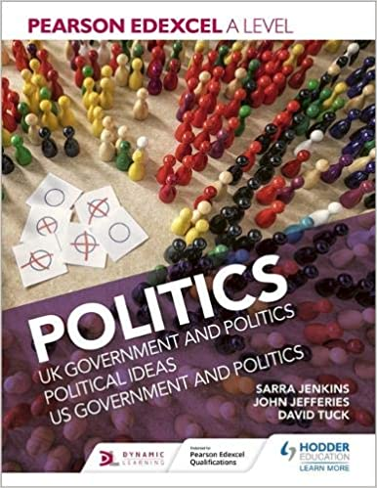
Useful Resources

