Slide 1


Higher Modern Studies
5.2: Mr Neil Hattie – gw20hattieneil@glow.sch.uk
5.6: Mr James McMordie - mcmordie.james@glow.sch.uk Miss Kirsty Wylie - gw21wyliekirsty@glow.sch.uk

Slide 2

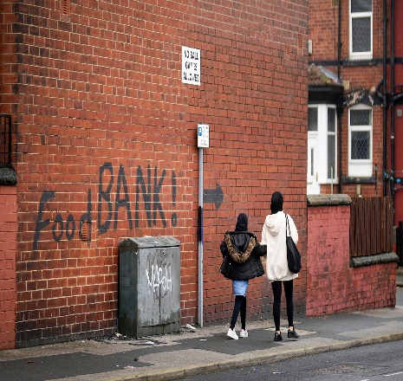

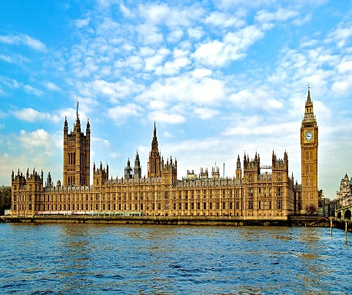
What is Higher Modern Studies?
Overview of the course
Unit 1:
Democracy in Scotland and the UK
Unit 2:
Social Inequality in the UK
Unit 3:
World Power: USA

Slide 3
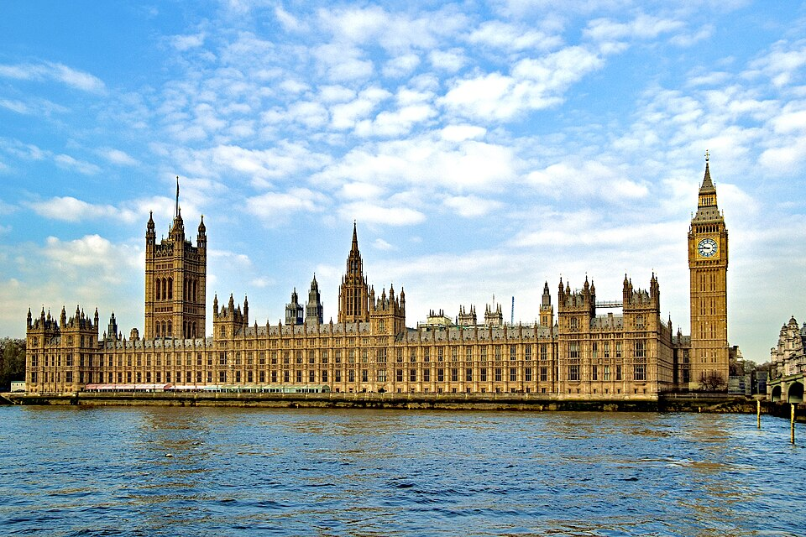
What is Higher Modern Studies?
Unit 1: Democracy in Scotland and the UK
Voting Systems
Voting Behaviour
Holding the government to account
Participation

Slide 4

What is Higher Modern Studies?
Unit 2: Social Inequality in the UK
Causes of Health Inequality
Causes of Wealth Inequality
Impact of Inequality
Effectiveness of Govt Responses

Slide 5
What is Higher Modern Studies?
Unit 3: World Power: USA
Participation
Checks and Balances
Influence
Effectiveness of Govt Responses

Slide 6
How is it assessed?
There are three parts to the assessment of the course
Exam Paper 1
(52 marks)
1hr 45
Exam Paper 2
(28 marks)
1hr 15
Coursework Assignment
(30 marks)

Slide 7
The Exam (May 2026)
Exam Paper 1
Candidates are required to write three essays on each of the units.
2 x 20 marks and 1 x 12 marks

Slide 8
The Exam (May 2026)
Exam Paper 2
Candidates answer three questions assessing their ability to use sources
Reliability: (8 marks)
Accuracy: (10 marks)
Conclusions: (10 marks)

Slide 9
Coursework Assignment
The Assignment (30 marks)
Candidates select a Modern Studies topic of their choosing, and spend time in class and home researching and gathering evidence.
Candidates will then write-up their findings in class on a date communicated by the teacher.
They have 1hr 30 to complete this task which is then sent to the SQA for marking.

Slide 10
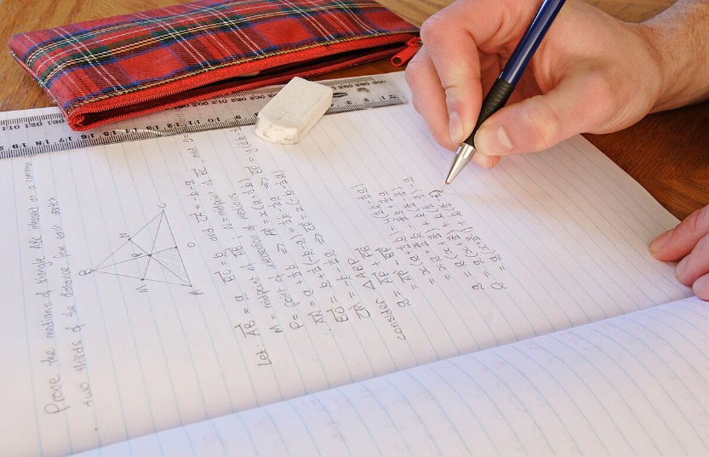
Homework
Formal homework is not strictly necessary in Higher Modern Studies. However, there is an expectation that learners will be regularly working independently on various aspects of the course, including;
Revision of content
Preparation for assessments
Preparation for essays
Catch-up of missed work

Slide 11

Key Dates
Unit 1: June 2025 - October 2025
Unit 2: October 2025 - December 2025
Unit 3: December 2025 – March 2025
Prelim: It is expected that a full prelim mirroring the final exam will take place in January 2026.
Assignment: Likely to be late February or early March 2026.
Exam: Date TBC but likely May 2026

Slide 12
How to get support?
Pupils can contact staff via email or Teams. Pupils are also welcome to speak to staff after class.
Staff will offer supported study sessions when required.
Class notes are all available on MS OneNote.
Further guidance is available on SQA website.
Ensure young people are keeping up with classwork and meeting necessary deadlines.

