Slide 1
National 5 History
How to support young people studying for National 5 History – a guide for parents and carers.

Slide 2


Course Content
3 units:
The Scottish Wars of Independence,1286-1328
Free at Last? Civil Rights in the USA,1918-1968
The Making of Modern Britain,1880-1951

Slide 3

June to October
The Scottish Wars of Independence,1286 – 1328
  The Succession Problem, 1286 – 1292
  Balliol and Edward I, 1292 – 1296
  William Wallace, 1296 – 1305
  Robert Bruce, 1306 - 1328

Slide 4
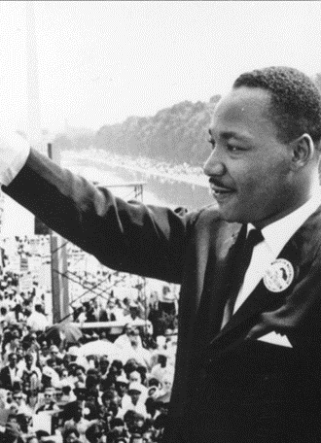
October to January
Free at Last? Civil Rights in the USA, 1918 – 1968
    The ‘Open Door’ policy and immigration to 1928
    ‘Separate but Equal’ to 1945
    Civil Rights campaigns, to 1968
    The ghettos and black American radicalism

Slide 5
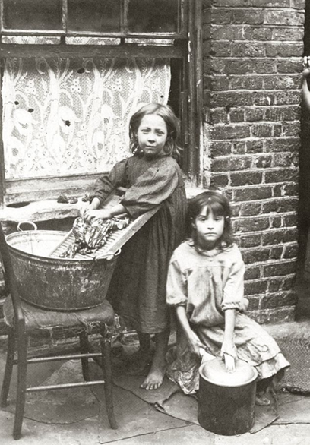
January to March
The Making of Modern Britain, 1880 – 1951
Divided Society: poverty, housing, politics
Liberal Reforms, 1906 – 1914
Social Impact of World War II on Britain
Labour Reforms: the Welfare State, 1945 – 1951

Slide 6


What We Provide
    All the resources below are available on your young person’s iPad, via Teams and One Note.
    In Team Files:
    Scottish Wars information booklet
    Free at Last digital textbook
    Making of Modern Britain digital textbook
    All the PowerPoints used in class
    N5 History Question Skills Booklet
    Videos of how to do each of the different types of question
    In One Note:
    All the work that your young person has done in class – their notes. This should be the first place they go to for revision
    All the practice skills questions that we have done in class – marked and with feedback
    All their test marks, with feedback and targets on an assessment tracking sheet. Feedback from assessments will also be shared on Showbie.

Slide 7
Assessment Timeline
September – Scottish Wars Test 1
October – Scottish Wars test 2
November – Free at Last Test 1
January – a prelim exam that covers all of Scottish Wars and Free at Last and the first part of Making of Modern Britain.
March – Assignment – 20% of final grade (see next slide)
April – Making of Modern Britain Test
May – final exam covering all of the course
The tests will cover at least half a unit each and the exam at least 70% of the course.
In addition to the tests and exam, we will practice regularly the different skills questions for N5 History.

Slide 8
Assignment
Students research and write an essay on a topic of heir choice for their N5 History Assignment.
This is written in class with a 200 word plan in an hour under exam conditions.
It is marked by the SQA and is worth 20% of the final grade.

Slide 9
Homework
All homework and assessments will be shared on Teams and student Outlook calendars.
N5 candidates should expect homework most weeks, at least once per week, duration usually 30mins – 1 hour per week
Tasks- additional questions to support learning, ‘finishing off’ class work, extra reading, watching a recommended documentary etc. The majority of homework will be focused upon exam skills and consolidation of content knowledge and understanding.
Preparation for assessments- revision as well as more exam skills. Pupils will be given adequate notice before all assessments -1-2 weeks and this will be posted in their Team.

Slide 10

SQA Past Papers
All SQA past-papers and marking instructions are available, for free on the N5 History SQA page:
https://www.sqa.org.uk/sqa/47447.html
We use this page in class often and students are encouraged to be proactive and practice as many past-paper questions as they can.
Ideally, these questions should be done without notes and timed at 1.75 minutes per mark.
Useful information about how marks are earned can also be found on the SQA Understanding Standards website:
https://www.understandingstandards.org.uk/Subjects/History/national5

Slide 11
Estimates
The prelim, which will cover at least 70% of the course will be the main piece of evidence used by teachers to base a final estimate grade on. (Specified by the SQA as being the most robust type of evidence to base estimates on).
We will also look at the test marks across the year, although these will carry less weight than the exam.
We will also look at the skills questions done in class throughout the year, although these will carry less weight than the tests and exam. Any done ‘closed book’ and timed will be more robust evidence.
It is enormously important that your young person works hard throughout the year. With no final SQA exam to work towards, it is important that all young people are striving to produce their best work and evidence all year.

Slide 12
What happens if my young person does not have evidence to estimate a National 5 pass?
The History classes are mixed National 4 and 5 level classes.
All pupils are working towards National 5 and following the National 5 course.
Most, but not all students will pass National 5 assessments.
We will identify, from an early stage, any pupil who we think may need to ‘bank’ National 4 level unit passes, for potential presentation at National 4 level.
Final decisions about presentation level will be made in the spring term.

Slide 13


How can you help?
Provide support and encouragement - take an interest
Check over work
Quiz before a test
Monitor progress and targets
Provide time and a quiet space to study
Health and well-being – encourage breaks, exercise and good sleep
Help your young person with organisation and planning.
Encourage attendance and punctuality

Slide 14

Useful Websites and Resources
BBC Bitesize History
https://www.bbc.co.uk/bitesize/subjects/z2phvcw
Mr Marr History
https://mrmarrhistory.wordpress.com/national-45/
If you want to invest in a study guide, the Bright Red ones are best. Avoid the ‘How to Pass’ for N5 History – it isn’t very good.

