Slide 1

Higher History
A guide for parents and carers

Slide 2
Qualifications for the Course
The most suitable qualification for Higher History is a good pass at N5 History. This is because some of the skills at N5 are applicable at Higher, though the performance level will be more demanding.
Students who have not studied History before Higher will require to have a pass at N5 or better in another Social Subject.
Students not meeting either of the key requirements may be admitted after discussion with Ms Watterson, the Faculty Head.

Slide 3
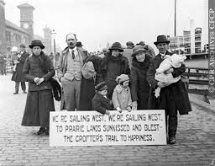
Course Content
Section 1 – Scottish
Migration and Empire, 1830-1939
The migration of Scots
The experience of immigrants in Scotland
The impact of Scots emigrants on the empire
The effects of migration and empire on Scotland, to 1939

Slide 4
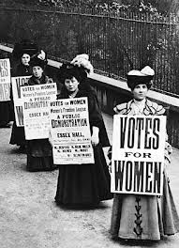
Course Content Cont.
Section 2 – British
Britain 1851-1951
The women's suffrage movement up to 1928.
An assessment of the Liberal welfare reforms 1906-1914.
The reasons why the Liberals introduced their welfare reforms.
An assessment of the Labour social welfare reforms 1945-1951

Slide 5
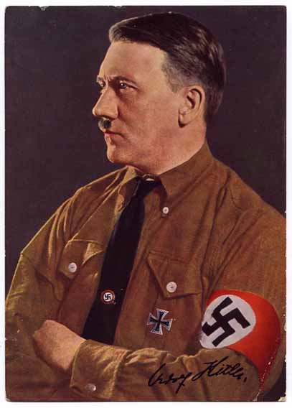
Course Content Cont.
Section 3 – European and World
Growth of Nationalism: Germany 1815-1939 and Appeasement and the Road to War, to 1939
The rise to power of the Nazis, 1918-1933.
The Nazis in power, 1933-1939.
The reasons for aggressive Fascist Foreign Policy, 1933-1939.
The reasons for the British policy of Appeasement 1936-1938

Slide 6
The Final Grade is made up of…..
The Final Exam – students will have to complete 2 papers
Scottish – 36 Marks (33%)– 1 hr 30 mins
Questions are worth 8, 10, 10 & 8 marks each – based around all 4 of the Scottish Topics.
British, European and World – 44 marks (40%) – 1 hr 30 mins
- One 22 mark essay from the British Unit
- One 22 mark essay from the German Unit
Course Assignment – 30 marks (27%) 1 hour 30 minutes in class with a plan of up to 250 words. The essay is externally marked by the SQA.

Slide 7

What we provide….
Five periods per week of teaching.
Slides and information on One Note pages for each unit of learning as well as a skills booklet, supporting students to develop essay writing and source handling skills. For the Germany and British units we also have electronic textbooks available on the class Team.
Opportunities for individuals to come with queries at lunchtimes, and/or after school, as issues arise
Young people can post questions on Teams or email their class teacher with questions at any time and they will be answered by within a reasonable time frame.

Slide 8

And…..
For much of the year, the Higher Class may well be our top priority with regard to preparation and marking.
The teachers involved meet regularly to discuss the progress of both classes and individuals, to ensure consistency of assessment marking, to ensure momentum is maintained and for simple transmission of information. The amount of cooperation between colleagues is extensive and we work as a team throughout.

Slide 9
What else?
The History department is uses Teams to allow students to access extensive support materials, including course descriptors, PowerPoints, textbooks, skills booklets and many more resources.
Students can access a range of support materials and past papers/marking instructions via the SQA website. The SQA Understanding Standards website gives samples of marked work and explains how the marks were awarded.
All homework tasks are posted on Teams Assignments. Sometimes this involved finishing One Note pages, or completing essay plans or source questions. It also includes preparing for timed assessments. This means pupils can take responsibility for their own learning and catch up on any work missed.
Our use of One Note means there is an electronic version of written work for pupils and teachers to refer to at all times. Teachers will give feedback on draft essay plans on young people’s One Note pages through annotations and/or voice notes.

Slide 10
What you could do to support your child…..
Outlook Calendar –
Synching your digital calendar with your child’s will allow you to reinforce homework and assessment deadlines.
Textbooks
It’s very important for your child to flesh out notes taken in class with extra detail/analysis.
Detailed plans
Once the teacher has marked the detailed essay plan for a topic, young people are expected to use the comments given to redraft this.
Learning information
Students benefit greatly from making study notes/mind maps/ using Quizlet study tools on each topic as the course progresses, in order to embed facts. Many young people will also benefit from quizzing and fact testing.
Practising past paper questions – These are available at https://www.sqa.org.uk/pastpapers/findpastpaper.ht. Encouraging your child to practice these in a time frame which mirrors the exam will aid preparation. Teachers are happy to mark any extra questions or essays.

Slide 11

What if my child is absent?
Good attendance is VITAL to the success of every Higher candidate, regardless of ability.
Missed lessons mean missed content but also, more importantly, missed teacher input and class discussion, both of which are critical to achieving success.
We are be pro-active in encouraging full attendance, as well as in supporting students who do have unavoidable absences to catch up.
We would appreciate your support in encouraging students to attend every lesson as far as possible, on time and with the necessary materials. If a young person is absent, it is important that they take the initiative to find out what they have missed, and to catch up.

Slide 12

Assessments
We WILL do our very best to support your child to pass all the assessments required in the course.
We WON’T “spoon-feed” them or write essays/responses for them, nor will we accept work that has been copied and pasted from the internet, plagiarised from another source, produced with AI, or otherwise clearly not the student’s own work.
Most assessments will be done in the classroom and under timed conditions. Some will involve the use of a pre-prepared plan or the skills booklet, some won’t, and students will be advised accordingly regarding preparation for assessments.
We are happy to mark extra essays, past paper practice responses and rough plans, if students wish as part of their prelim and exam preparation.
Although we can give general comments on Assignment essay plans we can not mark these as thoroughly as we would class essays, nor are we able to mark Assignment essays in draft form.

Slide 13
Assessment Timeline – this is an approximation and timings can change according to the progress of classes
June – Liberals Issue 5 essay
September – Liberals Issue 4 essay
October – Women and the vote essay
November – Labour welfare reforms essay
December – Rise of the Nazis Essay
December – Scottish Test
January – prelim, date TBC
February – Rise of Nazis essay
March - Nazis in Power essay and Assignment essay
April – Fascist Foreign Policy essay and Appeasement essay

Slide 14


To sum up…..

