Slide 1

PHS 2025 Exams
Study leave
Exam timings
Exam locations
Coming into school to study
Be Prepared - What must I bring in?
What can't you bring in?
What if something goes wrong?

Slide 2

Is this you?

Slide 3

or is this You?

Slide 4


Slide 5
It is difficult and tough to be organised and prepared and find time/focus to study.
It is difficult and tough to be unprepared and anxious, worried and stressed.
Choose your difficult / tough.

Slide 6
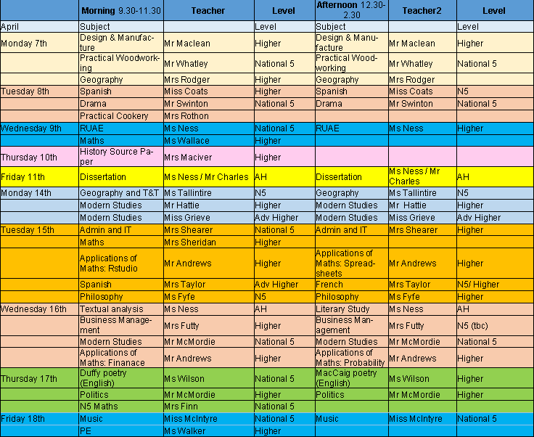

Slide 7

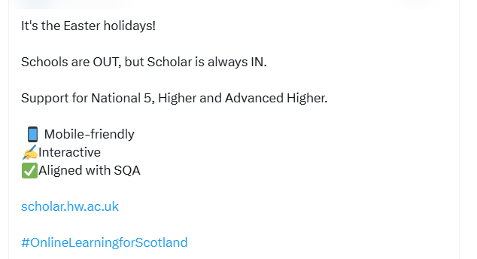

Slide 8
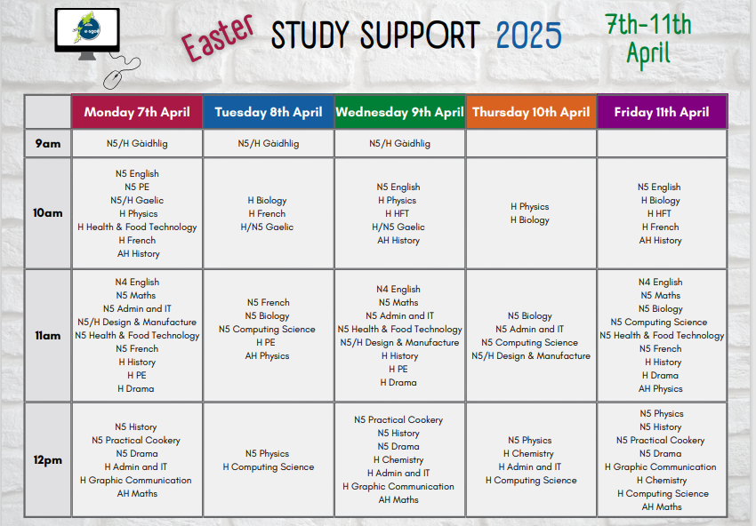

Slide 9
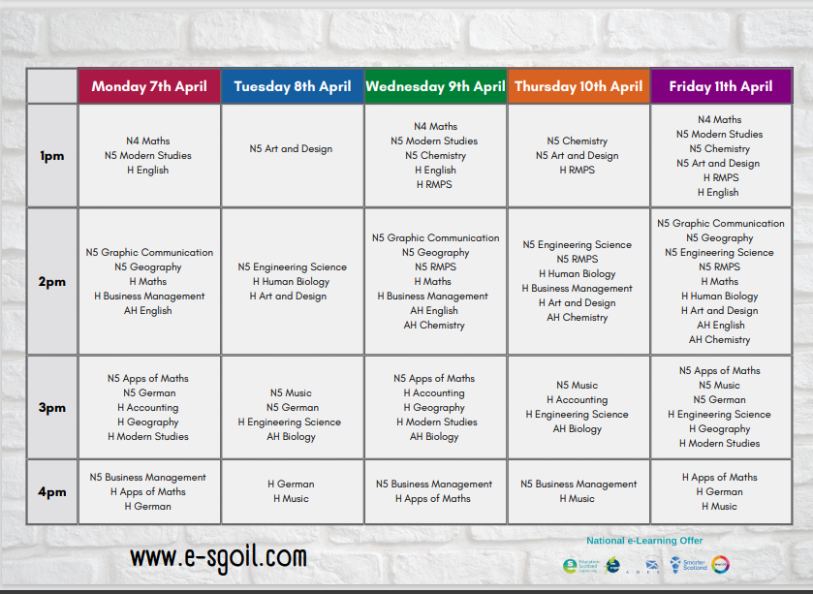

Slide 10

STUDY LEAVE
The Exam diet and study leave will run from
Friday 25th April – Friday 30th May.
New academic year will begin on Monday 2nd June

Slide 11
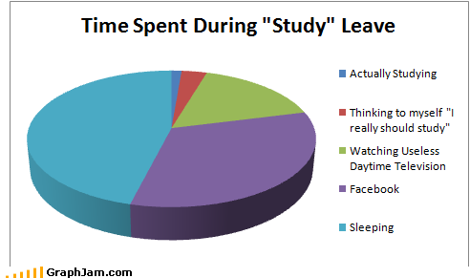

Slide 12
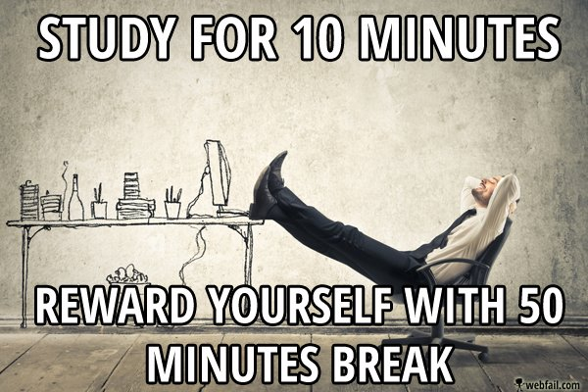

Slide 13
STUDY LEAVE
The clue is in the title…STUDY LEAVE!
Use it wisely; plan, practise, prepare
Think about revision techniques – use whatever works for you
Take (reasonable) breaks!
Eat and drink well
Talk to your teachers

Slide 14
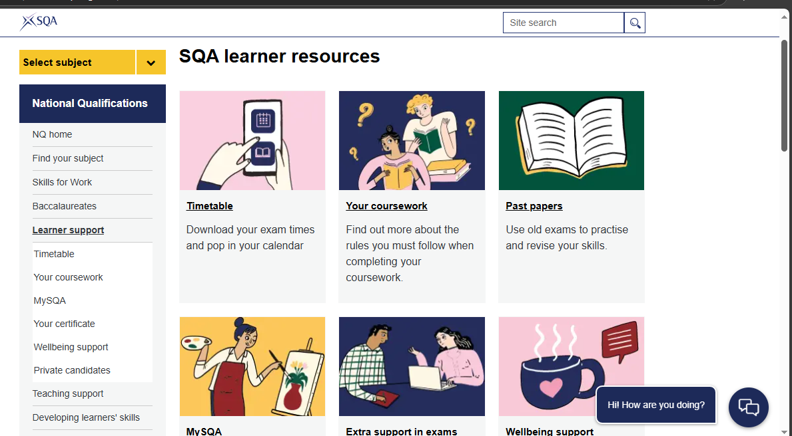
SQA
Your exams what you need to know 2025

Slide 15

Do…
Check that all the details on your exam timetable are accurate. If exams are later it is up to YOU to arrange transport.
Let me know ASAP of any changes that need to be made
Wear your school uniform
Check that you are sitting at the right desk, with the right subject exam paper in front of you!
Speak up if you have any questions or concerns, as soon as you think of them. Either find me or put your hand up and an invigilator will come to you

Slide 16
On exam day
DO be outside the exam room at least 10 minutes before the exam is due to begin
DO check the lists to be SURE of your room and seat number. (Assessment Arrangements).
If you can’t see your name, or think something is not right– DON’T PANIC! Speak with an invigilator or come and find me
If you have as assessment arrangement, or have elected to use a pc, check your letter.

Slide 17
Allowable equipment
All writing should be in blue or black pen. NO GEL PENS!
Diagrams, graphs, etc in HB pencil (nice & sharp)
Bottle of water
Rulers, rubbers, calculators, highlighters, protractors, etc
No pencil cases & please ask invigilators to check your glasses case
No phones, iPods, earphones, smart watches etc

Slide 18
During the exam
Be considerate of others.
Check you have been given the correct papers.
Question sheet is yours.
If you need assistance raise your hands.
If finished, triple check your work.
Hand everything back to the invigilator before your leave

Slide 19

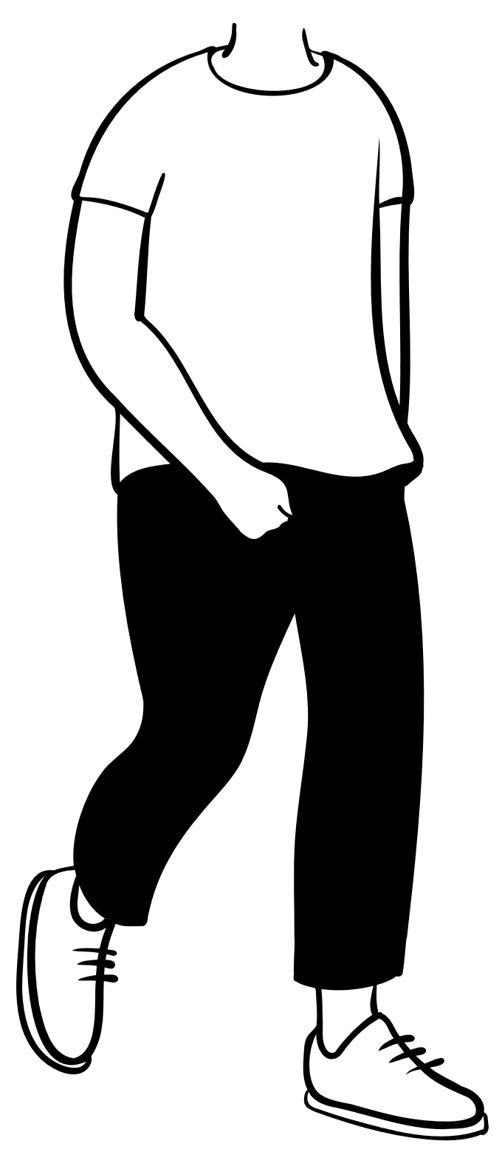



Leaving the Exam Room

Slide 20
What if…?
My bus is running late?
I sleep in or I am late for any other reason?
I am unwell on the day of an exam?
My exam takes place on a Friday afternoon?
The Fire Alarm sounds?
I get hungry?
I finish the exam early?

Slide 21
Please remember
School still happens!
The rules are the same for each exam, no matter which room you are seated in
Most problems can be fixed, if we are alerted to them. SPEAK UP!

Slide 22
Appeals
You can request an appeal if you feel that a grade you receive on results day is wrong.
It does not need alternative assessment evidence to support a request
Exceptional Circumstances Requests

Slide 23

…and finally…

