Slide 1
New School Presentation
Friday 10th January 2025

Slide 2
Overview
First floor "practical subjects" that require equipment or large spaces + canteen and hall. (Music/Drama/Science/HLS,etc)
Second floor – Classrooms + library + staff base. (Maths/Languages/Social Subjects/BCT,etc)
Detailed plans are available at:
https://peebleshighschool.com/the-new-school-2/

Slide 3
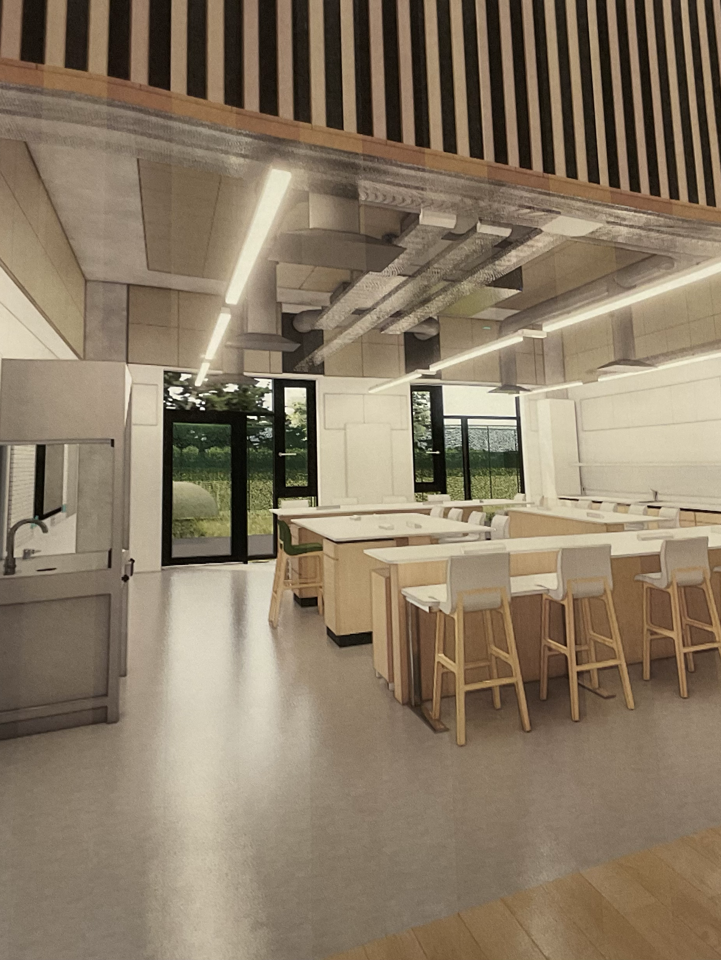
Classrooms
Some of classes will be open plan and others will be fixed but all open plan spaces have partitions to separate the large classes into two again.
Classes will have either a electronic board and/or a standard white board depending on the councils choices further down the line
Each class will have blinds some will be electronic (automatic) others will be cord operated but they will be in each classroom this is depending on the councils choices the classes will have windows facing outward and some will have glass on the other side of the room looking down on the open spaces above the canteen for example
Classes will have exposed piping on the ceiling similar to the new changing rooms in PE.
More information on classes being divided up and teachers having their own spaces to come soon.

Slide 4
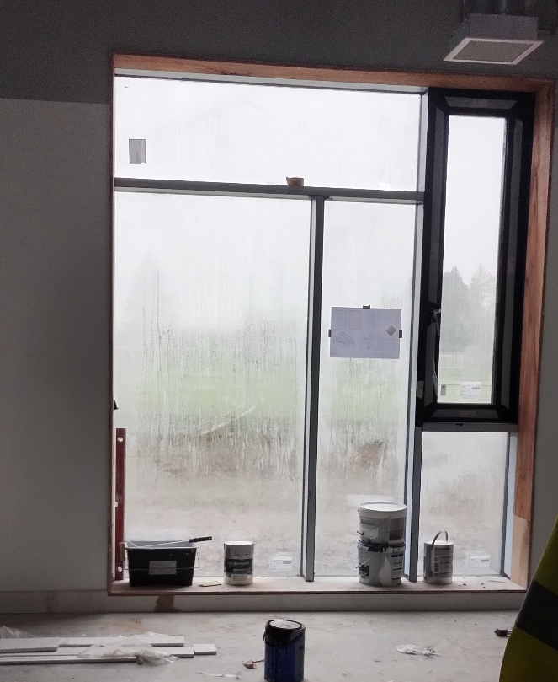
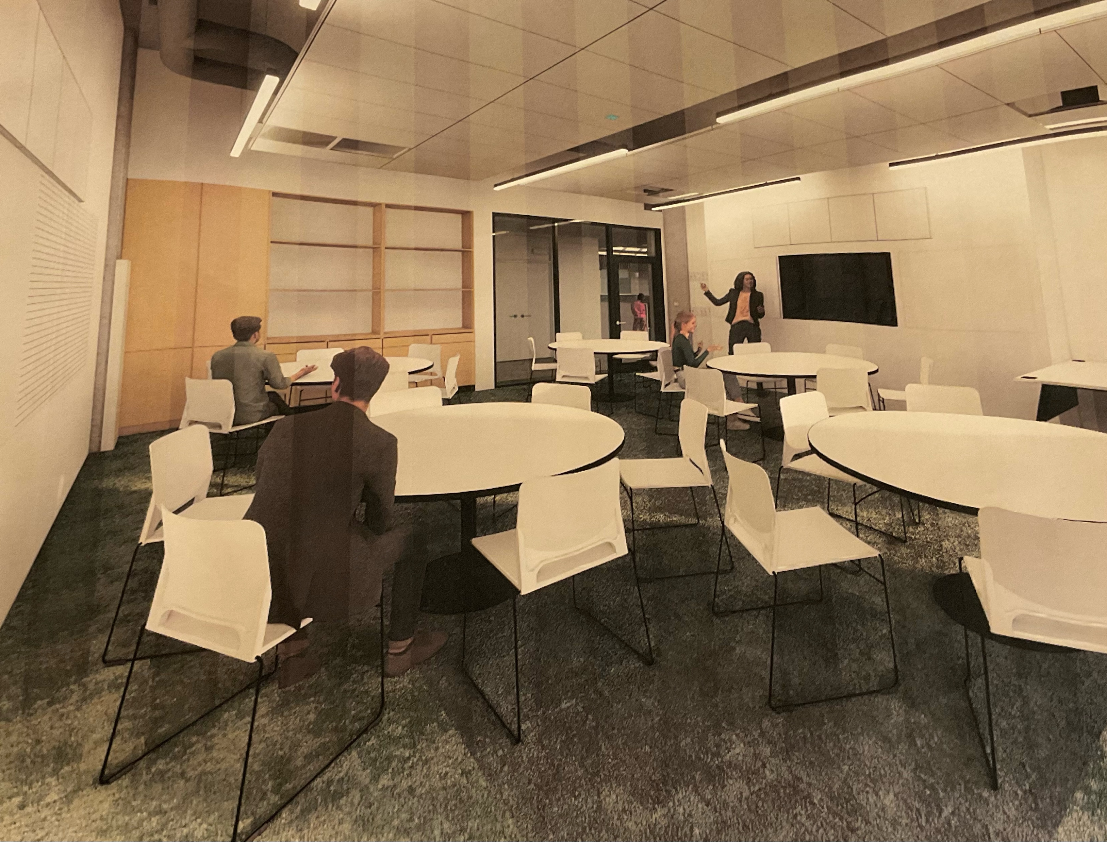
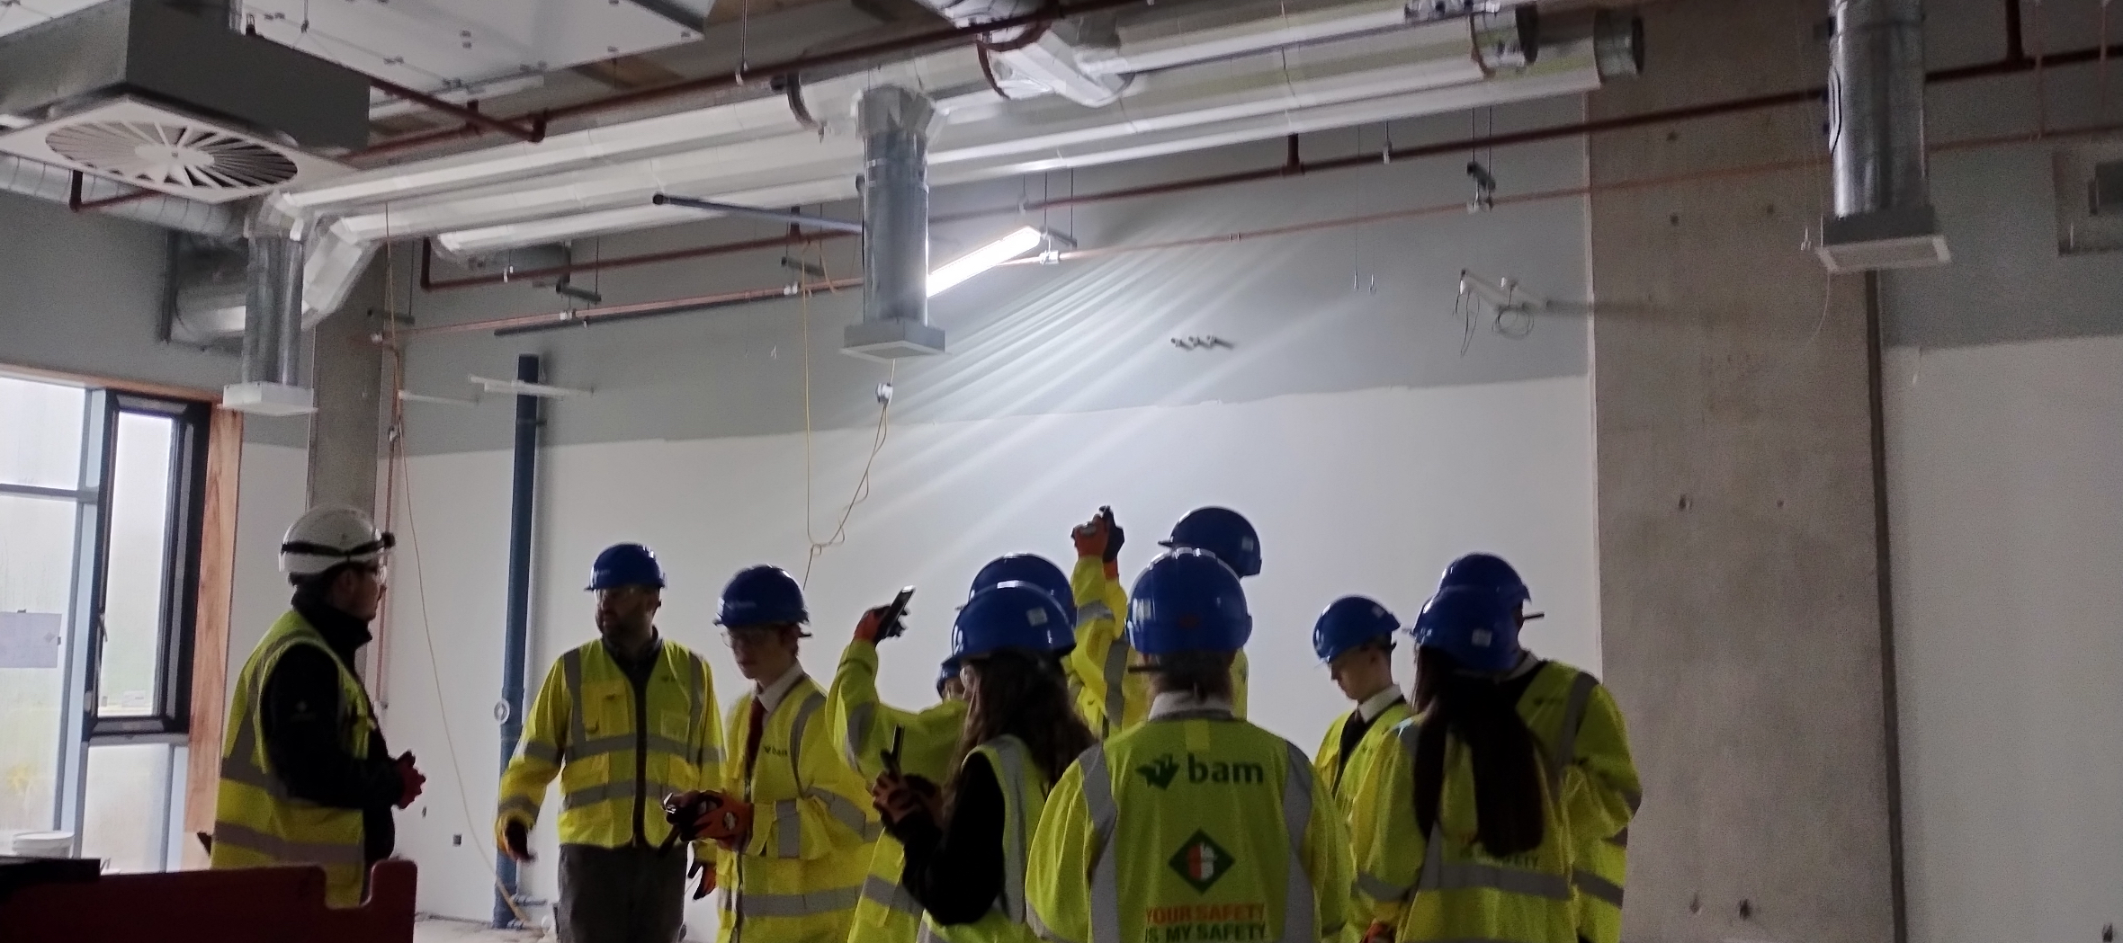

Slide 5
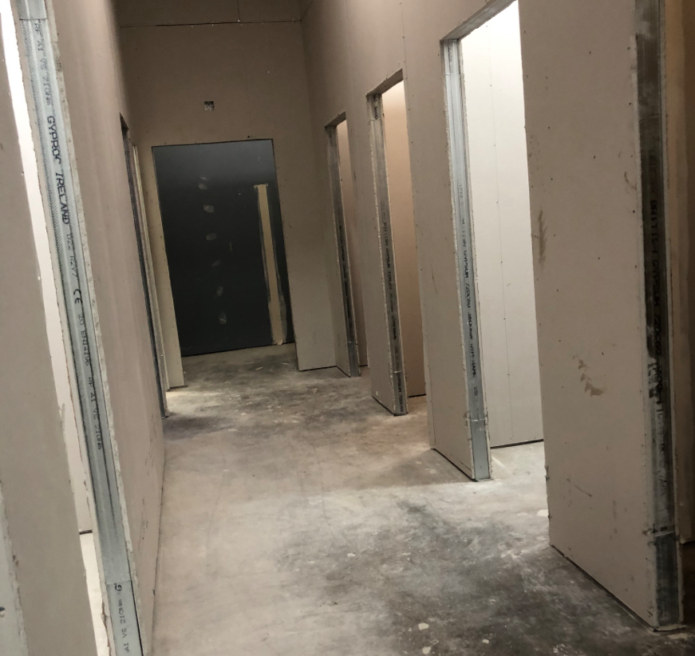
Toilets
Each cubicle is separate with a sink and toilet.
The material on the walls is vandalism resistant. (Easy to wipe things off hard to scratch writing into).
There are many blocks of cubicles dotted around the school
There is 7 cubicles in a block.

Slide 6
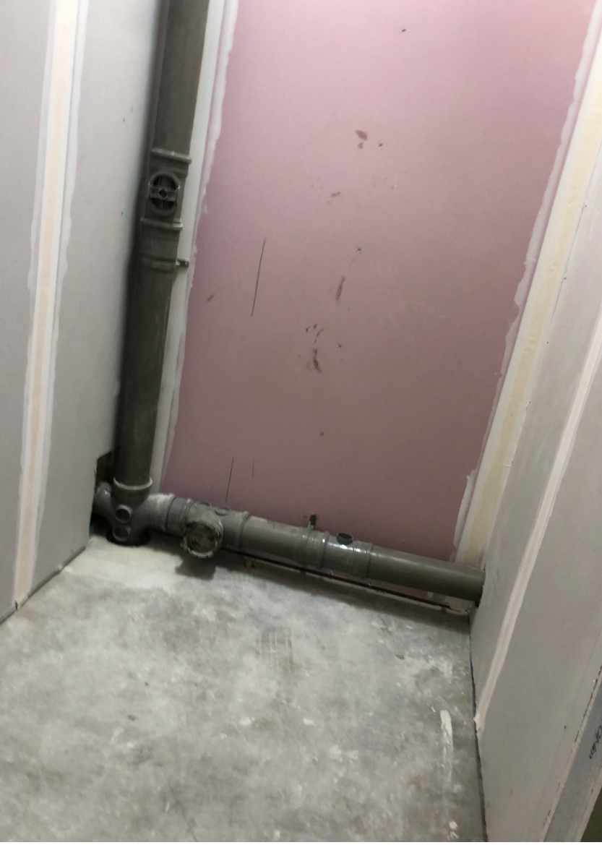

Toilets Continued
There are four toilet blocks on the ground floor, and six upstairs (seven cubicles in each block)
All of the blocks contain a disabled toilet and a shower.
Only toilets, no urinals.
There will be CCTV cameras outside each block.
The school hasn’t yet decided on whether the toilets are unisex or not, but we will inform everyone when they do.
Inside a cubicle

Slide 7
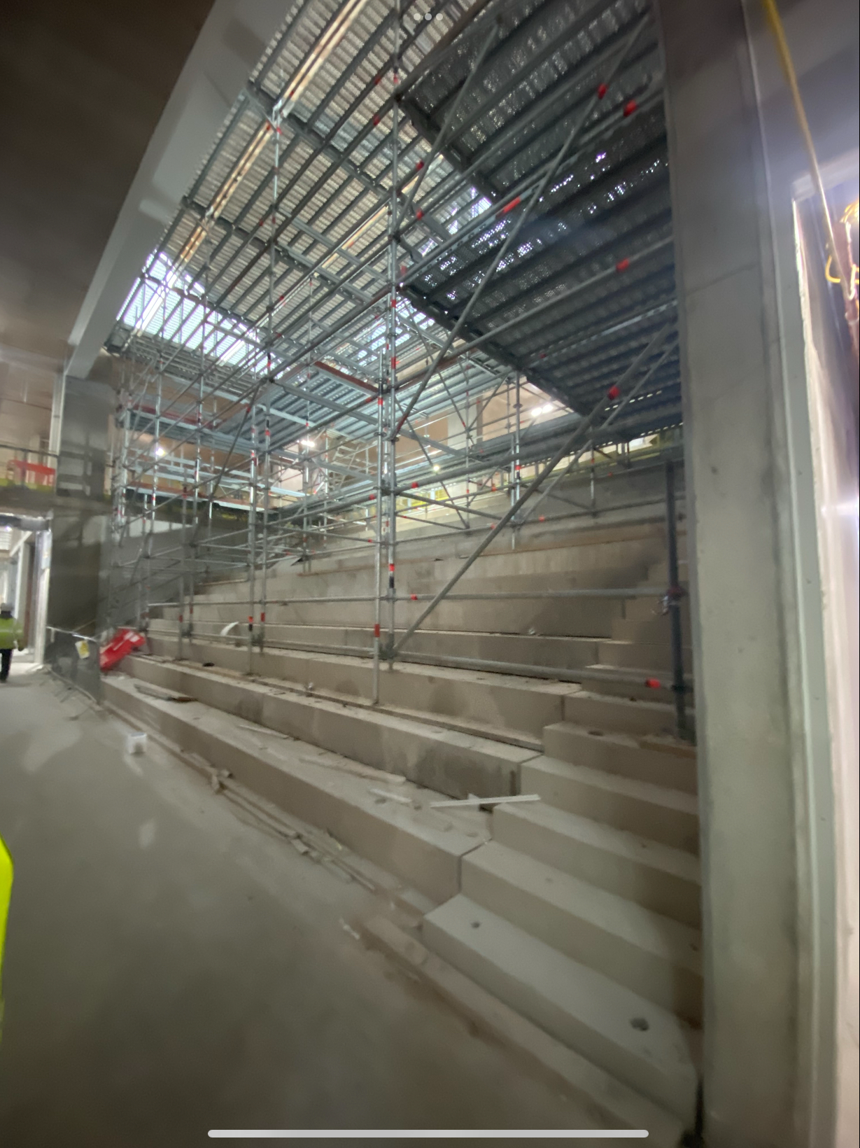
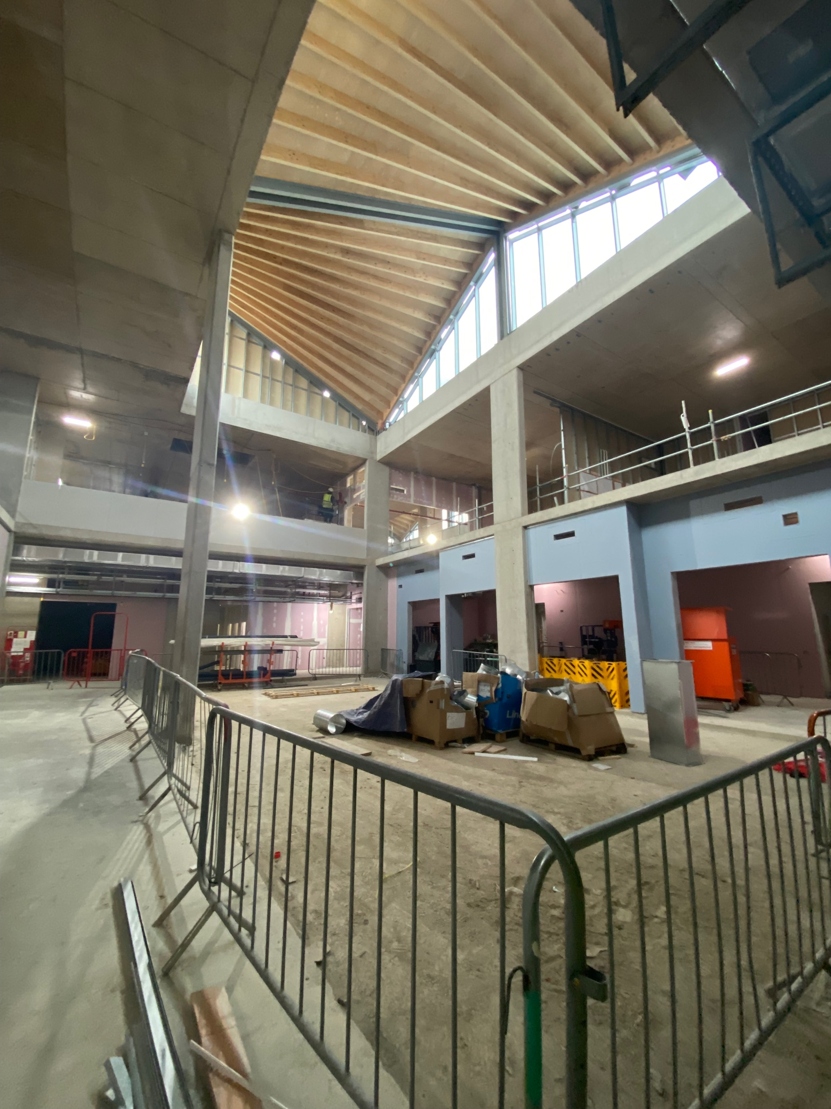
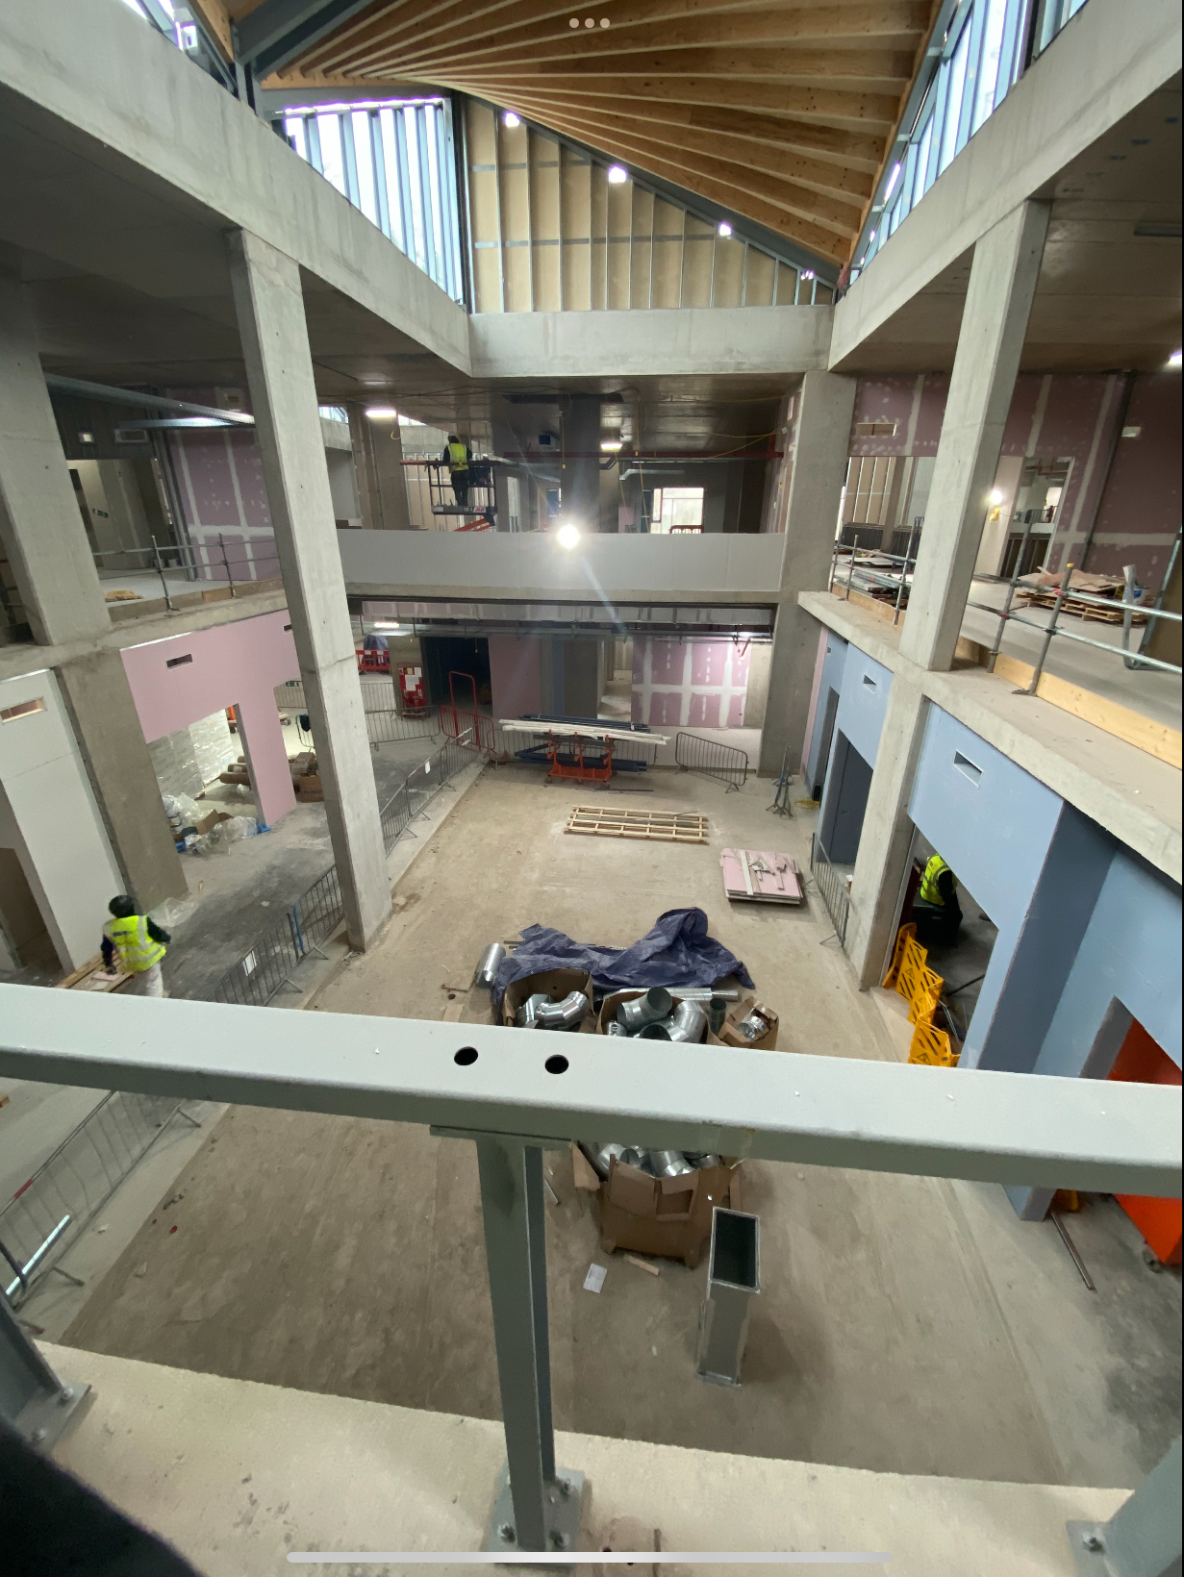
The Canteen
The food from the canteen will not change in the new school
The canteen will have separate serving stations for hot and cold foods
There are 2 dining spaces each 119m2 and can seat 114 and also a staggered level seating area
We don’t know if the 2 spaces will be divided into junior and senior yet

Slide 8
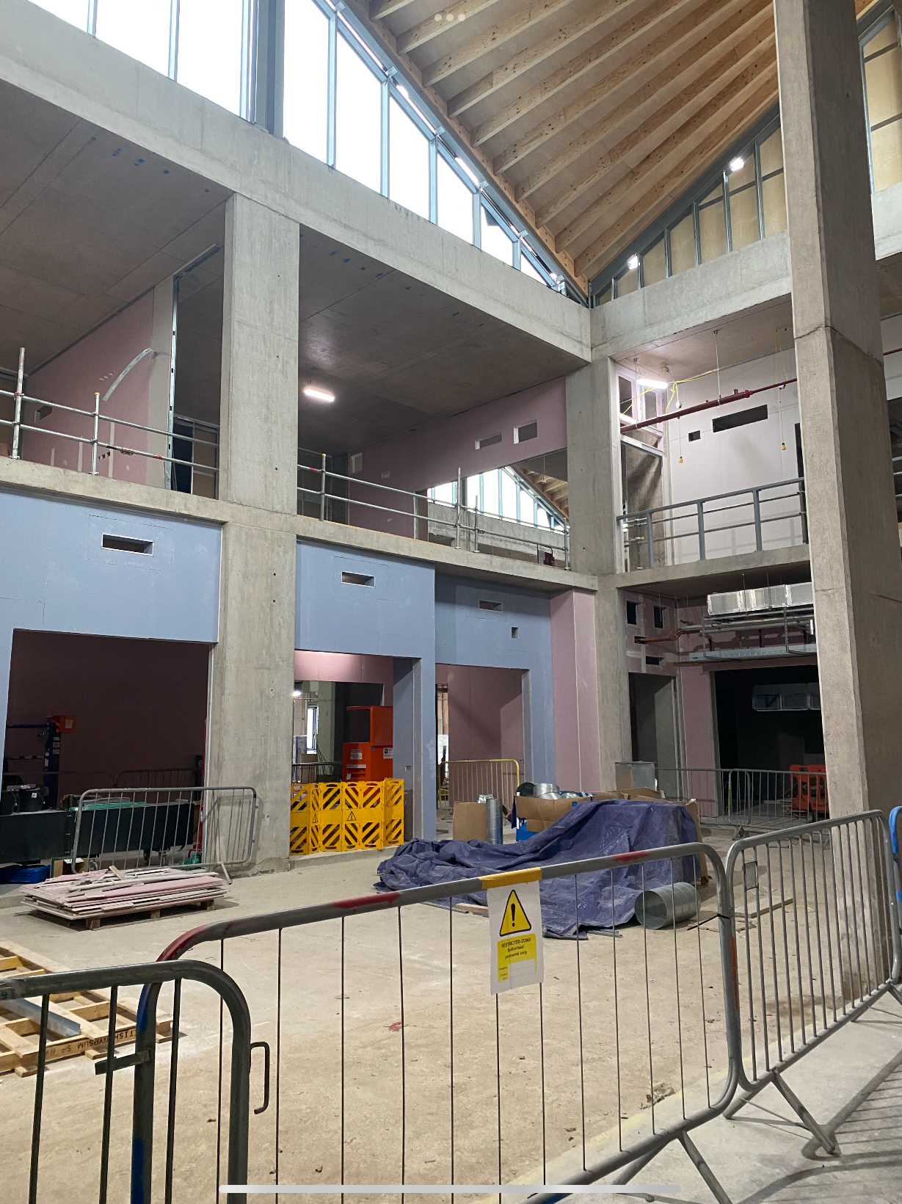




Slide 9
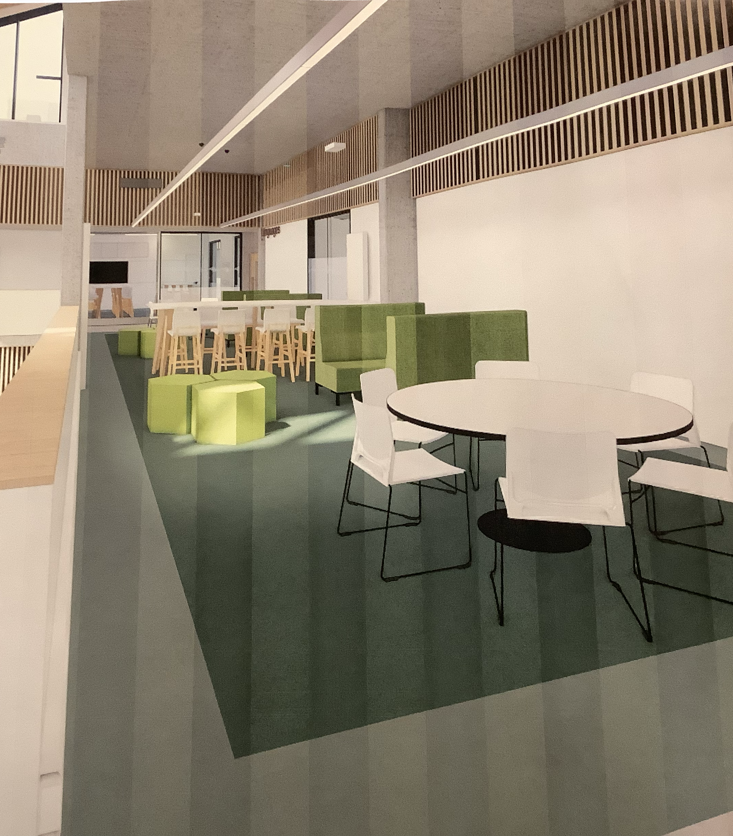
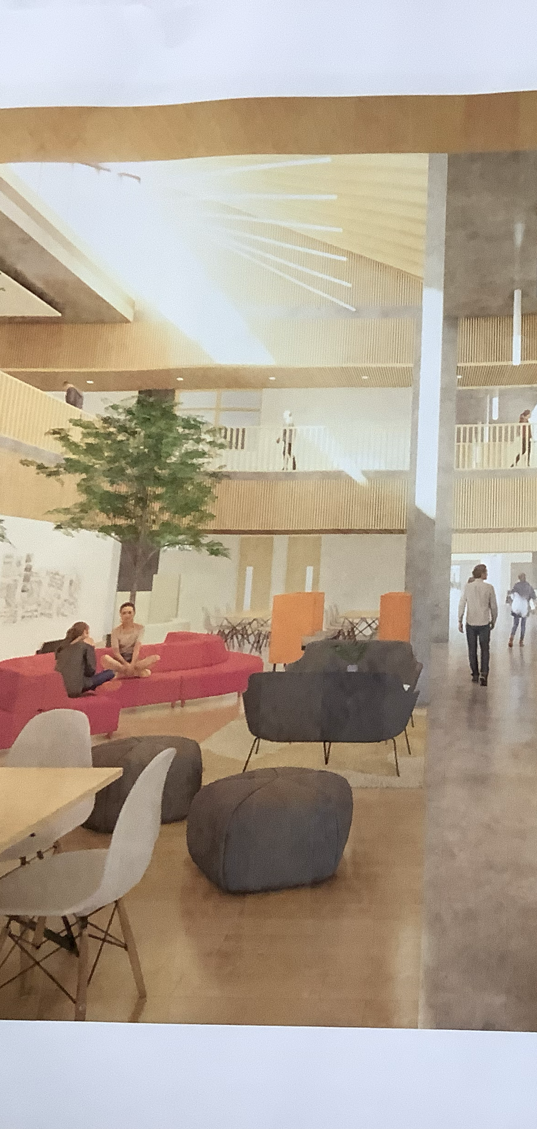
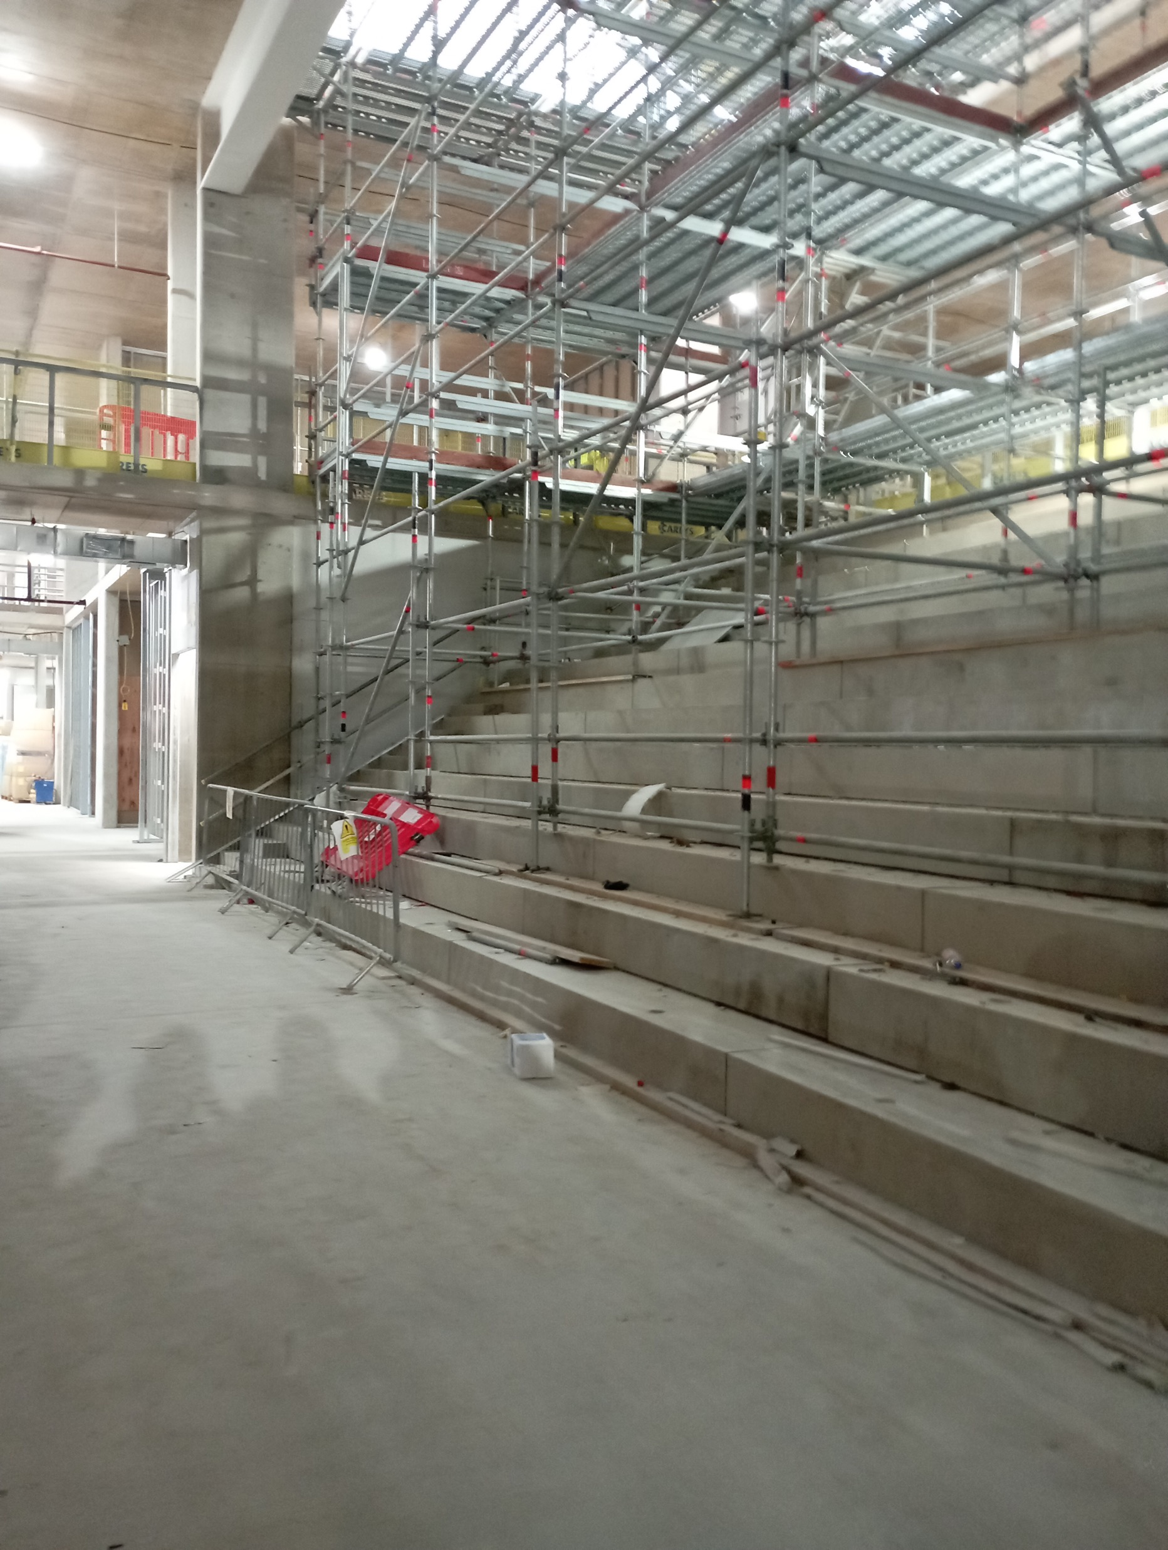
Social Spaces
No Young Scot Card machines- all done online
All year groups mixed
No big atrium- there will be a number of break out spaces
No plug sockets to charge iPads
Furniture being worked on by the design team

Slide 10
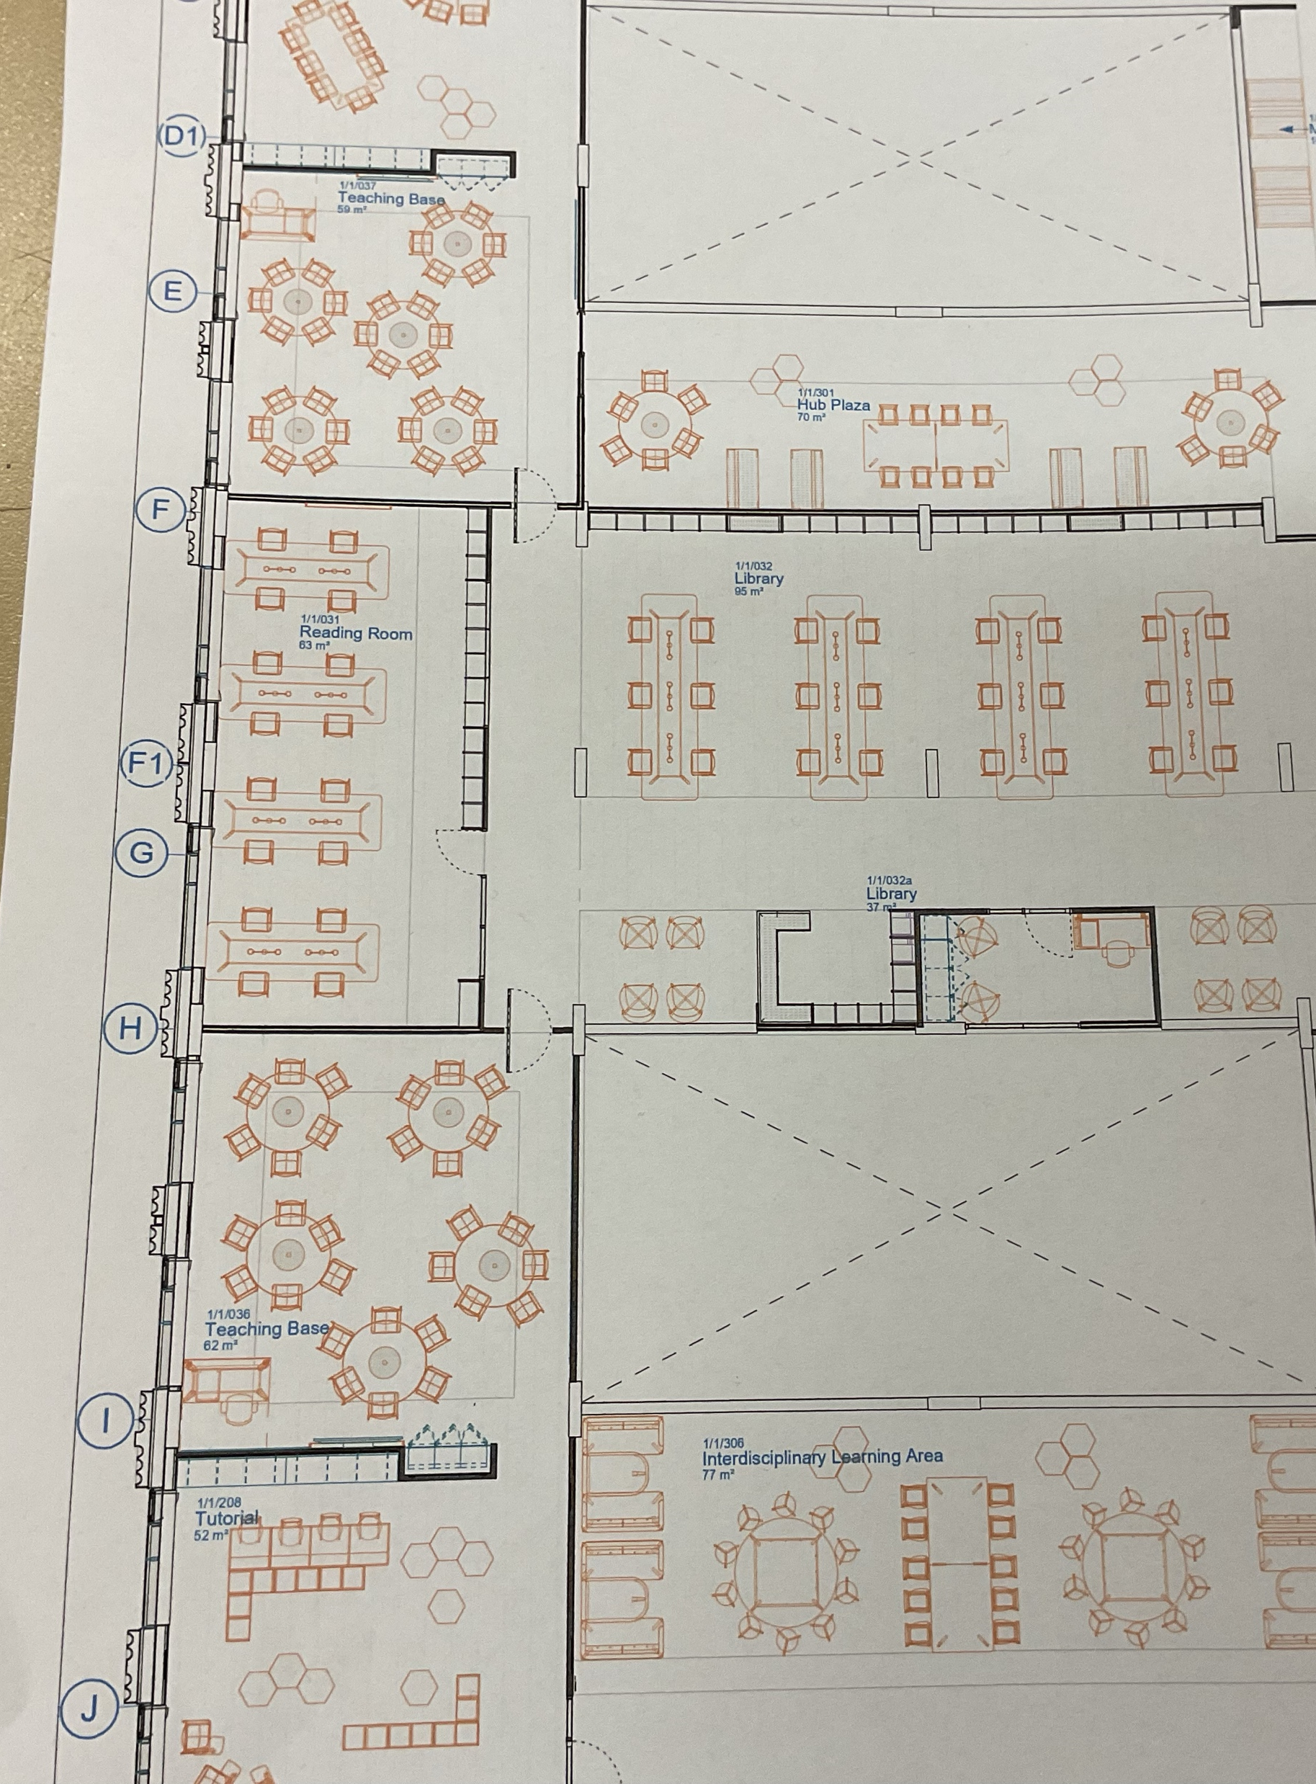
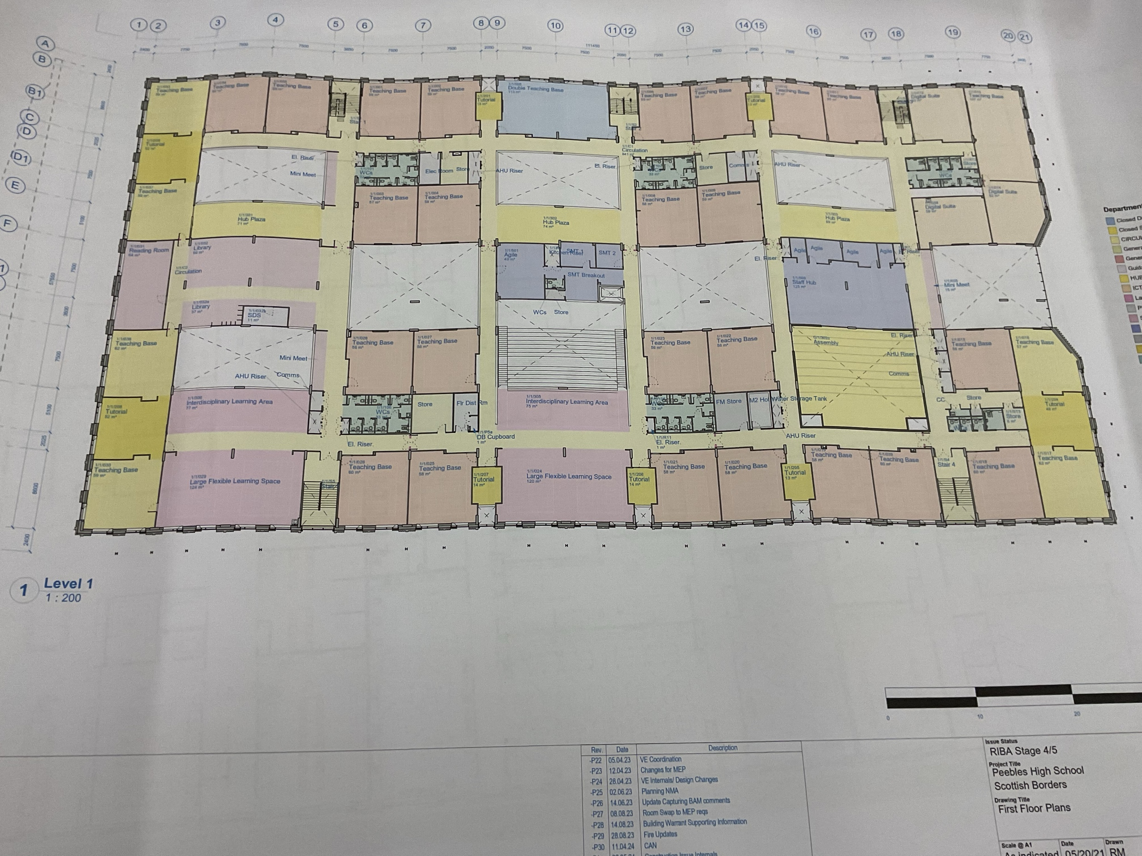
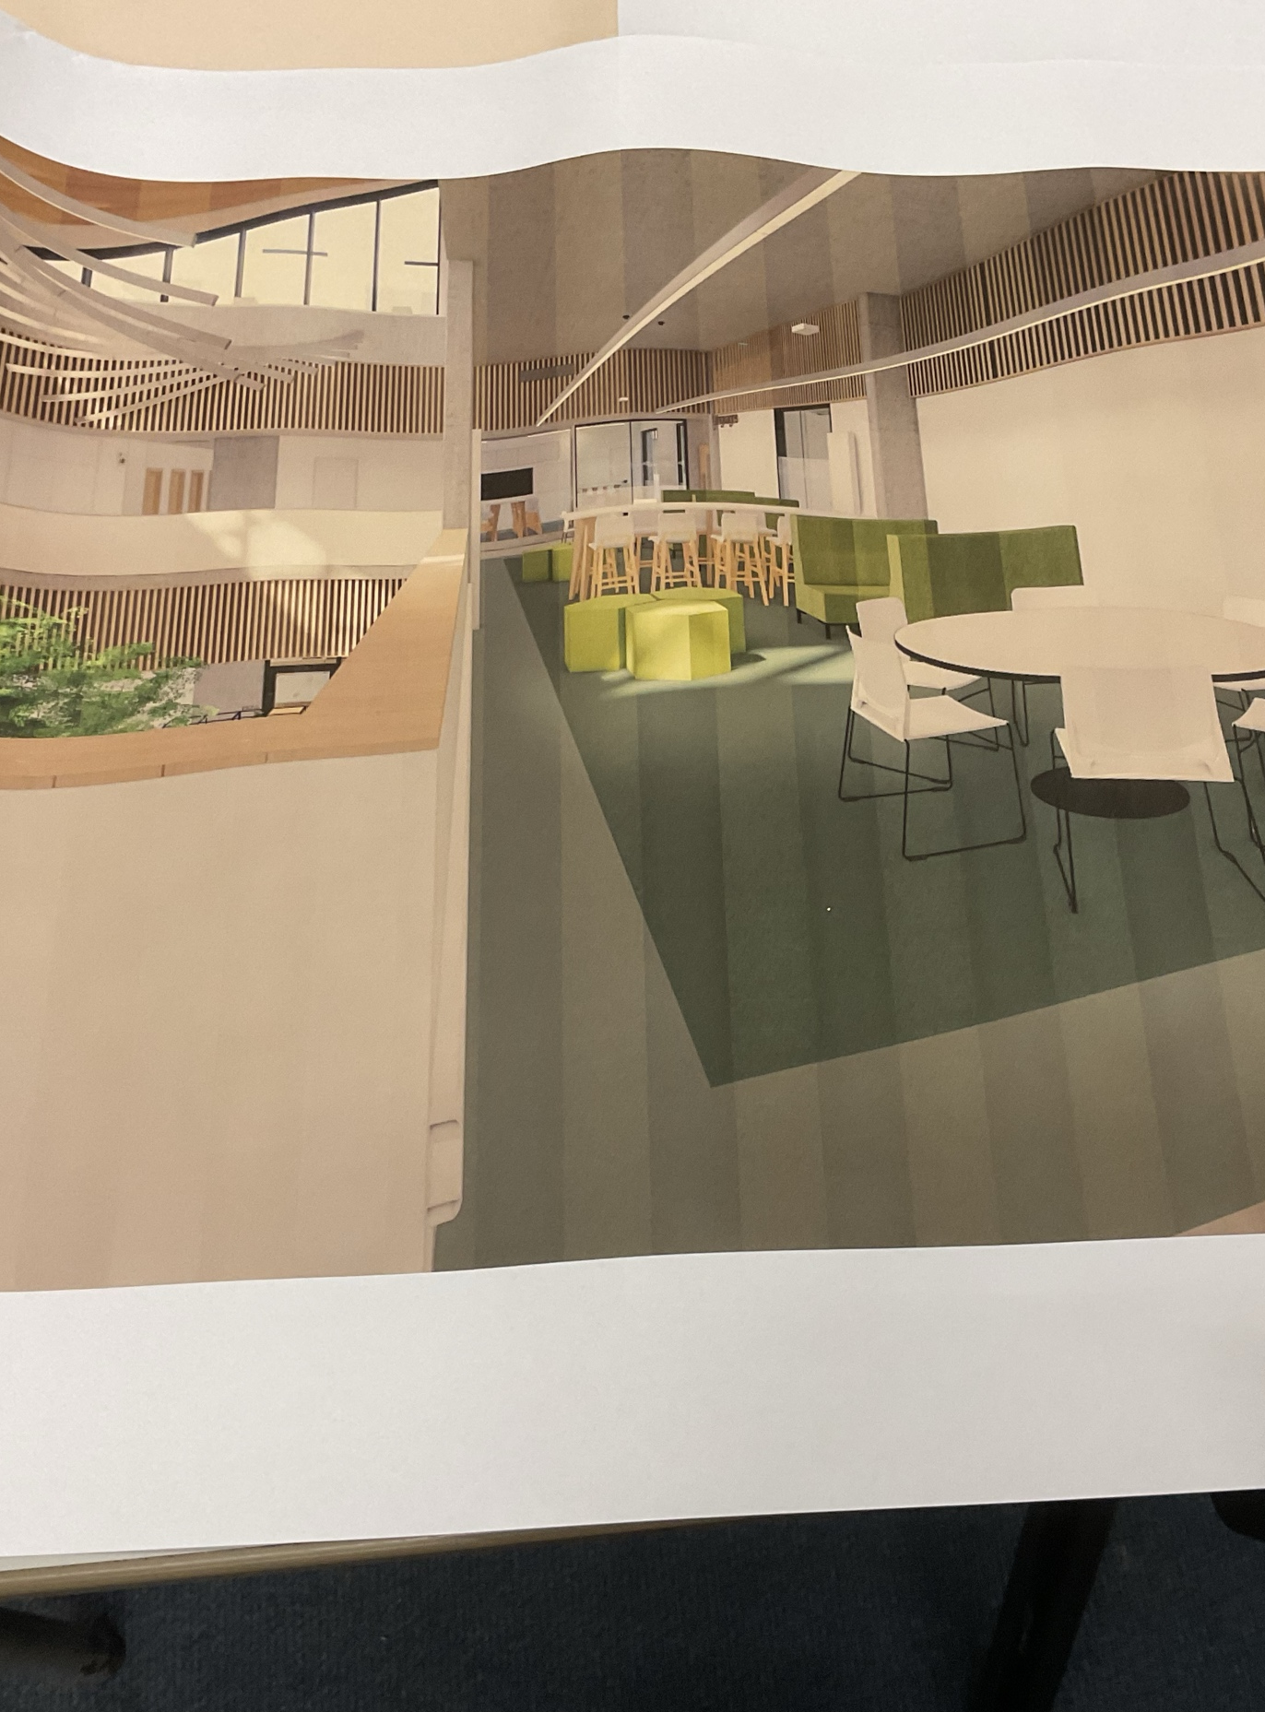


Study Spaces
There will be a library in the new school on the first floor, with a quiet study space behind it.
There will also be smaller study pods dotted around the school.
What the library will look like
Library location
Detailed plan of library

Slide 11
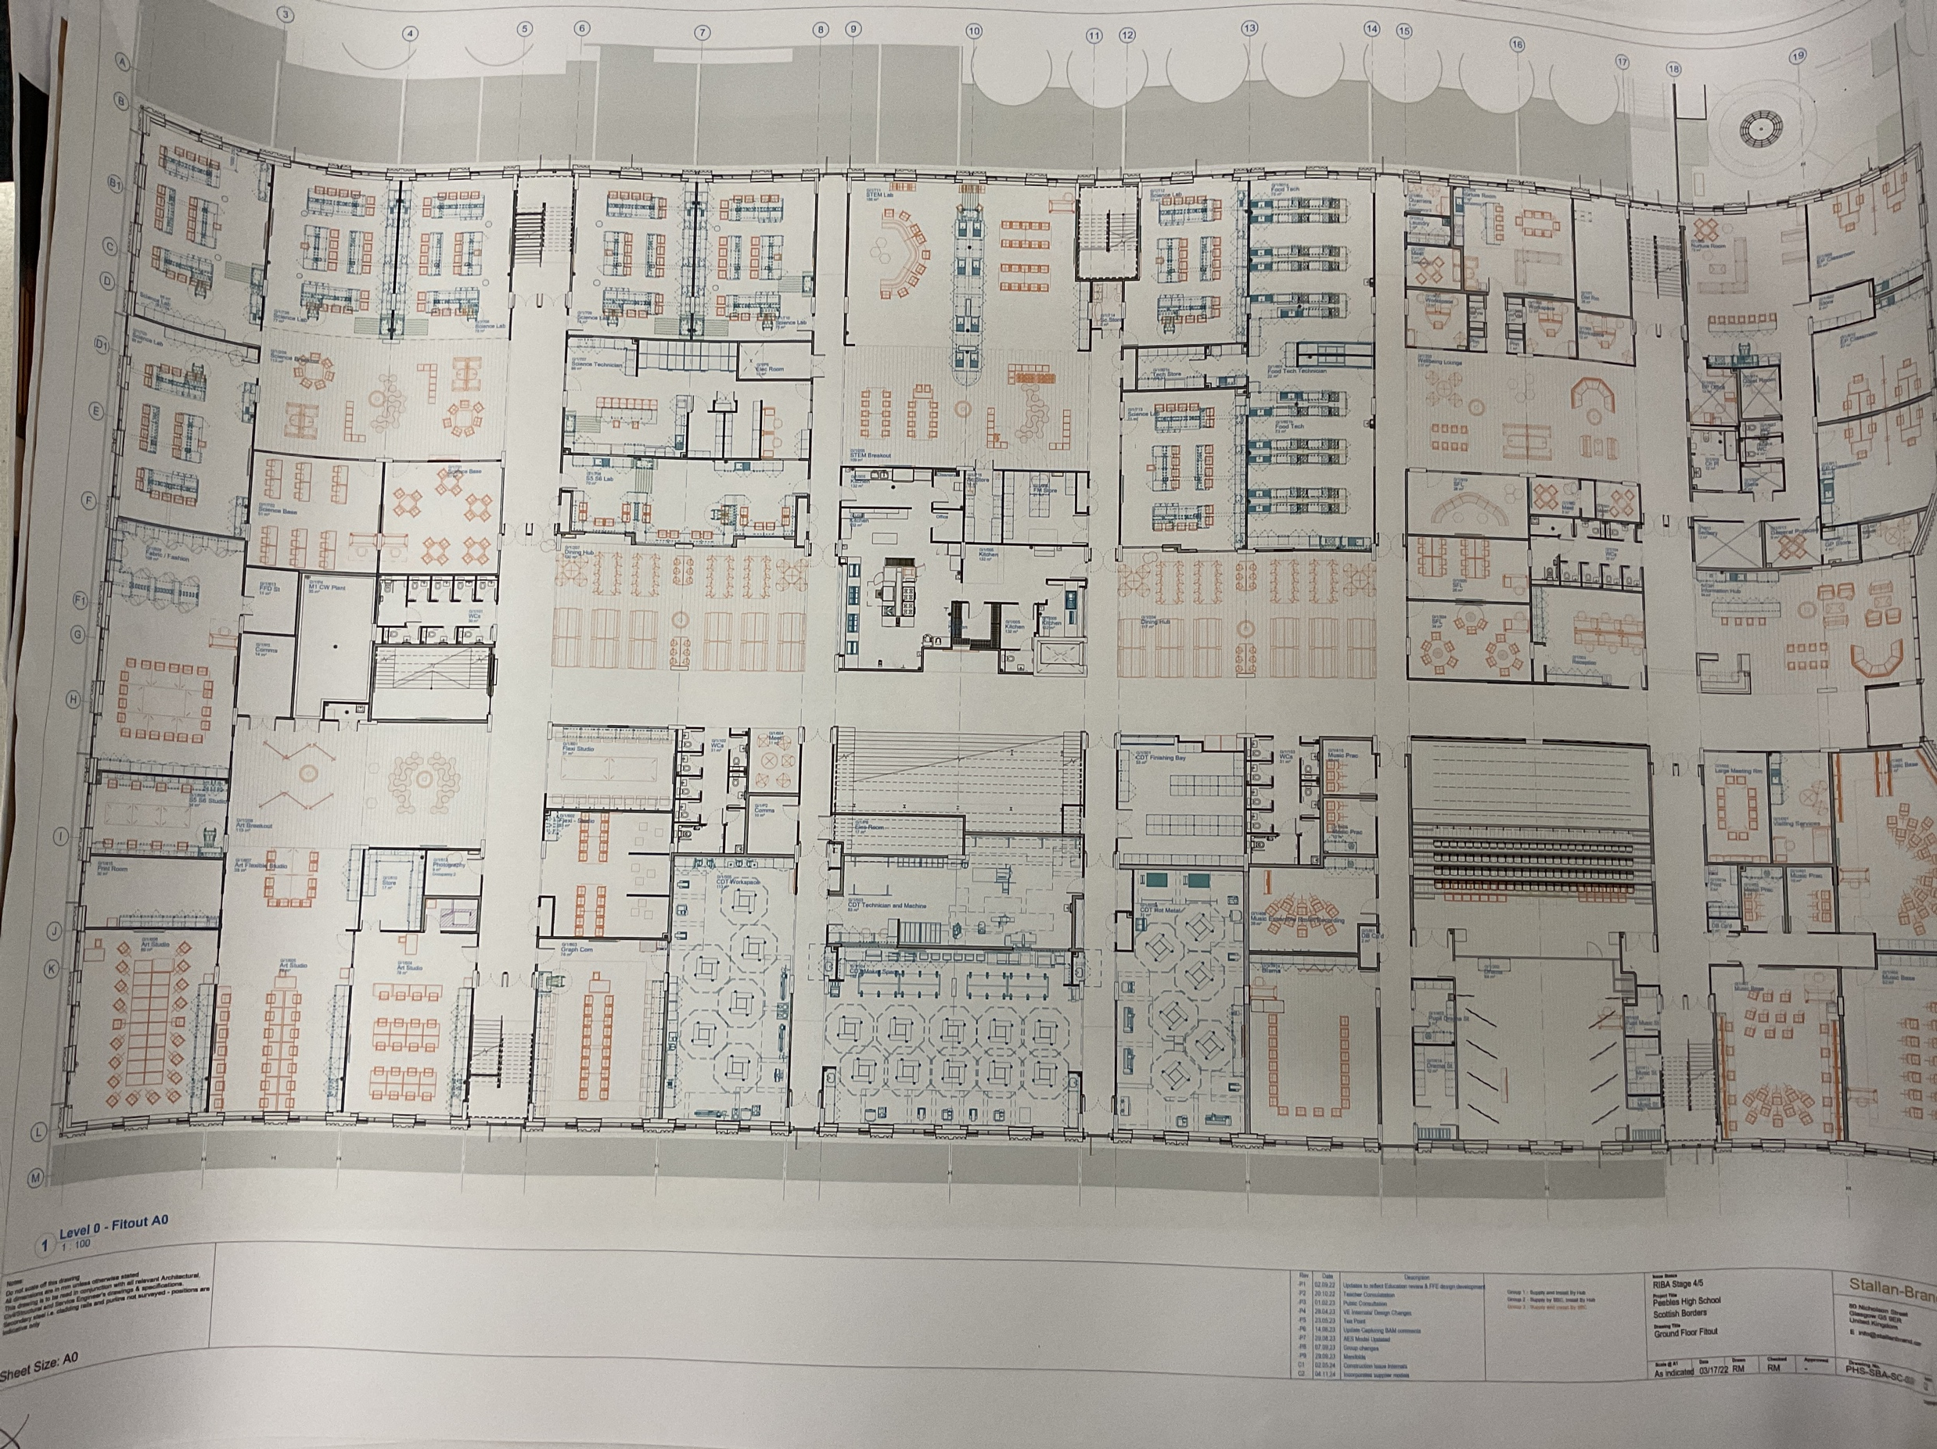
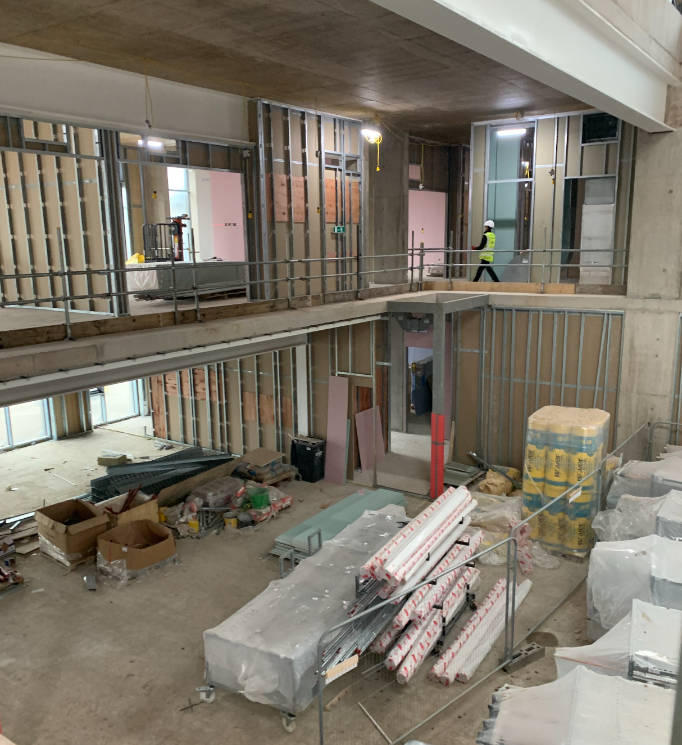
Assembly Hall
The assembly hall raked seating seats 317 people with an additional 23 lose seats
The assembly hall is 117m²
It is also the main studio out of the three drama spaces
There will not be a stage
Notes:
In the survey many questions were also asked about the assembly hall.
As you may know an assembly hall was not part of the original plans however one has been added after concerns were raised
E - The assembly hall has fold away bleachers that will seat up to 317 people with room for an additional 23 seats however there will be no room for a stage
The hall is also the main drama studio out of the three drama spaces, one of which is located next to the hall separated by a sound proof fold away wall.

Slide 12
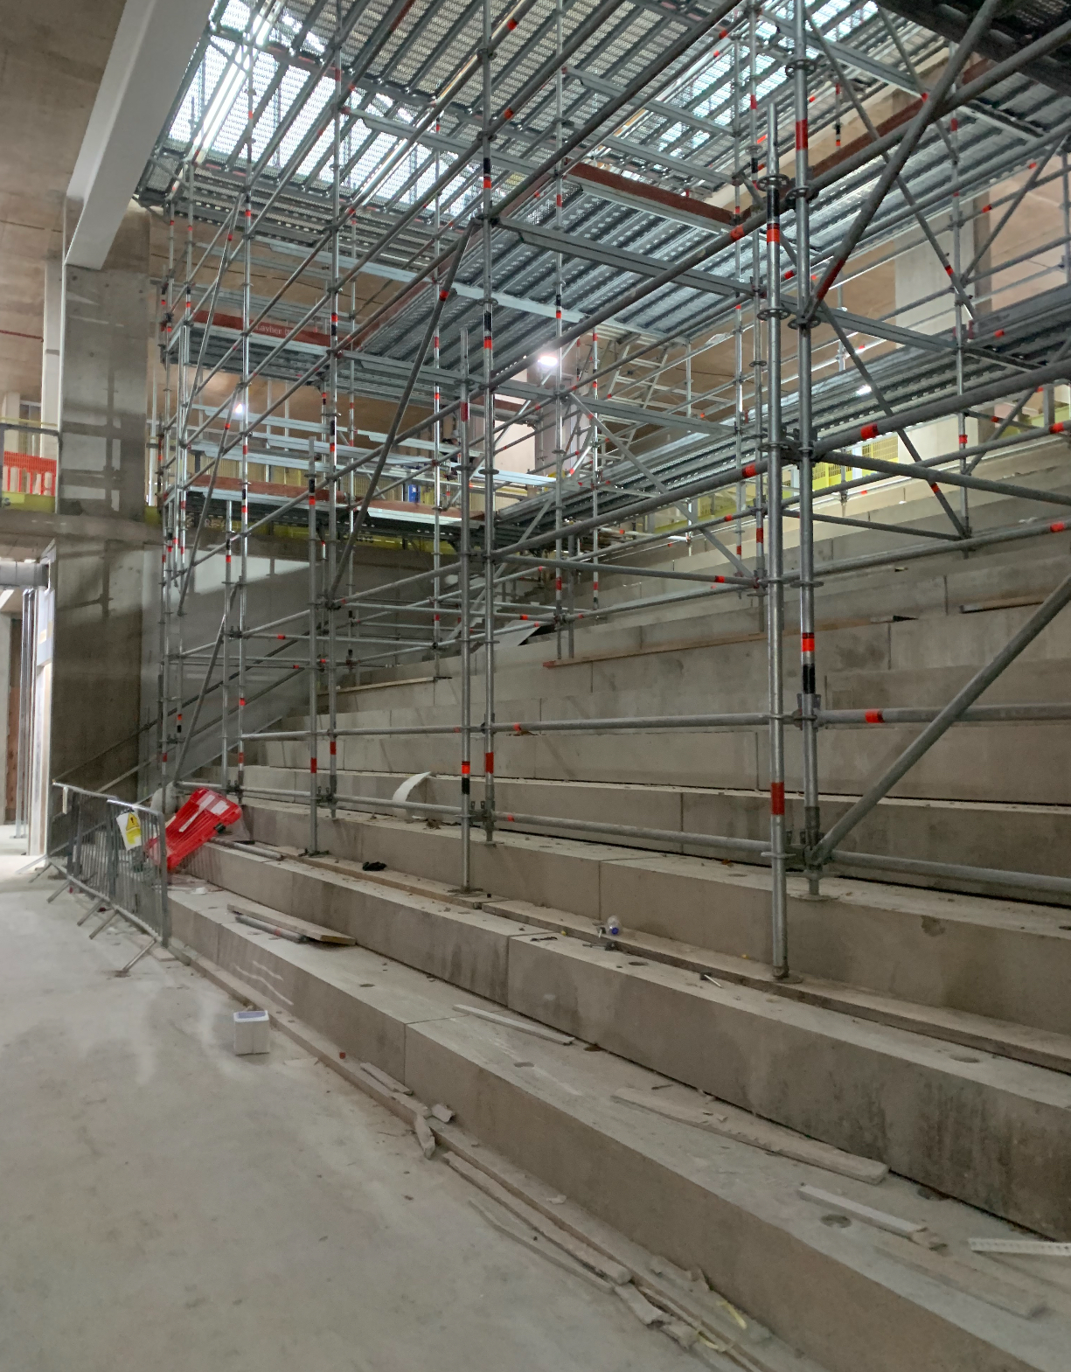
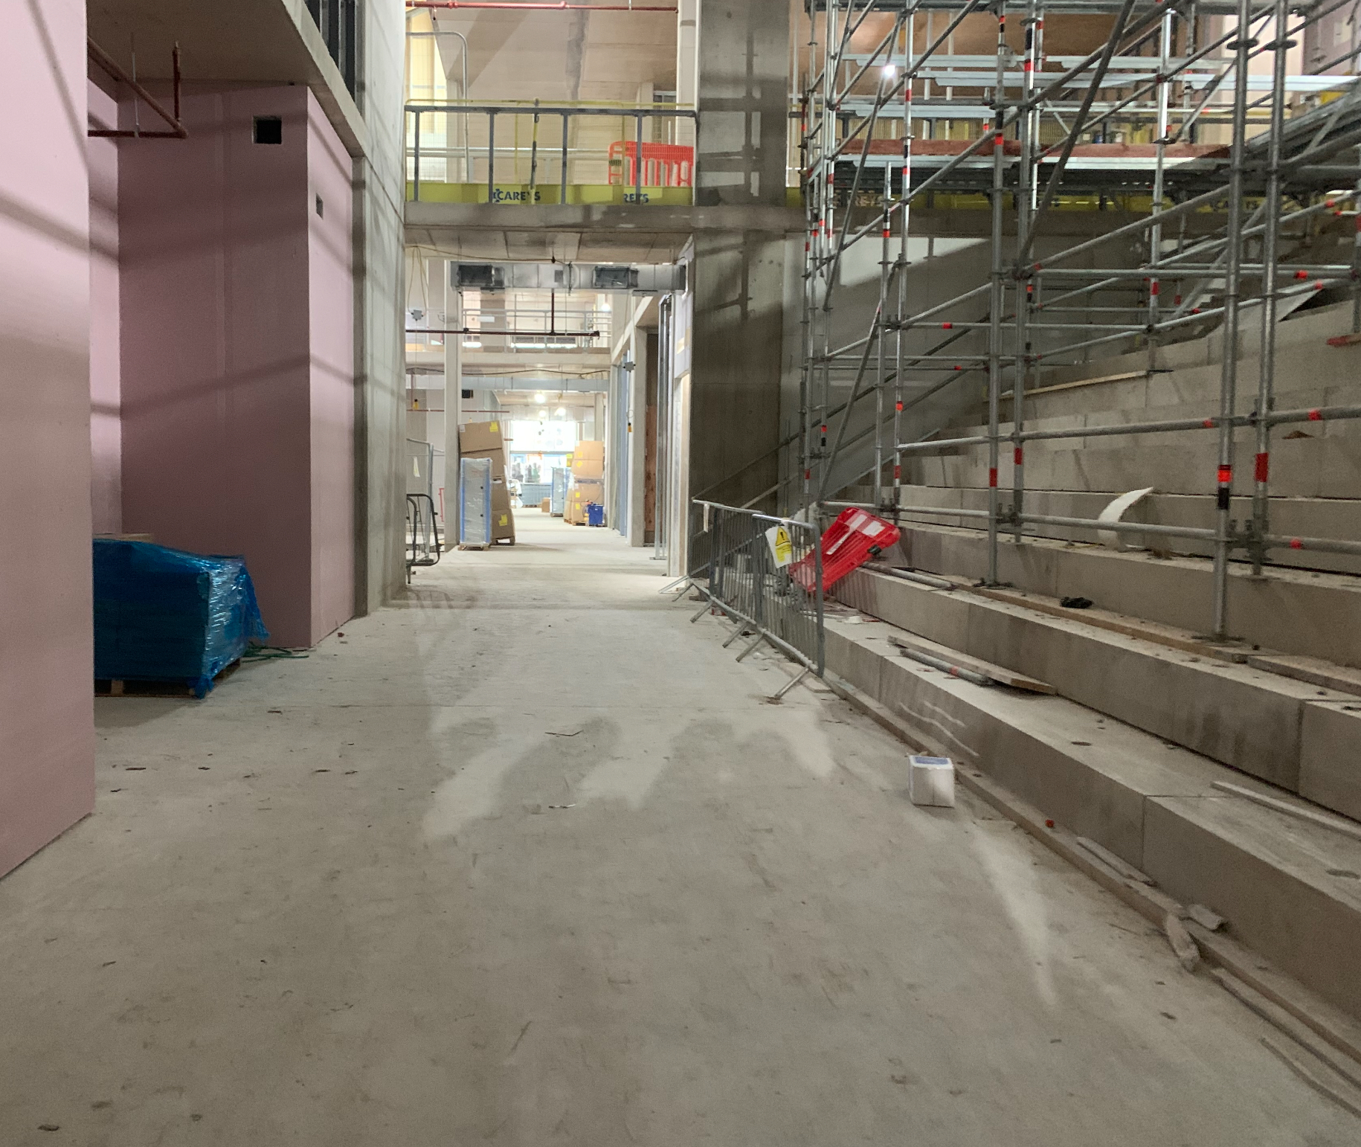
Stepped Presentation/Seating Area
Notes:
E - There is a second presentation area next to the canteen which will primarily be a social space however it is also designed to accommodate smaller presentations with tiered seating and room for a drop down projection screen. You can see what it currently looks like on the screen.
The final presentation space is a small area with a few stepped seats and sound proof walls. It will likley be used for staff meetings, and for students or teachers to present to their classes. But the space is designed to be versatile so it may be used for a number of other things too.

Slide 13
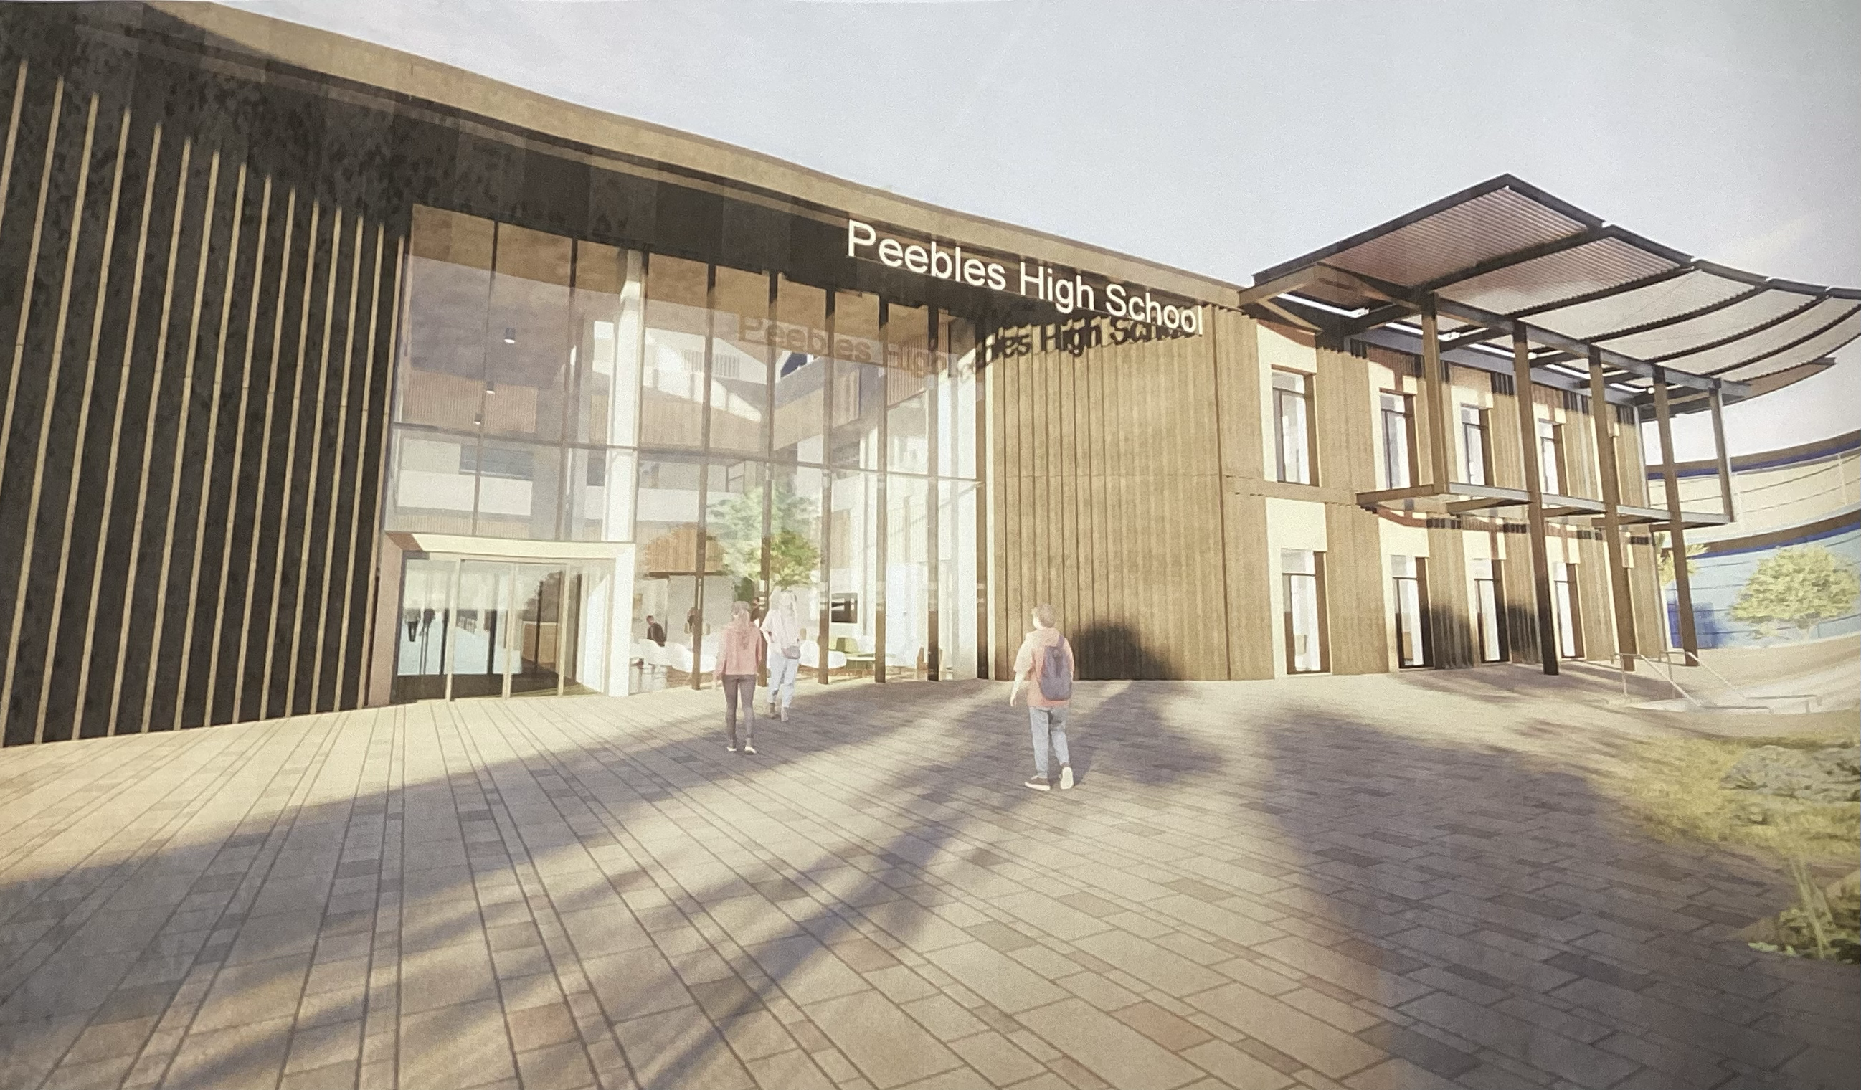
Transition to the New School
The building is due to finish construction in September 2025
After demolition, the area will be landscaped and all of this should be finished within 8-9 months after the building is finished, possibly up to a year (September 2026)
The transition will take place during the October holidays 2025 – whether or not pupils get time off is yet to be decided. It is to be determined if we move by year or all at once
The store and drama building will be kept but will not be used by the school and SBC are considering other uses. The PE building also will not change.
It is undecided if and when tours/an open day for the community will occur – likely when we move into the new school to prevent building work being held up.

Slide 14
Legacy
What from the current school will be brought over to the new school?
  Photographs in the Hall of Heroes
  Stained glass & plaque in the atrium restored
  Prize-winning boards and Nelson Prize Boards (found in Ms Watterson’s classroom)
  All trophies (found outside Ms Watterson’s classroom and outside the assembly hall)
  Yeargroup photographs and yearbooks from the library
  Photograph outside Mr Ryalls’ office
If you think that there is anything else, please contact either me (gw12brownabbie2@glow.sch.uk) or Mrs Maciver (gw09maciverjane@glow.sch.uk)

