Slide 1


Assemblies
Surveys – well done!
SIP – what next?
Student Parliament – how the school listens to you
Prefects – aspiration!
School Improvement
Attainment
Attainment Reviews
Senior Phase policy
Leadership
SIR
SIP
Leadership Framework
CC and RAP
3. Pupil Support Information/Whole School Tracking
Surveys
New school
6. Uniform merits/demerits

Slide 2
HMI Areas for Improvement
AFI 1 – BGE Planning and LTA
AFI 2 – Meeting Learners’ Needs
AFI 3 – Leadership and Attainment
Purpose of my session
You will have a clear understanding of the school's improvement priorities in this area and the role you play in this.
Operational updates in Update to come later.
3 parts –
outcomes and purpose
story so far
what now – our priorities and your role

Slide 3
Outcomes and purpose
The end, if not it is all stuff, we do the means, we do not get to the end so need to be clear about the outcomes and purpose.
Pupils say
I know what level I am working at, I know how to improve, my work is the correct level, my teachers know me as a learner.
Staff say
I have a clear sense of direction and sense of purpose, I am growing as a professional, I have ownership on how I deliver school priorities.
Leaders say
Through clear communication, I know what is expected of me and my team know what is expected of them, I am accountable, I am empowered and I empower my team.

Slide 4
Parents say?

Slide 5
Story so far 1
AFI 1 - BGE Planning and LTA Toolkit
Behaviour policy
BGE planning sheets
LTA Evaluation toolkit
Improvements in attainment
Curriculum pathways
S5 and S6 Leadership and School Service

Slide 6
Story so far 2
AFI 2 - Meeting Learners’ Needs
Connect
Enhanced Provision more mainstream
Whole school tracking for attainment
R2L plans
SfL Referrals
Dyslexia Collective
PSAs impact on attendance and inclusion

Slide 7
Story so far 3
AFI 3 Leadership and Attainment
Culture and ethos of school
Whole School Tracking
Leadership Framework – clarity of roles and remits, self and team evaluation of leadership with HGIOS4
Breakspear Clarify Canvas and Rapid Action Plan
HMI surveys show clear improvements across the board

Slide 8
Story so far 4
School Improvement Report June 2024
Satisfactory
1.3 Leadership of Change
2.3 LTA
3.1 Ensuring Wellbeing Equality and Inclusion
3.2 Raising Attainment and Achievement
Now - need to see impact/fruits of labour
HMI 9 Dec Selling our house!
We will do a further self-evaluation then
VG by 2027

Slide 9
Story so far 5
Satisfactory
strengths just outweigh the weaknesses
learners have access to a basic level of provision
strengths have a positive impact on learners’ experiences
weaknesses do not have a substantially adverse impact, but they constrain the overall quality of learners’ experiences
Good
there are important strengths yet there remains some aspects which require improvement
strengths have a significantly positive impact on almost all young people (90%)
The quality of learners’ experiences is diminished in some way by aspects in which improvement is required

Slide 10
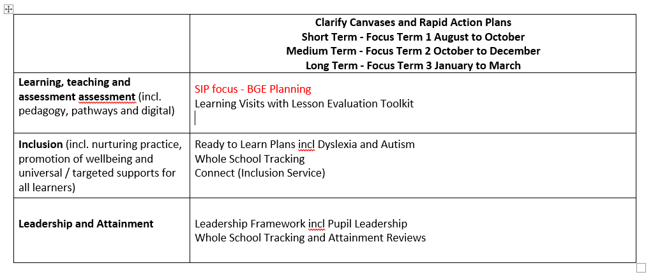
School Improvement Priorities 2024-25

Slide 11
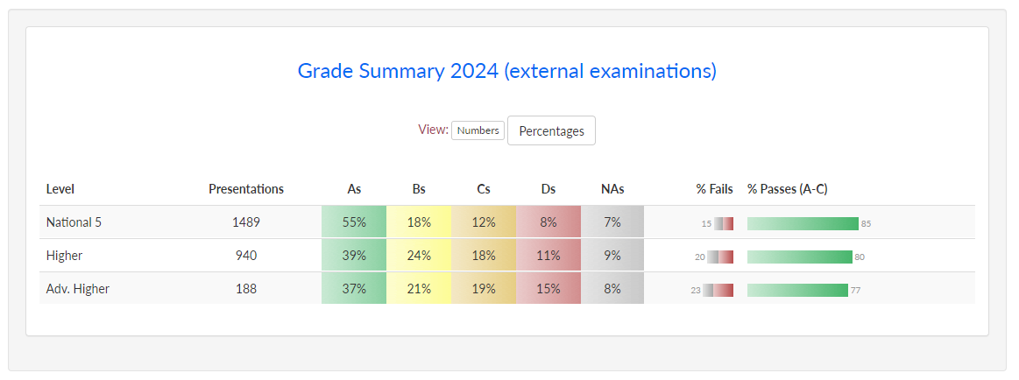
No drop policy from January
QA calendar - comprehensive

Slide 12
Attainment Review 1 | 2024- 2025 | SQA Results
Throughout this self evaluation exercise please remember the words of Lewis Patterson from INSIGHT. When explaining the data are we giving a reason, spotting a missed opportunity or giving an excuse.
Using the Results machine analysis - Course Summary What are the Pass/Fail percentages in comparison to the whole school cohort. |  | Whole school Fail/Pass rates for comparison. N5 15% 85% (A-C ) Higher 20% 80% Adv Higher 23% 77%

Slide 13
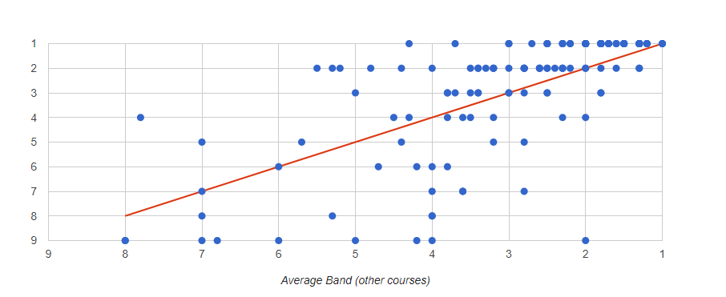
Using the Results machine analysis – Scatterplot
Looking at courses and levels are their young people with a significant difference between their dot and the line. How can we improve this picture for this session?
Who are the successes and why did they do so well. Who achieved disappointing results and why did this happen?

Slide 14
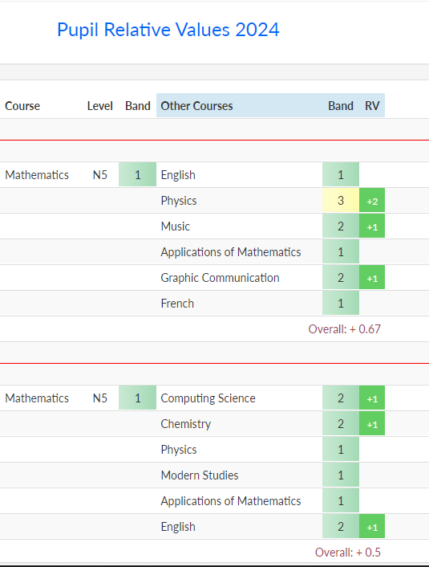
Using the Results machine analysis –
Pupil summary or RV Summary
Do any of your courses/levels stand out among others as positive/negative stories.
Where are the successes and why did they do so well. Where achieved disappointing results and why did this happen?

Slide 15
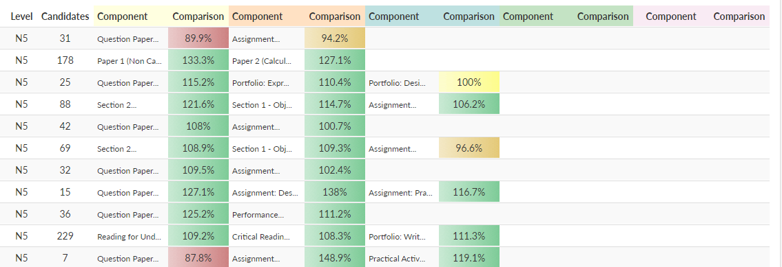
Using the Results machine analysis –
Component mark analysis
Are their any mismatches of colour which would indicate a difference in the success of elements of the course.
Note. All greens or all reds only indicates a consistent grade as the cohort may have been strong or weak, the RV highlights this.

Slide 16
Using the Results machine analysis –
Progression (by course)
In the grid numbers in the top left are best and bottom right are worst. A diagonal from top right to bottom left is expected.
Retakes are on the right hand side.
Crash courses are shown below without a tick or cross. Do your courses provide good progression for young people?

Slide 17
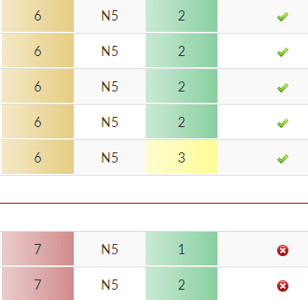
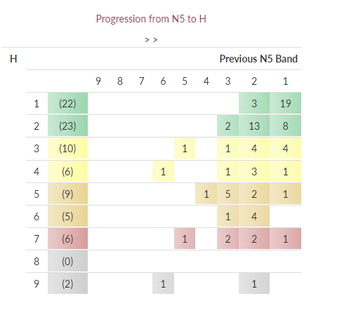

Slide 18
https://blogs.glowscotland.org.uk/sb/public/peebleshighschool/uploads/sites/3558/2024/08/23150246/Senior-Phase-Expectations-June-2024.pdf

Slide 19
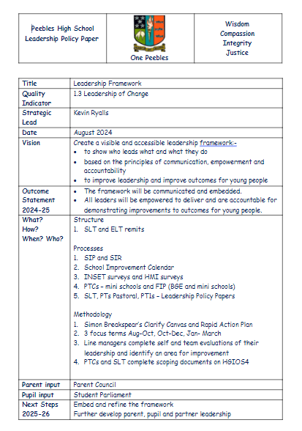

Slide 20
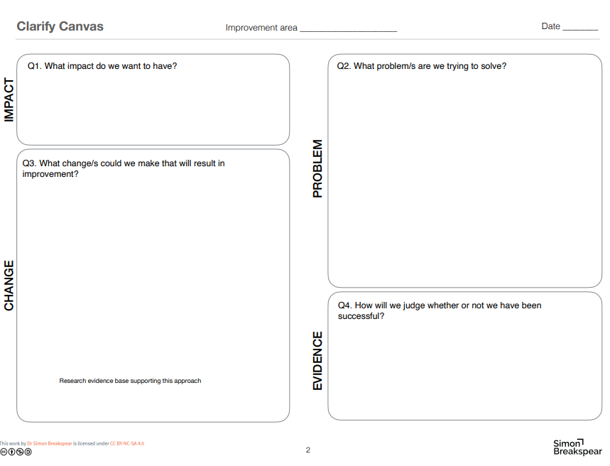

Slide 21
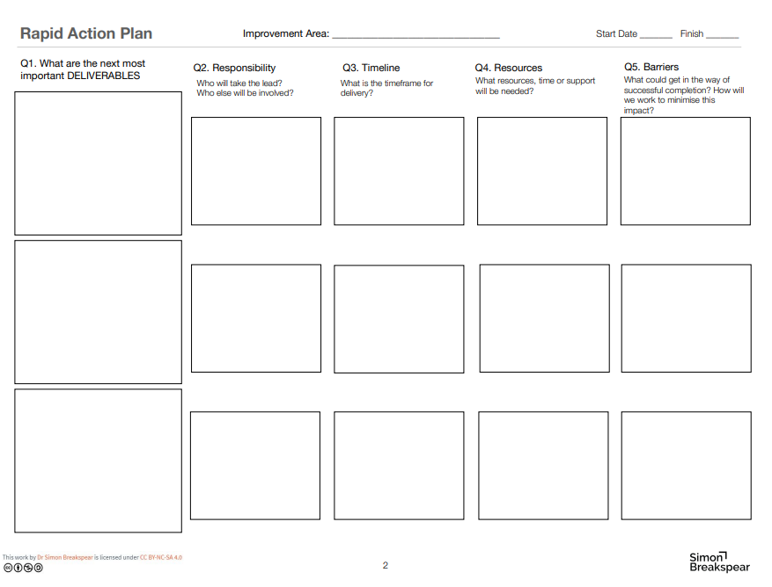

Slide 22
Whole School Tracking
Primary School | House Class | Practical Class | Pastoral Teacher | VYP Attendance Alert | 14+ Tracker (SDS) | Pastoral Info | Ready to Learn Plans | Support for learning |  | Myself as a Learner | Wider Achievement |  | IHP | Care Experienced | Attendance Year (%) | Attendance Range (%) | Impacted by Poverty |  |  |  | IEP | Mainstream Integration (number) | Non-mainstream integration (number) | SNSA |  |  |  |  |  | Track 1 Literacy and Numeracy |  |  |  | Track 2 Literacy and Numeracy |  |  |  | Subject | S2 Teacher | S2 CFE Level and Progress | Level Breakdown | Data Track 1 |  | Data Track 2 |  |  | Subject | S2 Teacher | S2 CFE Level and Progress | Level Breakdown | Data Track 1 |  | Data Track 2 |  |  | Subject | S2 Teacher | S2 CFE Level and Progress | Level Breakdown | Data Track 1 |  | Data Track 2 |  |  | Subject | S2 Teacher | S2 CFE Level and Progress | Level Breakdown | Data Track 1 |  | Data Track 2 |  |  | Subject | S2 Teacher | S2 CFE Level and Progress | Level Breakdown | Data Track 1 |  | Data Track 2 |  |  | Subject | S2 Teacher | S2 CFE Level and Progress | Level Breakdown | Data Track 1 |  | Data Track 2 |  |  | Subject | S2 Teacher | S2 CFE Level and Progress | Level Breakdown | Data Track 1 |  | Data Track 2 |  |  | Subject | S2 Teacher | S2 CFE Level and Progress | Level Breakdown | Data Track 1 |  | Data Track 2 |  |  | Subject | S2 Teacher | S2 CFE Level and Progress | Level Breakdown | Data Track 1 |  | Data Track 2 |  |  | Subject | S2 Teacher | S2 CFE Level and Progress | Level Breakdown | Data Track 1 |  | Data Track 2 |  |  | Subject | S2 Teacher | S2 CFE Level and Progress | Level Breakdown | Data Track 1 |  | Data Track 2 |  |  | Subject | S2 Teacher | S2 CFE Level and Progress | Level Breakdown | Data Track 1 |  | Data Track 2 |  |  | Subject | S2 Teacher | S2 CFE Level and Progress | Level Breakdown | Data Track 1 |  | Data Track 2 |  | Subject | S2 Teacher | S2 CFE Level and Progress | Level Breakdown | Data Track 1 |  | Data Track 2
 |  |  |  |  |  |  |  | ASN | AA |  | In School | Out of School |  |  |  |  | SIMD | PEF | FSM | Clothing Grant |  |  |  | SNSA Numeracy Result | SNSA Numeracy Score | SNSA Reading Result | SNSA Reading Score | SNSA Writing Result | SNSA Writing Score | Numeracy | Reading | Writing | Listening and Talking | Numeracy | Reading | Writing | Listening and Talking |  |  |  |  | Achievement Level and Progess | Level Breakdown | Achievement Level and Progess | Level Breakdown | S4 Predicted Pathway |  |  |  |  | Achievement Level and Progress | Level Breakdown | Achievement Level and Progress | Level Breakdown | S4 Predicted Pathway |  |  |  |  | Achievement Level and Progress | Level Breakdown | Achievement Level and Progress | Level Breakdown | S4 Predicted Pathway |  |  |  |  | Achievement Level and Progress | Level Breakdown | Achievement Level and Progress | Level Breakdown | S4 Predicted Pathway |  |  |  |  | Achievement Level and Progress | Level Breakdown | Achievement Level and Progress | Level Breakdown | S4 Predicted Pathway |  |  |  |  | Achievement Level and Progress | Level Breakdown | Achievement Level and Progress | Level Breakdown | S4 Predicted Pathway |  |  |  |  | Achievement Level and Progress | Level Breakdown | Achievement Level and Progress | Level Breakdown | S4 Predicted Pathway |  |  |  |  | Achievement Level and Progress | Level Breakdown | Achievement Level and Progress | Level Breakdown | S4 Predicted Pathway |  |  |  |  | Achievement Level and Progress | Level Breakdown | Achievement Level and Progress | Level Breakdown | S4 Predicted Pathway |  |  |  |  | Achievement Level and Progress | Level Breakdown | Achievement Level and Progress | Level Breakdown | S4 Predicted Pathway |  |  |  |  | Achievement Level and Progress | Level Breakdown | Achievement Level and Progress | Level Breakdown | S4 Predicted Pathway |  |  |  |  | Achievement Level and Progress | Level Breakdown | Achievement Level and Progress | Level Breakdown | S4 Predicted Pathway |  |  |  |  | Achievement Level and Progress | Level Breakdown | Achievement Level and Progress | Level Breakdown |  |  |  |  | Achievement Level and Progress | Level Breakdown | Achievement Level and Progress | Level Breakdown | S4 Predicted Pathway
Kingsland Primary | 3C1 | P2 | K Robertson |  |  |  |  |  |  |  | Netball |  |  |  | 98.11 |  | 8 |  |  |  |  | 9 |  |  |  |  |  |  |  |  |  |  |  |  |  |  |  | Spanish | D Taylor | 3 | Working within |  |  |  |  |  | Art | H Davies, M Tweedie | 3 | Working within |  |  |  |  |  | Biology | I Minto | 3 | Near completion |  |  |  |  |  | Modern Studies | K Wylie | 4 | Beginning |  |  |  |  |  | Chemistry | L Johnson | 3 | Near completion |  |  |  |  |  | BCT | S Cleland | 3 | Working within |  |  |  |  |  | PE | R Hadjitofi | 3 | Working within |  |  |  |  |  | Physics | S Coltman | 3 | Working within |  |  |  |  |  | Drama | S Swinton | 3 | Beginning |  |  |  |  |  | English (Y1) | J Ness, S Whitehead | 3 |  |  |  |  |  |  | Maths (Y1) | I Wallace, C McCann | 4 | Beginning |  |  |  |  |  | RMPS | M McLean-Foreman | 2 |  |  |  |  |  |  | PSE | K Robertson |  |  |  |  |  |  | PE (X3) | L Walker | 3 | Working within

Slide 23
HMI survey Parent Data over time.xlsx (sharepoint.com)
HMI survey Pupil Data over time.xlsx (sharepoint.com)
Curriculum – timeline
New School - Engagement Calendar
Uniform – merits and demerits

Slide 24
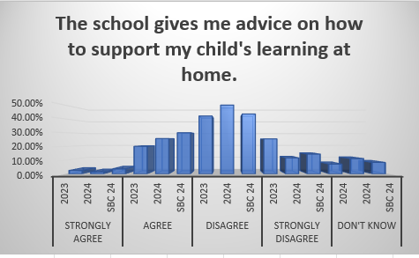
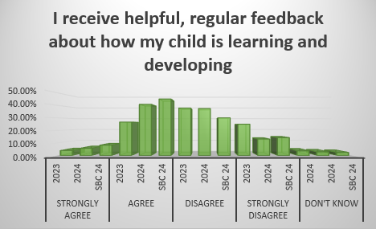
ACTION - Showbie

Slide 25
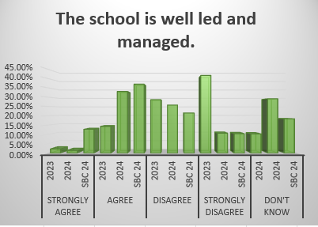
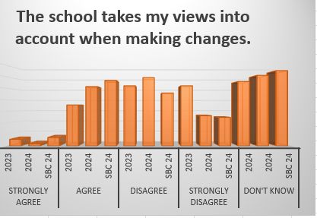
ACTION – Explain parent voice in policy making through HT Updates

