Slide 1


Welcome back
1.Caroline Connor
2.Expectations
3.Moving forward

Slide 2



Slide 3



Slide 4



Slide 5



Slide 6


Slide 7
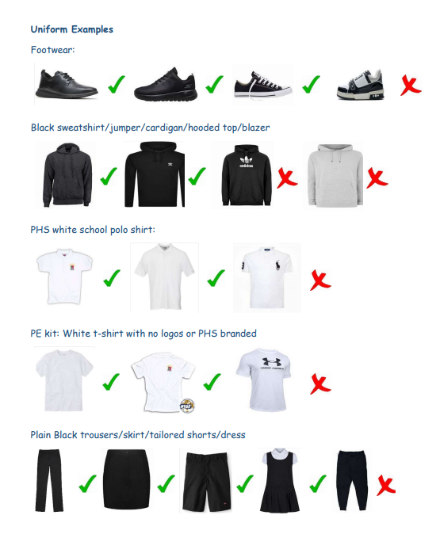
Expectations
Uniform – weekly letter home
Doors
Phones
Uniform
Out of class slips
Relocation
Corridors

Slide 8
S1
Welcome! Very important year for you
You are now Peebles High School pupils
We have higher expectations of you
We believe in you
We are here to help you
What is the most important thing to help you do the best you can do?

Slide 9
S2
Very important year for you
You are no longer the youngest pupils
This means we have higher expectations of you
Your S4-6 course preparation starts now
We are here to help you
What is the most important thing to help you do the best you can do?

Slide 10
S3
Very important year for you
Punctuality
You will choose your S4 subjects in 5 months
It is more important than ever that you give it your all
We are here to help you
What is the most important thing to help you do the best you can do?

Slide 11
S4
Exam and completion of courses year
You will choose your S5 subjects in 5 months
It is more important than ever that you give it your all
We are here to help you
What is the most important thing to help you do the best you can do?

Slide 12
S5
Outstanding year group
You will choose your S6 subjects in 5 months
Keep going!!
Do your best
We are here to help you
We need your help
What is the most important thing to help you do the best you can do?

Slide 13
S6
Unique and very impressive year group
Unique opportunity for you and the school
Keep going!!
Do your best
We are here to help you
We need your help
What is the most important thing to help you do the best you can do?

Slide 14
Your timetables
Course Choices – Changes following exam results
Changes possible up until Friday 30th August
Class lists will be changed upon meeting with your pastoral teacher
Continue to attend any timetabled class for which you are timetabled until pastoral has confirmed this change

Slide 15
Your timetables
School Service
Applications to be in by Friday 30th August

Slide 16
Your timetables
S6 Home Study Agreements
From September, you can apply for HSA in PSE
Only at start or end of day
You should be in House Time until HSA in place
You should be in LRC for study until HSA in place
P5 Study – Lunch 10 mins early
Signing in/out Folders in LRC – Cademuir/Dunrig/Meldon
  Sign in for late arrival or Study Period
  Sing out if leaving school early for lunch
  Sign out at school office if leaving for the day

