Slide 1



Slide 2
Assemblies 1 November 2024
Review feedback and expectations
Mr Ryalls
Attendance
Mrs Sykes, Mrs Nisbet, Mrs Falcon - PSAs
Showbie
Mrs McDowell
4. S4-6 Parents’ Nights
Mrs McDowell

Slide 3
Year Group messages
All – toilets separate at lunch S1-3/S4-6, not at break.
S1 – behaviour in park.
S2 and S3 - behaviour expectations.
S4 - exams year.
S5 - College students go to S5 study in hall Tues p3 and Wed p6 and p7.
S6 – in LRC unless home study or other arrangement. Spot checks to be carried out.

Slide 4
SBC School Review – see letter in your teams
All staff and young people agreed that the environment for learning has improved, both in an out of the classroom.
The climate for learning in all observed lessons was positive.
Pupils report that behaviour is better and that there is a firm but fair ethos in the school.
HMI visit to come in December

Slide 5
Pastoral Support Assistants (PSAs)
Who are we and
which houses do we represent?
Mrs Sykes – Cademuir
Mrs Nisbet – Dunrig
Mrs Falcon - Meldon

Slide 6
Pastoral Support Assistants (PSAs)
What is our role in school?
Extra Pastoral support
Drop in if you want to chat – all welcome!

Slide 7
Importance of Regular Attendance
Regular attendance in school is important for a number of reasons including
Academic achievement
Wellbeing
Career prospects
Long-term outcomes
Risk of anti-social behaviour

Slide 8
Impact of Being Late or Missing Class
The school will be addressing lateness to school more closely
We will contact parents of students late to school 3x in a week will be contacted

Slide 9
If in a school year, you are late everyday by… 5 minutes 10 minutes 15 minutes 20 minutes 30 Minutes | you lose this number of days in one year … 3.5 days 7 days 10 days 14.5 days 22 Days | or this number of lessons in one school year … 20 lessons 41 lessons 55 lessons 82 lessons 123 Lessons

Slide 10
Celebrating Good Attendance
10 house points will be allocated every month to the house-time class with the best attendance.
This will be shown on the board outside our office and will also be posted on our social media pages.
Thank you !

Slide 11
Who am I?
1. Mrs McDowell
2. Mrs O’Neill
3. Mrs Moretta

Slide 12
What is my role in the school?
1. Pastoral support assistant
2. Child protection coordinator
3. Acting depute headteacher

Slide 13
Which house am I the house head of?
1. Cademuir
2. Dunrig
3. Meldon

Slide 14
What area of school improvement
am I responsible for?
1. Leadership
2. Curriculum
3. Learning, Teaching and Assessment

Slide 15




Name the app.
1.
2.
3.
4.

Slide 16
Why?
It is our only parent/carer facing platform
Research shows that the average impact of parental engagement in secondary schools is about an additional two months’ progress over the course of a year. There are also higher impacts for pupils with low prior attainment.
showbie
Link to EEF

Slide 17
What?
Your reflections on key assessments from each of your subjects. These will detail your progress and next steps in your learning.
Your annual progress and achievement report.
showbie

Slide 18
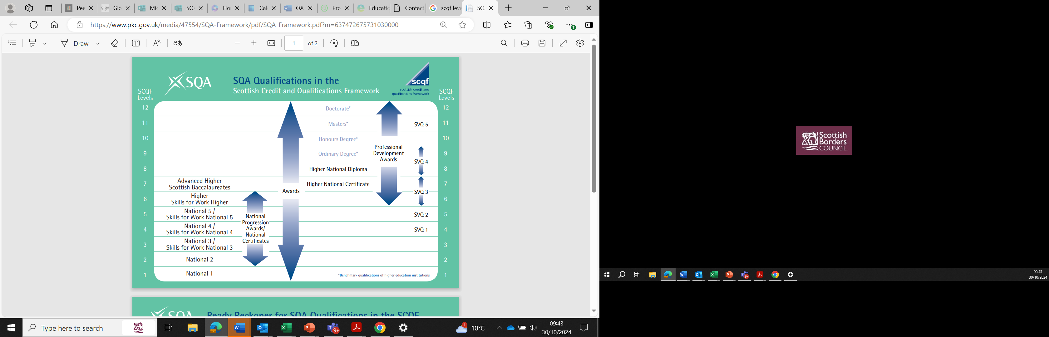

Slide 19
Event | When | Opens/Closes on Parent booking
SCQF level 6 & 7 Parents Progress and Achievement evening. (S5 and S6 Higher and Advanced Higher) | 11th November | Online | Monday 28th October Thursday 7th November
SCQF level 1-5 Parents Progress & Achievement evening. (Mostly S4 National 1 to National 5s) | 19th November | Online | Monday 4th November Thursday 14th November
All SCQF levels 1-7 Parents Progress and Achievement evening. (S4, S5 and S6) Parents Progress & Achievement evening. ‘mop up’ | 27th November | Online | Friday 15th November Monday 25th November

