Slide 1


10th December 2025
PHS
Parent Council:
Curriculum Update
Notes:
Improve on levels of anxiety for learners and parents.
Improve the integrity of our system especially for those who lack strong advocates at home.
Reduce the wasted resources of setting up supports that are not needed, wanted or sometimes not expected.
Increase accountability, responsibility and support for classroom teachers in meeting learners needs.

Slide 2
Purpose:
Providing clarity of the PHS Curriculum Vision
A review of recent PHS curriculum changes
A review of next steps
Notes:
Improve on levels of anxiety for learners and parents.
Improve the integrity of our system especially for those who lack strong advocates at home.
Reduce the wasted resources of setting up supports that are not needed, wanted or sometimes not expected.
Increase accountability, responsibility and support for classroom teachers in meeting learners needs.

Slide 3
PHS Vision and Values – The Curriculum as a Vehicle for Change
In PHS, we want
A varied curriculum that meets the needs of every student as well as enabling and inspiring students to reach their full potential.
A curriculum that is not only as engaging as possible, but also be rooted in the real world pathways and opportunities available to our young people.
A Broad, General Education in S1-3 that exposes our young people to as wide a range of opportunities and experiences as possible.
An S4-S6 Senior Phase that caters for the broad range of pathways to the positive destinations of our young people.
Notes:
Improve on levels of anxiety for learners and parents.
Improve the integrity of our system especially for those who lack strong advocates at home.
Reduce the wasted resources of setting up supports that are not needed, wanted or sometimes not expected.
Increase accountability, responsibility and support for classroom teachers in meeting learners needs.

Slide 4
School Context:
With the largest school and catchment of the Scottish Borders, Peebles High School is recognised at a local authority level as having a complex demographic. To plan a curriculum that caters for all, it is important to use data to understand both who we are as a school, and what destinations our young people reach upon leaving school.
Therefore we use a range of data to inform decisions about our curriculum
Notes:
Improve on levels of anxiety for learners and parents.
Improve the integrity of our system especially for those who lack strong advocates at home.
Reduce the wasted resources of setting up supports that are not needed, wanted or sometimes not expected.
Increase accountability, responsibility and support for classroom teachers in meeting learners needs.

Slide 5
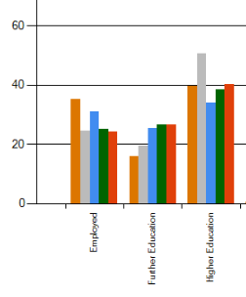
School Context:
PHS Typical Leaver Destinations (2023)
(PHS is the orange bar)
The highest-achieving 20% of learners in PHS is amongst the highest-achieving in the country, BUT this doesn’t mean all our young people leave school for University
High numbers of PHS school leavers go straight into employment
Notes:
Improve on levels of anxiety for learners and parents.
Improve the integrity of our system especially for those who lack strong advocates at home.
Reduce the wasted resources of setting up supports that are not needed, wanted or sometimes not expected.
Increase accountability, responsibility and support for classroom teachers in meeting learners needs.

Slide 6
School Context:
University Destinations, related to Subjects (2024)
AND THOUGH University destinations also tell us the sectors into which our young people aspire to go
Notes:
Improve on levels of anxiety for learners and parents.
Improve the integrity of our system especially for those who lack strong advocates at home.
Reduce the wasted resources of setting up supports that are not needed, wanted or sometimes not expected.
Increase accountability, responsibility and support for classroom teachers in meeting learners needs.

Slide 7
School Context:
PHS Recorded Actual Employment Destinations (2024 data)
Job Title
Activities Assistant | Food and Beverage Assistant | Mobile Catering assistant
Apprentice pastry chef | Food factory worker | Porter
Apprentice Roofer | House Keeping | Professional Footballer
Bar staff | Kitchen Porter | Sales assistant
Biking | Kitchen staff | Team member
Cleaner | Labourer
Commis chef | Landscaper | Waiter/waitress
Customer support | Leisure Assitant | Waiter, Chef, Admin
Dance teacher |  | Waiter/Bike Maintenance
The destinations young people tell us they want CAN DIFFER from their actual destinations when they leave school
Notes:
Improve on levels of anxiety for learners and parents.
Improve the integrity of our system especially for those who lack strong advocates at home.
Reduce the wasted resources of setting up supports that are not needed, wanted or sometimes not expected.
Increase accountability, responsibility and support for classroom teachers in meeting learners needs.

Slide 8
School Context:
Pupil Subject Choices
THEREFORE in school, we ask young people pick up a wide range of skills (“Meta-skills”) in all subjects that contribute positively to different employment sectors
Notes:
Improve on levels of anxiety for learners and parents.
Improve the integrity of our system especially for those who lack strong advocates at home.
Reduce the wasted resources of setting up supports that are not needed, wanted or sometimes not expected.
Increase accountability, responsibility and support for classroom teachers in meeting learners needs.

Slide 9
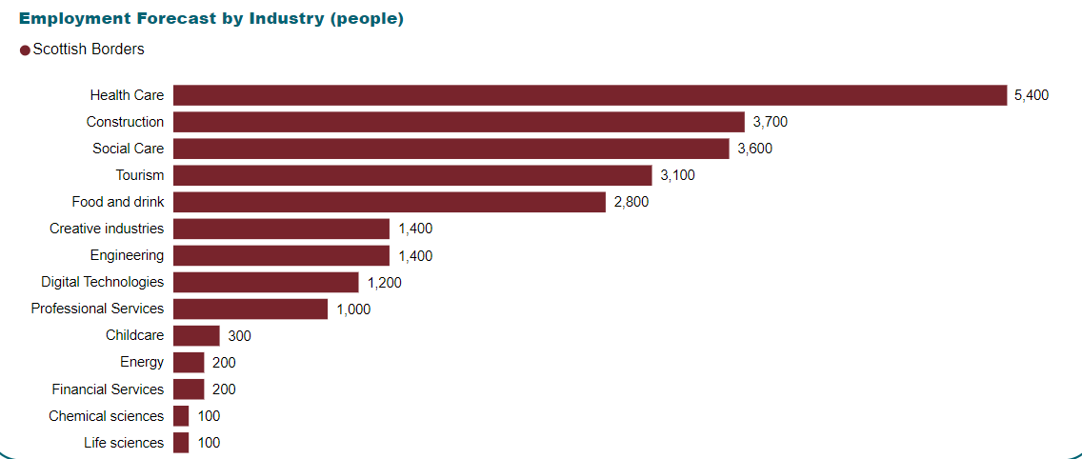

School Context:
Predicted Sector Needs
BECAUSE WE ALSO KNOW that the most popular subject choices do not always tally with the sector demands of the Scottish Borders(or the rest of the world)
Notes:
Improve on levels of anxiety for learners and parents.
Improve the integrity of our system especially for those who lack strong advocates at home.
Reduce the wasted resources of setting up supports that are not needed, wanted or sometimes not expected.
Increase accountability, responsibility and support for classroom teachers in meeting learners needs.

Slide 10
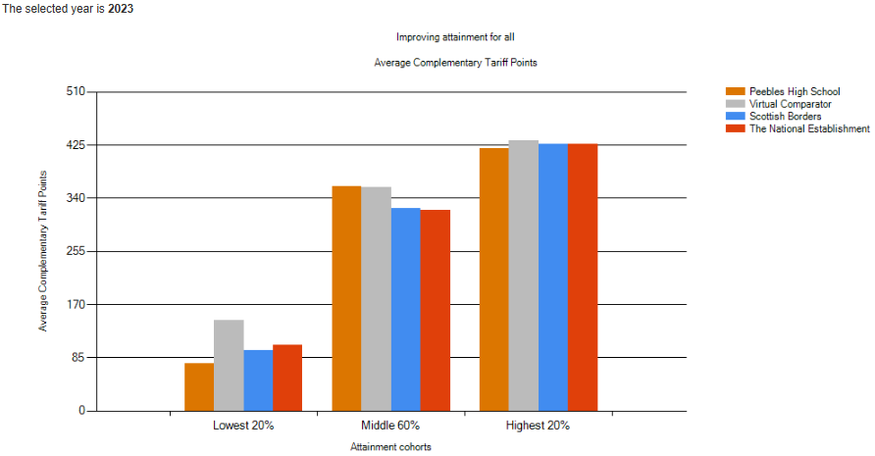
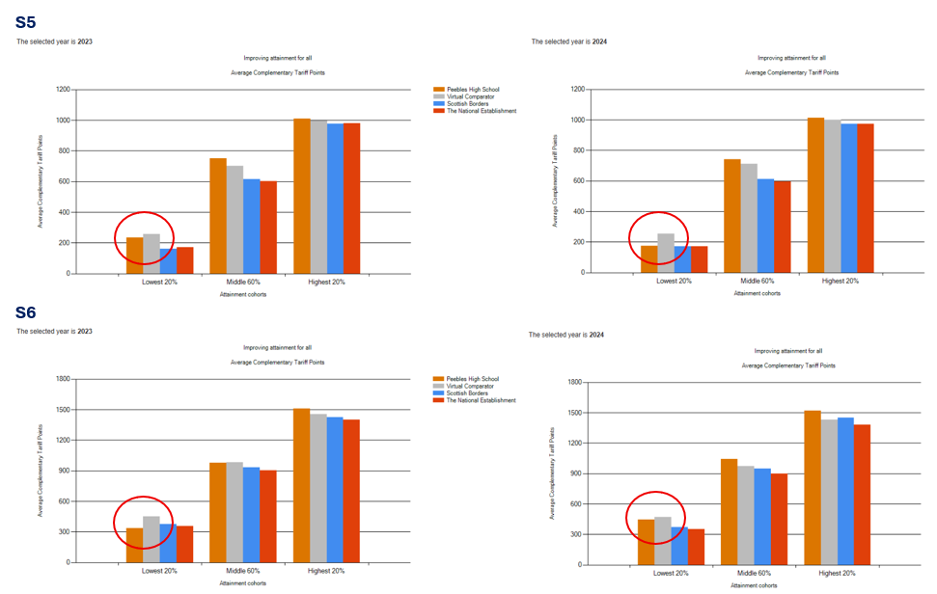
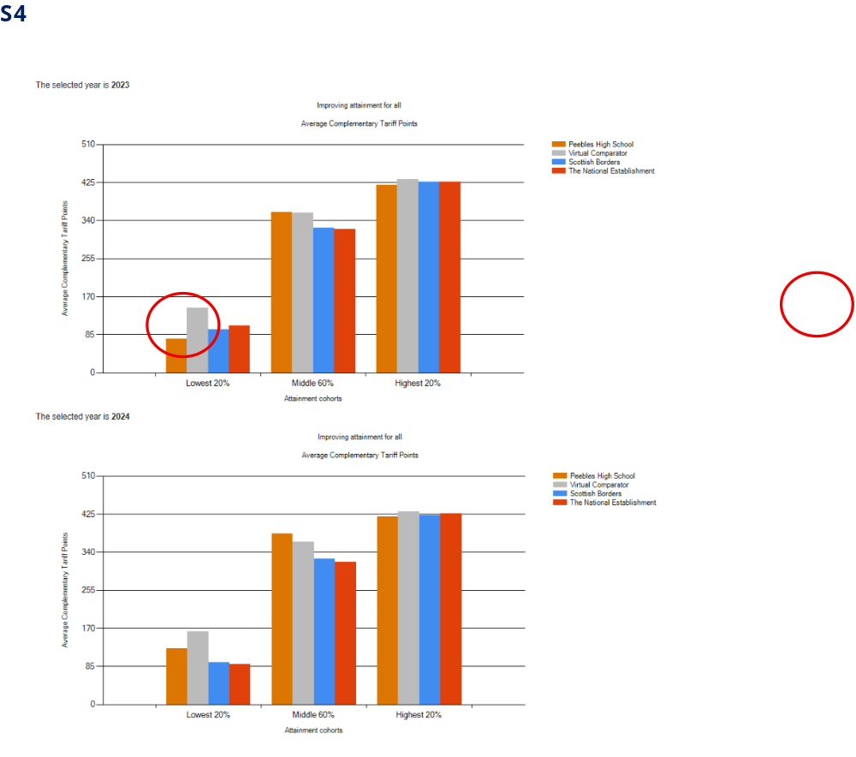
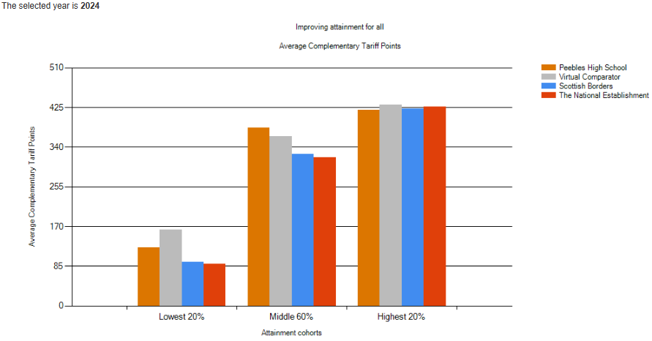
S4
School Context:
Performance of lowest-attaining 20% of learners
Notes:
Improve on levels of anxiety for learners and parents.
Improve the integrity of our system especially for those who lack strong advocates at home.
Reduce the wasted resources of setting up supports that are not needed, wanted or sometimes not expected.
Increase accountability, responsibility and support for classroom teachers in meeting learners needs.

Slide 11
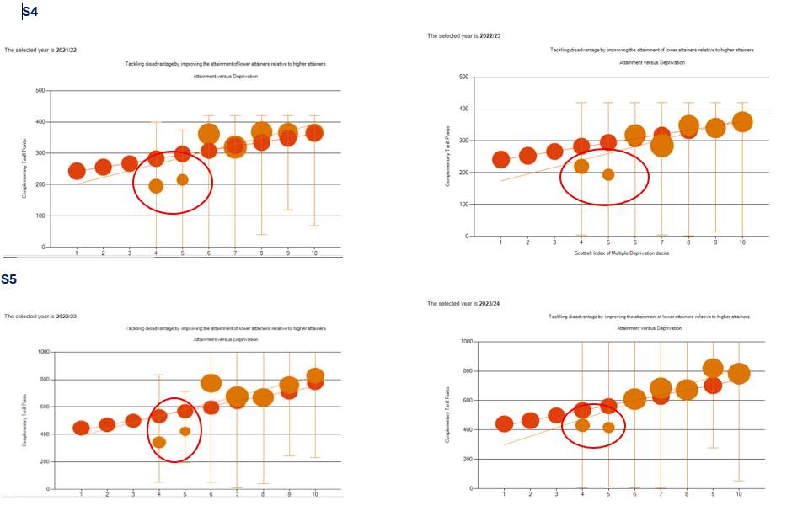
S4
School Context:
PHS Attainment v Scottish Index of Multiple Deprivation Deciles
Notes:
Improve on levels of anxiety for learners and parents.
Improve the integrity of our system especially for those who lack strong advocates at home.
Reduce the wasted resources of setting up supports that are not needed, wanted or sometimes not expected.
Increase accountability, responsibility and support for classroom teachers in meeting learners needs.

Slide 12
Curriculum
Changes so far
S5 & S6 Curriculum Changes | Ensuring senior phase is adding value to young person’s school experience Ensuring all senior pupils are productively engaged in their senior phase | All S5s asked to choose 6 subjects or 5 L6 plus School Study
 |  | All S6s asked to choose 3AH or L7 Leadership (2 periods) one other course, or School Service or 4 courses at any level Leadership (2 periods) one other course, or School Service
Notes:
Improve on levels of anxiety for learners and parents.
Improve the integrity of our system especially for those who lack strong advocates at home.
Reduce the wasted resources of setting up supports that are not needed, wanted or sometimes not expected.
Increase accountability, responsibility and support for classroom teachers in meeting learners needs.

Slide 13
Curriculum
Changes so far
S5 Study | Ensure all senior pupils are productively engaged in their senior phase Improved safeguarding of senior phase pupils | All S5s with study periods now supervised by SLT
S6 Study |  | Library is now only designated Study space for S6s in PHS Designated quiet zone
Notes:
Improve on levels of anxiety for learners and parents.
Improve the integrity of our system especially for those who lack strong advocates at home.
Reduce the wasted resources of setting up supports that are not needed, wanted or sometimes not expected.
Increase accountability, responsibility and support for classroom teachers in meeting learners needs.

Slide 14
Curriculum
Changes so far
S5 Core | Ensuring curriculum meets entitlements of all learners Increased opportunity for recognition of achievement (RMPS) Meeting health & wellbeing needs of all learners | S5 Physical Education (HWB) S5 RMPS (Religious Beliefs & Values Award)
Notes:
Improve on levels of anxiety for learners and parents.
Improve the integrity of our system especially for those who lack strong advocates at home.
Reduce the wasted resources of setting up supports that are not needed, wanted or sometimes not expected.
Increase accountability, responsibility and support for classroom teachers in meeting learners needs.

Slide 15
Curriculum
Changes so far
S6 Leadership | Recognition of existing achievements Raising expectation of senior phase (Eastgate launch) | All S6s now had opportunity to choose Leadership projects: Charities Home Learning DYW Inspire Tweed Reads Self-found (10%)
Notes:
Improve on levels of anxiety for learners and parents.
Improve the integrity of our system especially for those who lack strong advocates at home.
Reduce the wasted resources of setting up supports that are not needed, wanted or sometimes not expected.
Increase accountability, responsibility and support for classroom teachers in meeting learners needs.

Slide 16
Curriculum
Changes so far
S6 School Service | Recognition of existing achievements Raising expectation of senior phase | S6s can now opt to take an additional subject, or “School Service” as part of their S6 experience It is encouraged that this should be as closely as possible linked to their future pathways, and work or volunteering placements are strongly encouraged
Broadening of the Curriculum | Recognition of pathways not traditionally academic | Furniture Making Mountainbiking Skills for Work Courses Health Sector
Notes:
Improve on levels of anxiety for learners and parents.
Improve the integrity of our system especially for those who lack strong advocates at home.
Reduce the wasted resources of setting up supports that are not needed, wanted or sometimes not expected.
Increase accountability, responsibility and support for classroom teachers in meeting learners needs.

Slide 17
Curriculum
Changes so far
S5 & S6 High Expectations Policy | Ensure all senior pupils are productively engaged in their senior phase | Rethinking our approach to requests of pupils to “drop” subjects in their senior phase
PHS Connect - Inclusion Curriculum | The need for a varied curriculum that meets the needs of every student as well as enabling and inspiring students to reach their full potential. | Appointment of a dedicated PT Inclusion to devise a bespoke curriculum for our pupils most at risk of not engaging with school
Notes:
Improve on levels of anxiety for learners and parents.
Improve the integrity of our system especially for those who lack strong advocates at home.
Reduce the wasted resources of setting up supports that are not needed, wanted or sometimes not expected.
Increase accountability, responsibility and support for classroom teachers in meeting learners needs.

Slide 18
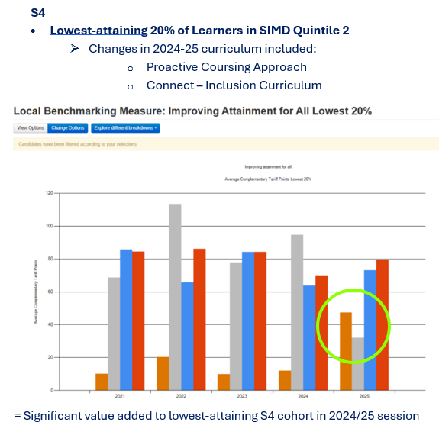
Curriculum
Impact so far
Notes:
Improve on levels of anxiety for learners and parents.
Improve the integrity of our system especially for those who lack strong advocates at home.
Reduce the wasted resources of setting up supports that are not needed, wanted or sometimes not expected.
Increase accountability, responsibility and support for classroom teachers in meeting learners needs.

Slide 19
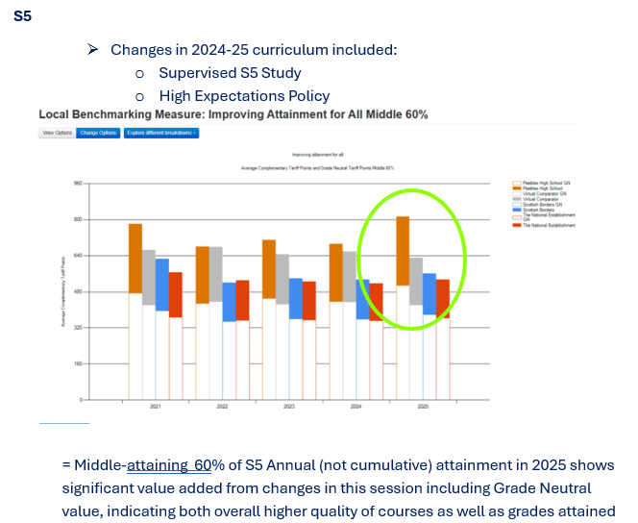
Curriculum
Impact so far
Notes:
Improve on levels of anxiety for learners and parents.
Improve the integrity of our system especially for those who lack strong advocates at home.
Reduce the wasted resources of setting up supports that are not needed, wanted or sometimes not expected.
Increase accountability, responsibility and support for classroom teachers in meeting learners needs.

Slide 20
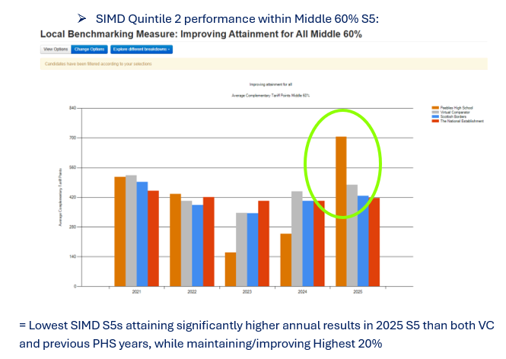
Curriculum
Impact so far
Notes:
Improve on levels of anxiety for learners and parents.
Improve the integrity of our system especially for those who lack strong advocates at home.
Reduce the wasted resources of setting up supports that are not needed, wanted or sometimes not expected.
Increase accountability, responsibility and support for classroom teachers in meeting learners needs.

Slide 21
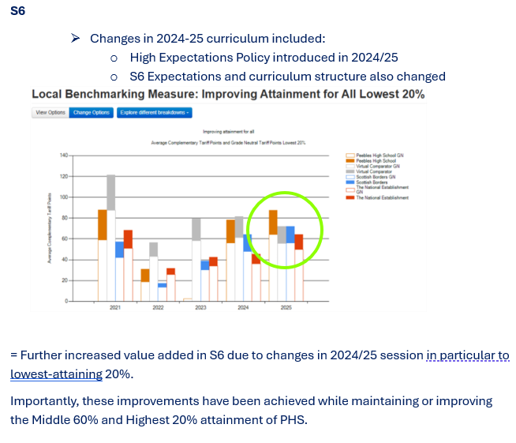
Curriculum
Impact so far
Notes:
Improve on levels of anxiety for learners and parents.
Improve the integrity of our system especially for those who lack strong advocates at home.
Reduce the wasted resources of setting up supports that are not needed, wanted or sometimes not expected.
Increase accountability, responsibility and support for classroom teachers in meeting learners needs.

Slide 22
PHS Curriculum Vision
In PHS, we want
A varied curriculum that meets the needs of every student as well as enabling and inspiring students to reach their full potential.
The curriculum we offer is designed not only to be as engaging as possible, but also be rooted in the real world pathways and opportunities available to our young people.
S1-S3 = Experiences
S4-S6 = Pathways
Notes:
Improve on levels of anxiety for learners and parents.
Improve the integrity of our system especially for those who lack strong advocates at home.
Reduce the wasted resources of setting up supports that are not needed, wanted or sometimes not expected.
Increase accountability, responsibility and support for classroom teachers in meeting learners needs.

Slide 23
Where are we going now?
To complete this vision, we are continuing to work towards further changes in the following areas:
      Inclusion Curriculum
      Move to 7 subjects in S4, and subsequent
        Changes to S3
        Changes to S2, and S1
      S5 & S6 Curriculum: 6 choices, not 6 periods
      A BGE Curriculum of Experiences
        BGE Curriculum of Experiences
        S2 Academies
      Enhanced Transition Support - School Leaver Programme
      Advanced Highers
      PHS School Service
Notes:
Improve on levels of anxiety for learners and parents.
Improve the integrity of our system especially for those who lack strong advocates at home.
Reduce the wasted resources of setting up supports that are not needed, wanted or sometimes not expected.
Increase accountability, responsibility and support for classroom teachers in meeting learners needs.

Slide 24
Where are we going now?
A varied curriculum that meets the needs of every student as well as enabling and inspiring students to reach their full potential.
Inclusion Curriculum
  Embedding a trauma-informed curriculum approach
Move to 7 subjects in S4, and subsequent
  Changes to S3
  Changes to S2, and S1
S5 & S6 Curriculum: 6 choices, not 6 periods
A higher number of “columns” offers more opportunities for broader experiences in school
Notes:
Improve on levels of anxiety for learners and parents.
Improve the integrity of our system especially for those who lack strong advocates at home.
Reduce the wasted resources of setting up supports that are not needed, wanted or sometimes not expected.
Increase accountability, responsibility and support for classroom teachers in meeting learners needs.

Slide 25
Where are we going now?
A Broad, General Education in S1-3 that exposes our young people to as wide a range of opportunities and experiences as possible.
A BGE Curriculum of Experiences
  BGE Curriculum of Experiences
  Access to a broader range of DYW experiences in school, that are strategic and sector-led
  S2 Academies
  Explicit focus on skills in BGE elective learning
Notes:
Improve on levels of anxiety for learners and parents.
Improve the integrity of our system especially for those who lack strong advocates at home.
Reduce the wasted resources of setting up supports that are not needed, wanted or sometimes not expected.
Increase accountability, responsibility and support for classroom teachers in meeting learners needs.

Slide 26
Where are we going now?
An S4-S6 Senior Phase that caters for the broad range of pathways to the positive destinations of our young people.
Enhanced Transition Support - School Leaver Programme
A flexible model that allows us to continue to support young people who are between school and the workplace/Foundation Apprenticeships
Advanced Highers
Continued development of online and Advanced Higher Consortium offer in SBC to ensure low-numbers of classes with specific needs are viable
Notes:
Improve on levels of anxiety for learners and parents.
Improve the integrity of our system especially for those who lack strong advocates at home.
Reduce the wasted resources of setting up supports that are not needed, wanted or sometimes not expected.
Increase accountability, responsibility and support for classroom teachers in meeting learners needs.

Slide 27
Where are we going now?
An S4-S6 Senior Phase that caters for the broad range of pathways to the positive destinations of our young people.
PHS School Service
We want our S6 and parents and carers of S6 to view this final school year in a more creative way, and take ownership of the creation of an experience that develops their skills needed beyond the classroom-based curriculum.
Further work to be done in helping our S6s to understand their responsibility in creating this offer and signposting opportunities for the development of Metaskills
Notes:
Improve on levels of anxiety for learners and parents.
Improve the integrity of our system especially for those who lack strong advocates at home.
Reduce the wasted resources of setting up supports that are not needed, wanted or sometimes not expected.
Increase accountability, responsibility and support for classroom teachers in meeting learners needs.

Slide 28

Curriculum Update
A varied curriculum that meets the needs of every student as well as enabling and inspiring students to reach their full potential.
Notes:
Improve on levels of anxiety for learners and parents.
Improve the integrity of our system especially for those who lack strong advocates at home.
Reduce the wasted resources of setting up supports that are not needed, wanted or sometimes not expected.
Increase accountability, responsibility and support for classroom teachers in meeting learners needs.

Slide 29
10th December 2025
PHS
Parent Council:
Curriculum Update
Thank you for Listening!
Questions & Comments
Notes:
Improve on levels of anxiety for learners and parents.
Improve the integrity of our system especially for those who lack strong advocates at home.
Reduce the wasted resources of setting up supports that are not needed, wanted or sometimes not expected.
Increase accountability, responsibility and support for classroom teachers in meeting learners needs.

